Slide 1
MODULE 3
By Akshatha T

Slide 2
INTRODUCTION TO MONGODB

Slide 7
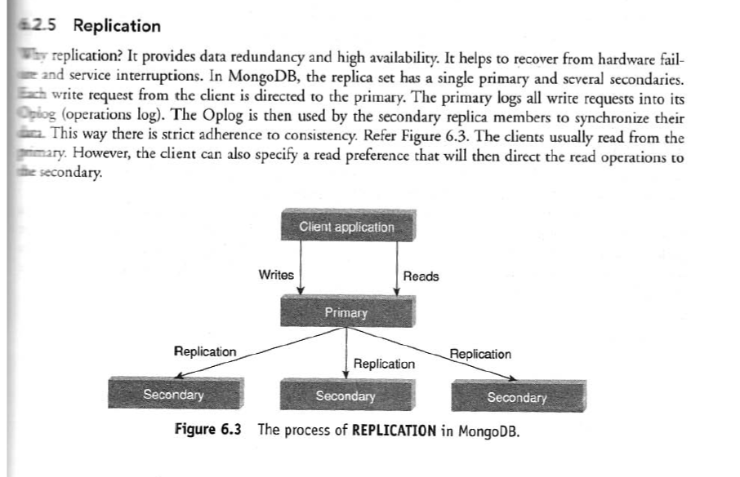

Slide 8
How Replication Works
Primary Node Accepts Writes:
  Clients send read and write operations to the primary node.
  Changes are recorded in the oplog (operations log).
Secondaries Replicate Data:
  Secondary nodes pull and apply changes from the primary node’s oplog.
  This ensures they have the same data as the primary.
Automatic Failover:
  If the primary node goes down, the secondaries hold an election.
  A new primary is elected automatically.
  Clients redirect operations to the new primary.
Read Preference Settings (Optional):
  By default, all reads go to the primary.
  You can configure read preferences to allow reads from secondaries for better performance.

Slide 9
A replica set in MongoDB is a group of MongoDB servers that maintain the same data across multiple nodes. It consists of:
Primary Node: The main server that handles all write operations.
Secondary Nodes: These replicate data from the primary and can take over if the primary fails.
Arbiter (Optional): A node that participates in elections but doesn’t store data.

Slide 12
Sharding in MongoDB is a method of distributing data across multiple servers to handle large datasets and high traffic loads.

Slide 13
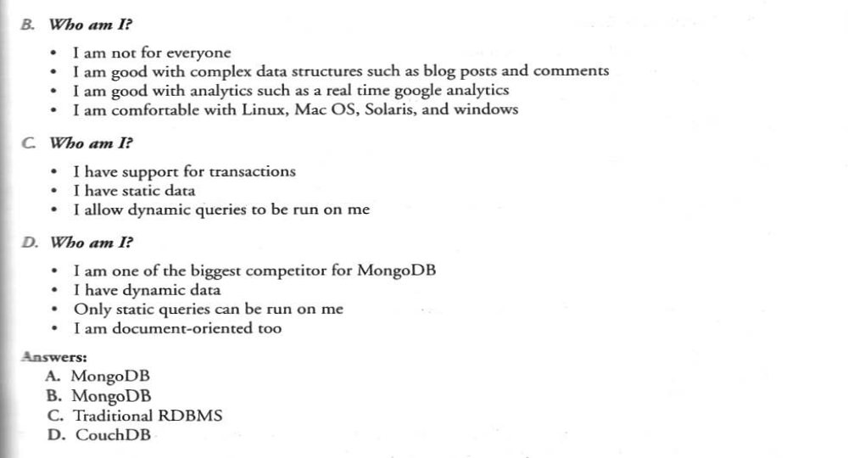

Slide 14
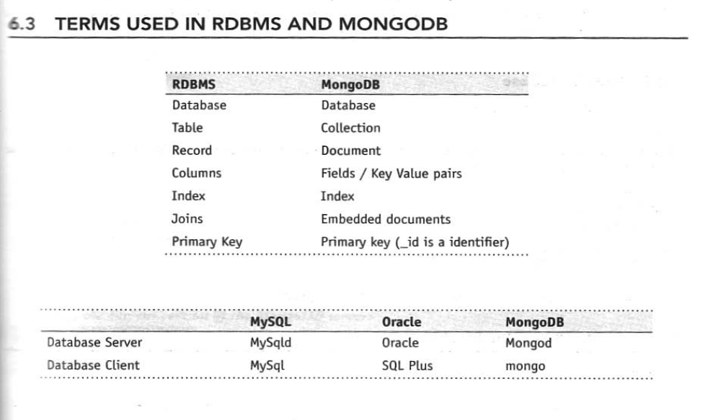

Slide 15
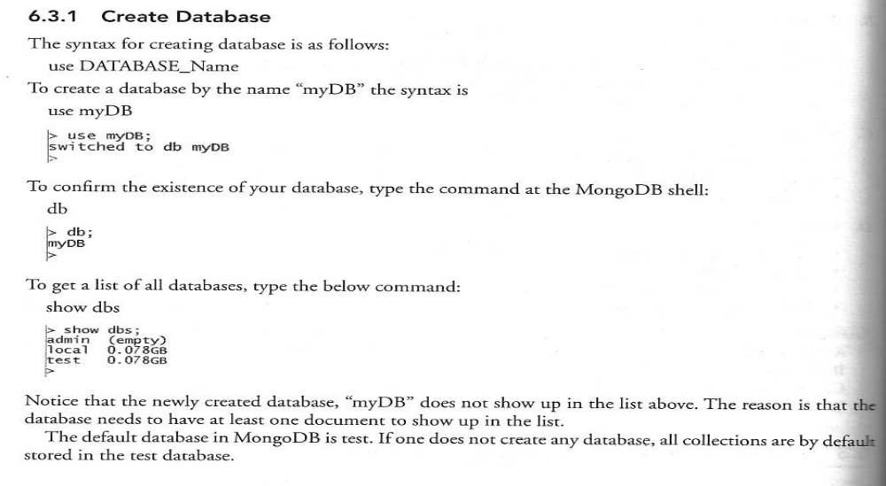

Slide 16
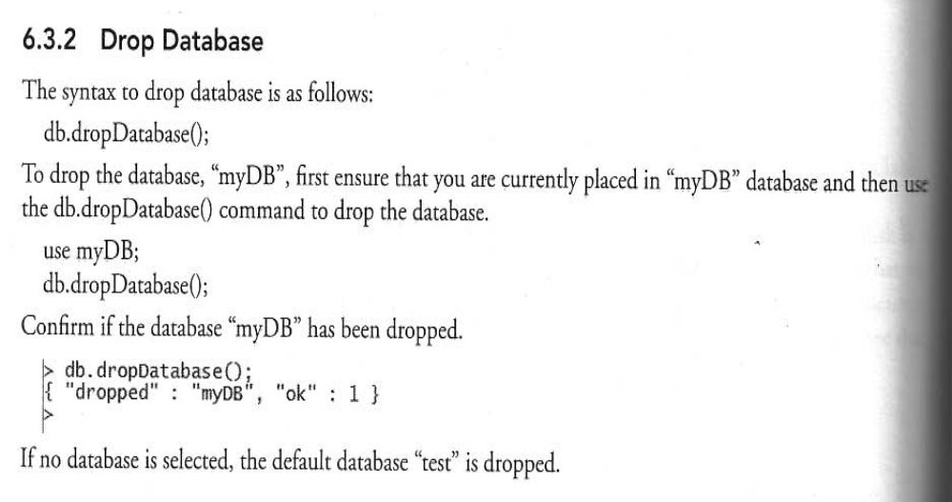

Slide 17
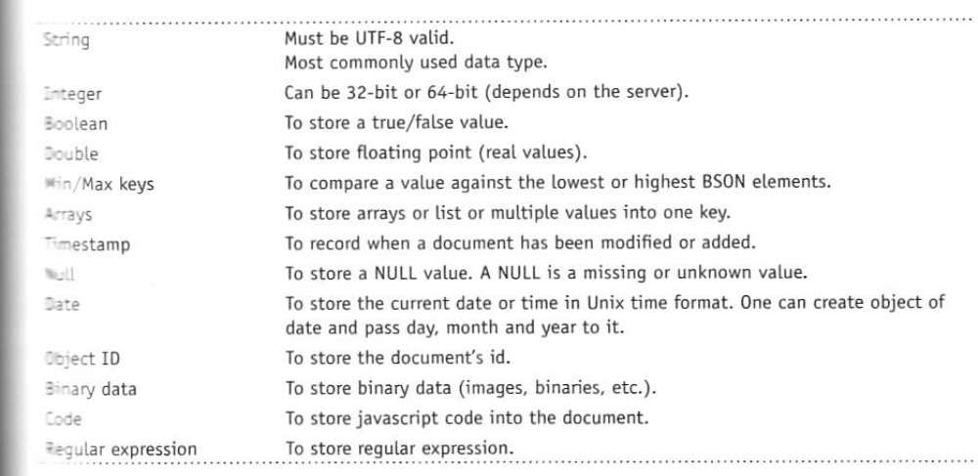

Slide 18
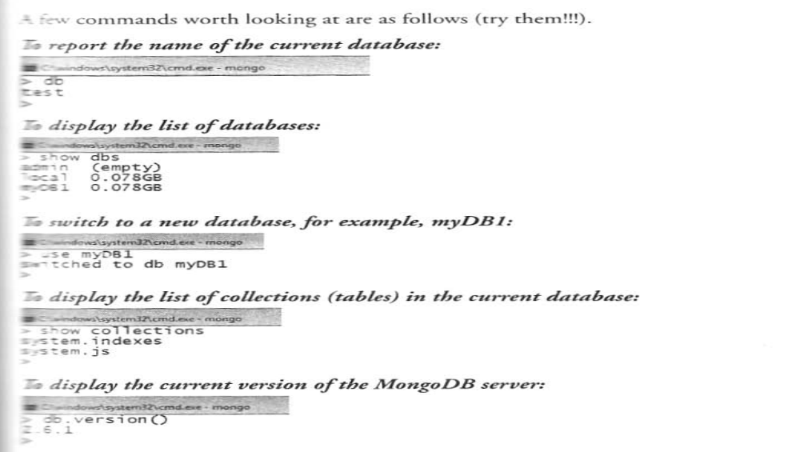

Slide 19
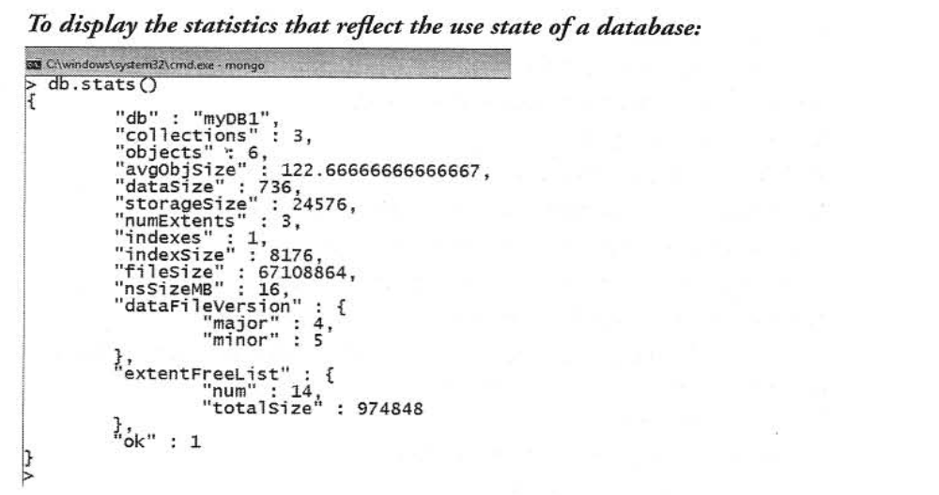

Slide 20
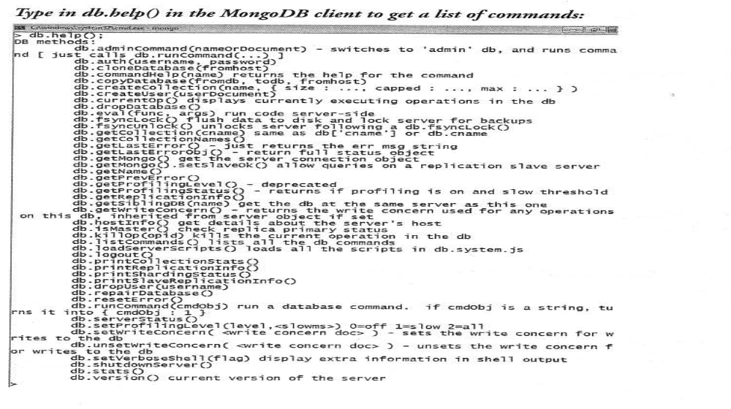

Slide 21
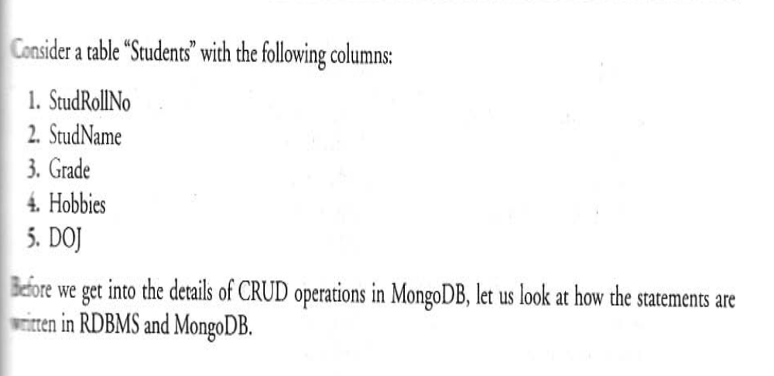

Slide 22
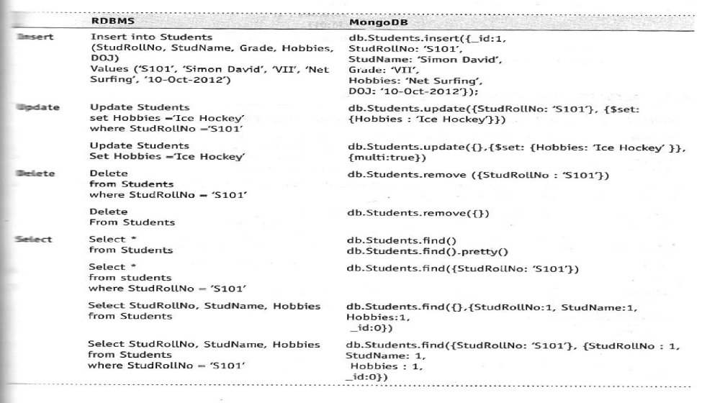

Slide 23
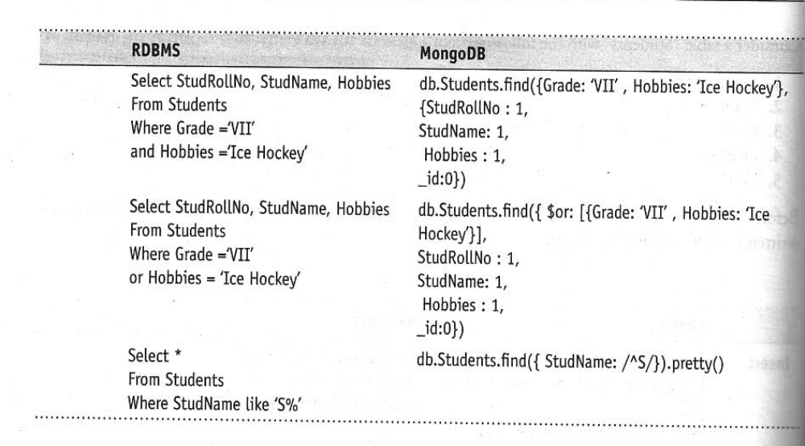

Slide 24
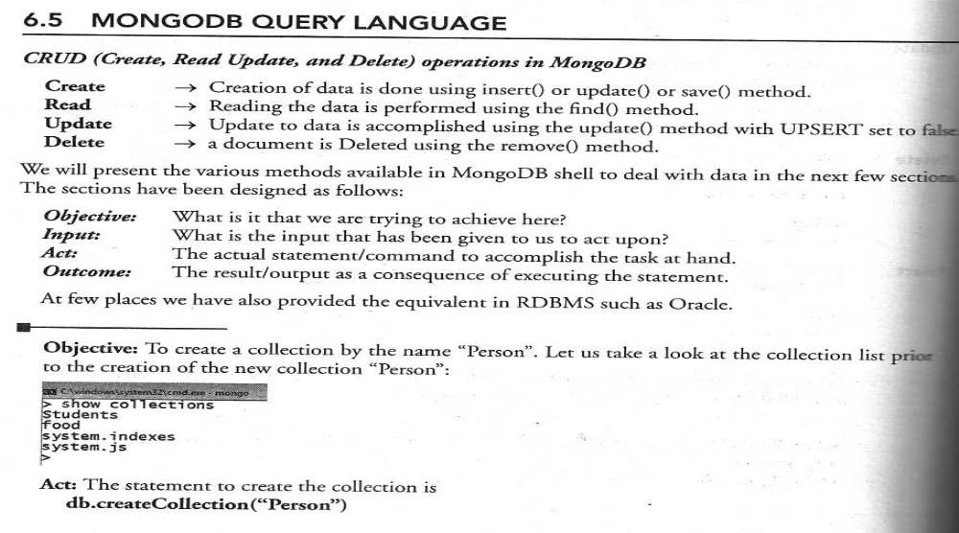

Slide 25
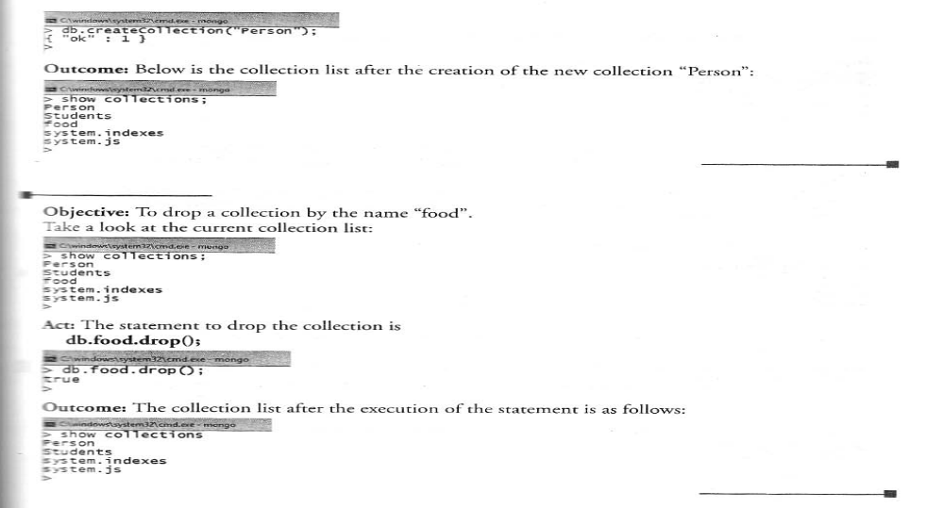

Slide 26
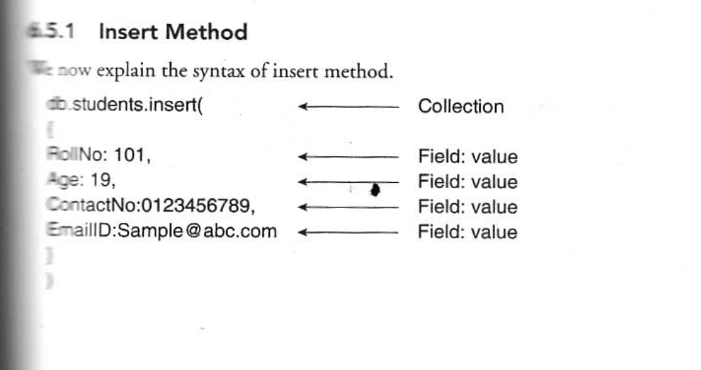

Slide 27
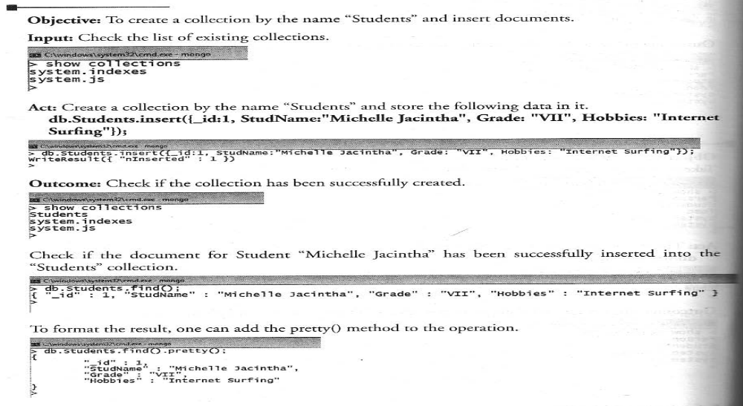

Slide 28
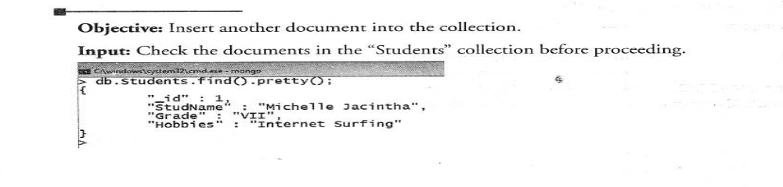
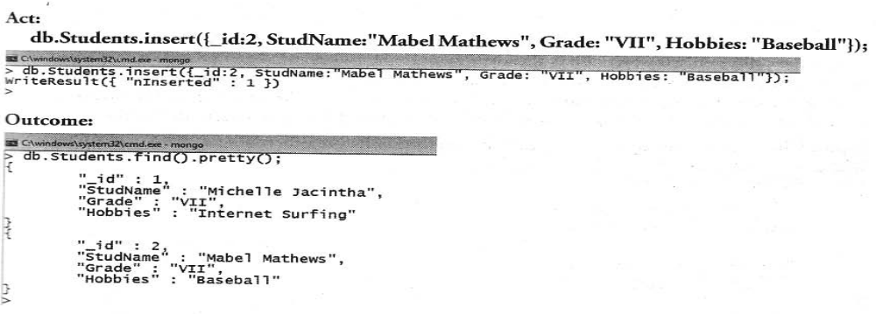

Slide 29
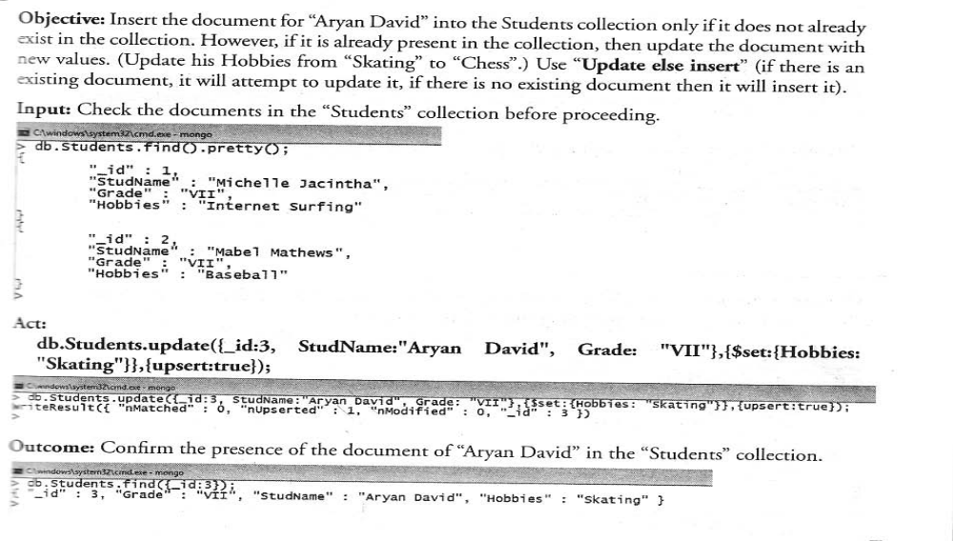

Slide 30
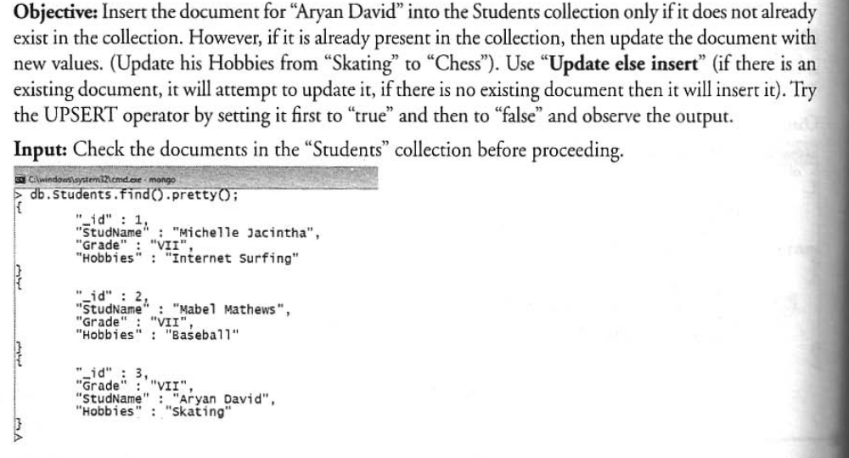

Slide 31
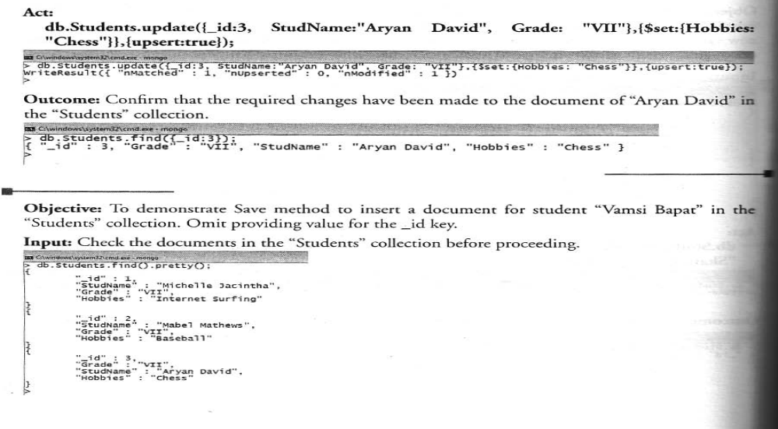

Slide 32
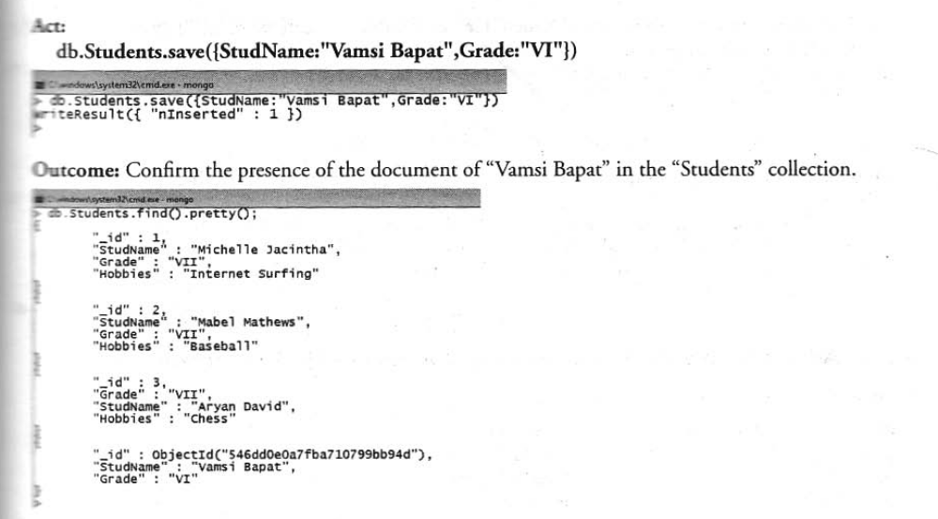

Slide 33
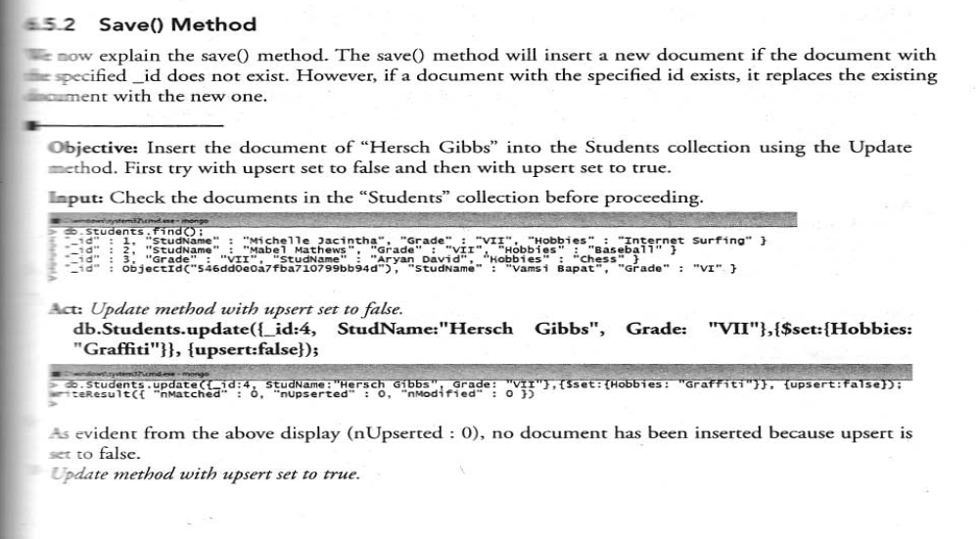

Slide 34
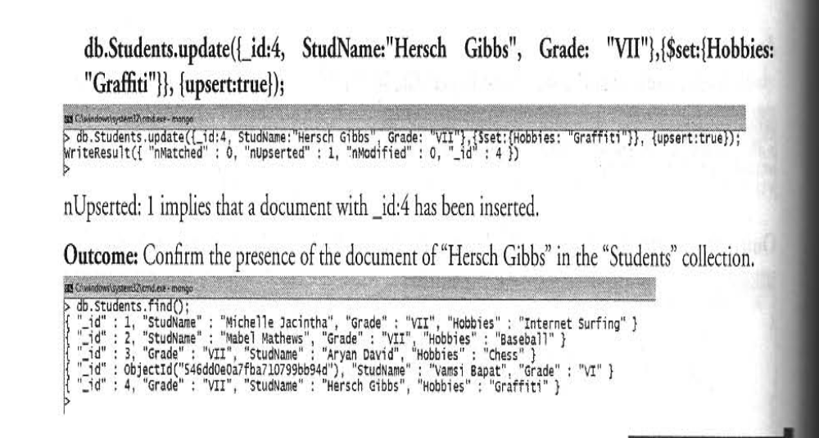

Slide 35
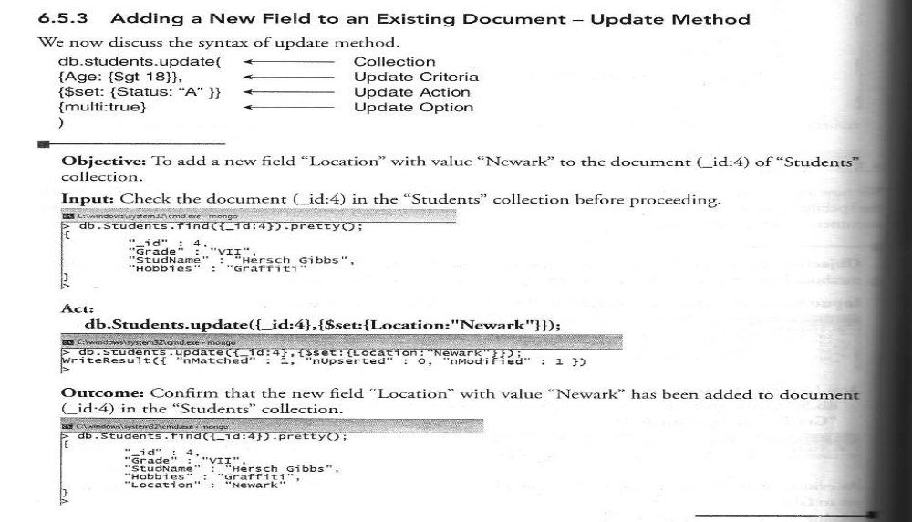

Slide 36
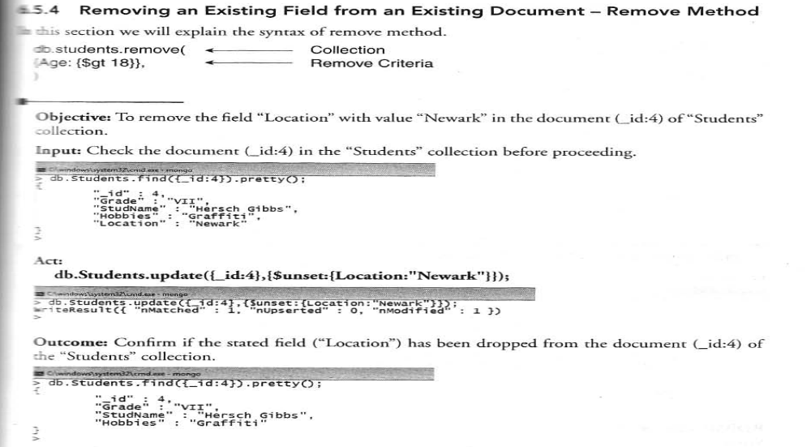

Slide 37
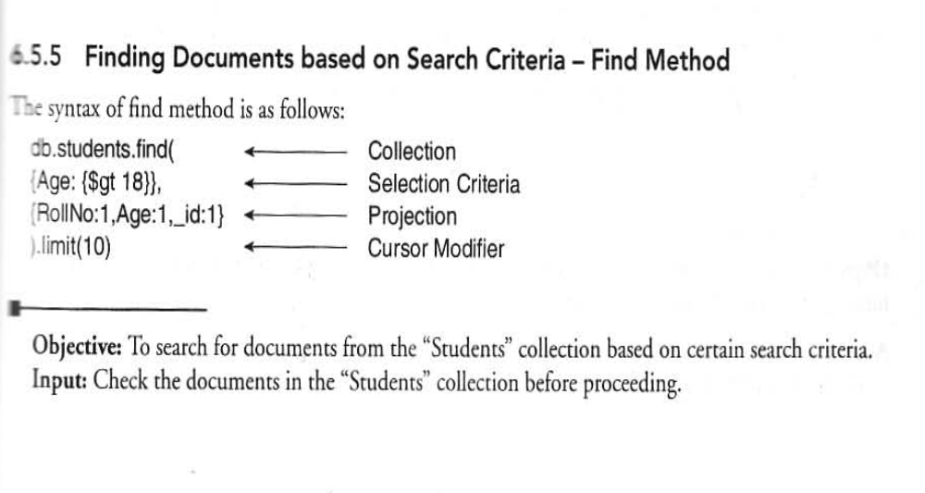

Slide 38
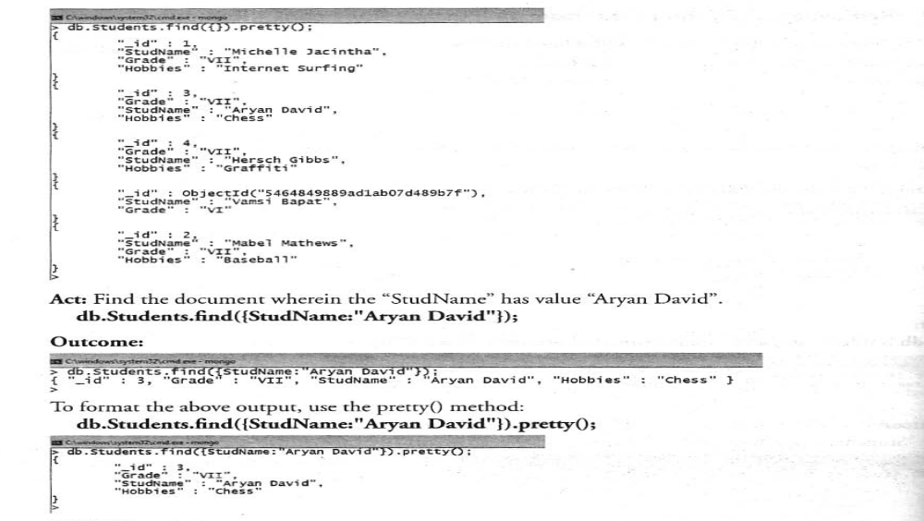

Slide 39
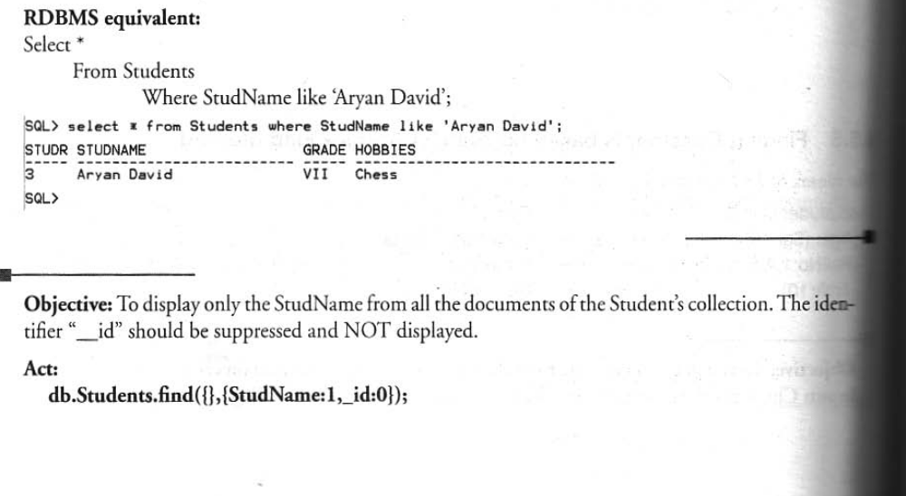

Slide 40
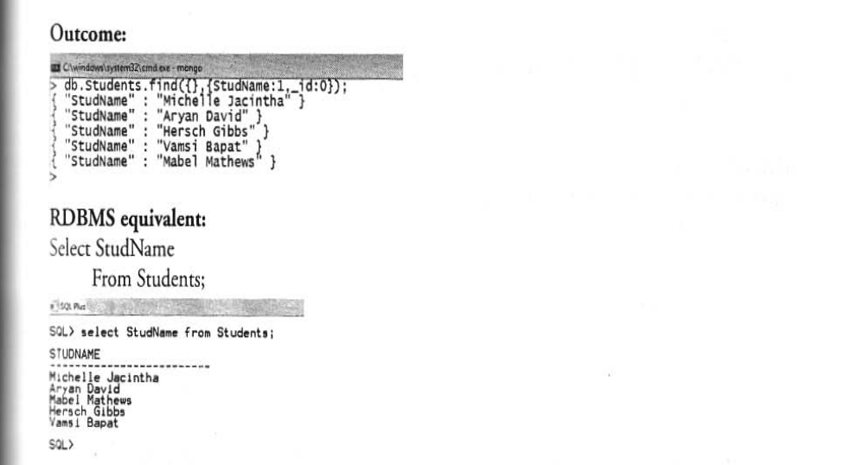

Slide 41
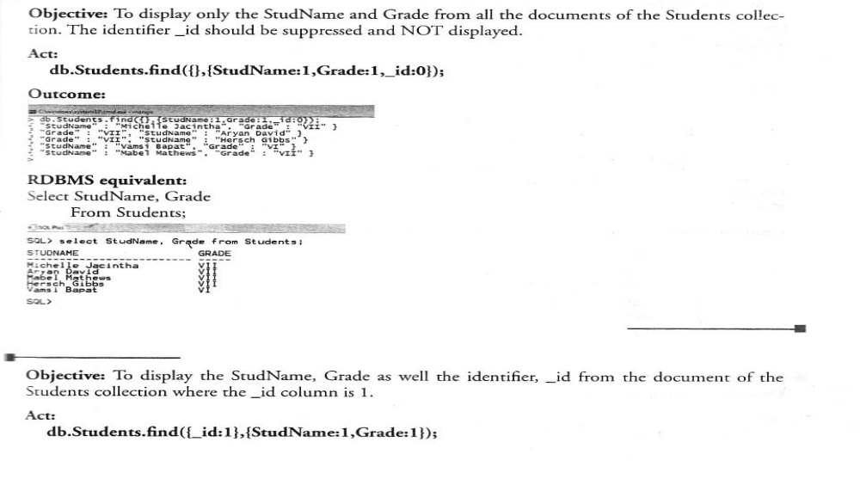

Slide 42
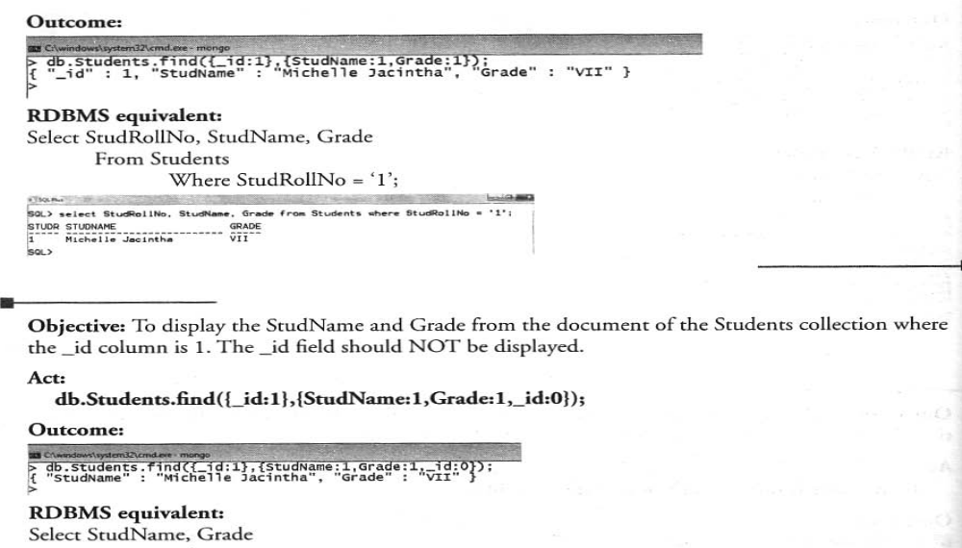

Slide 43
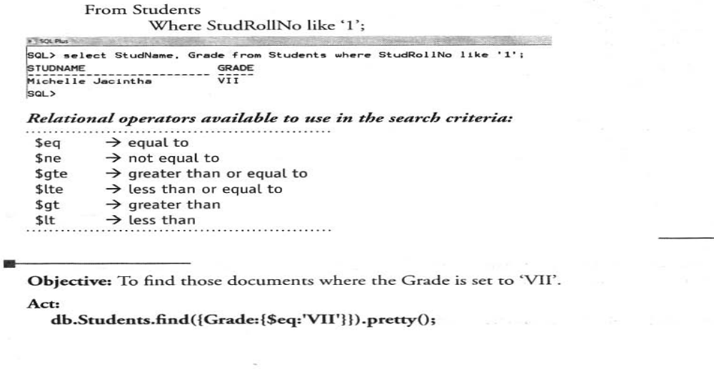

Slide 44
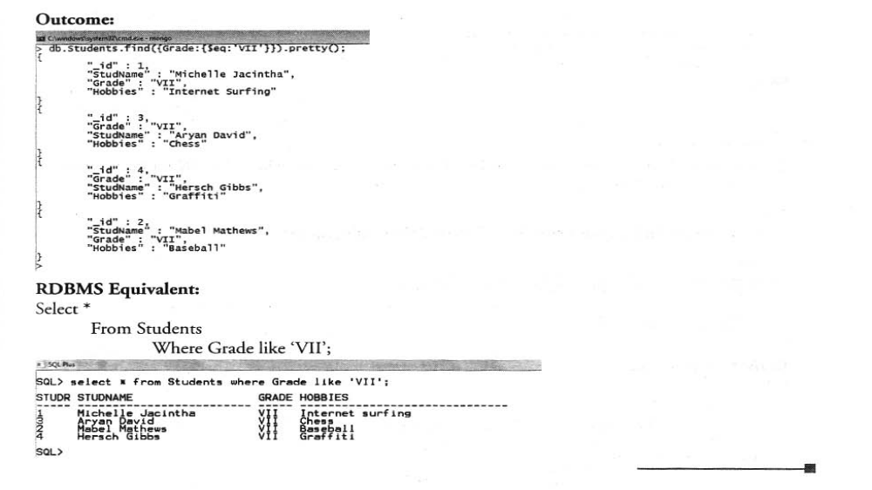

Slide 45
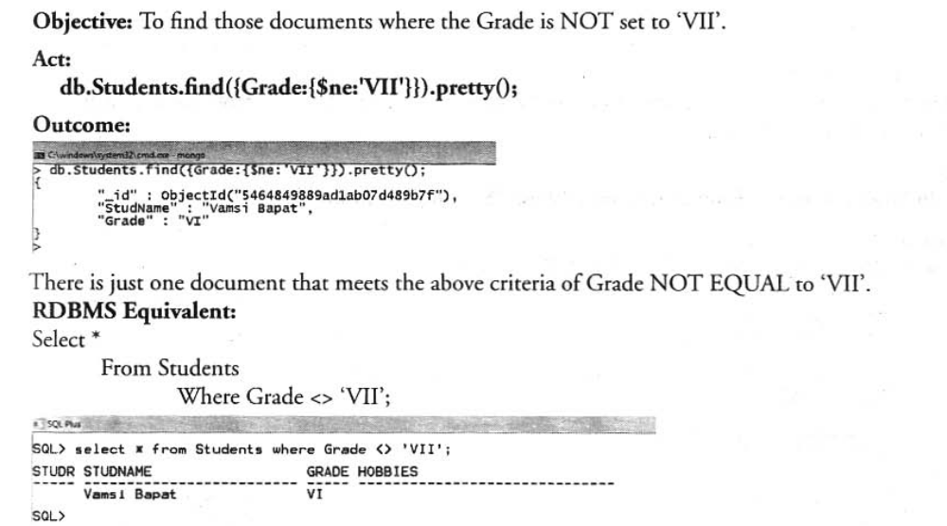

Slide 47
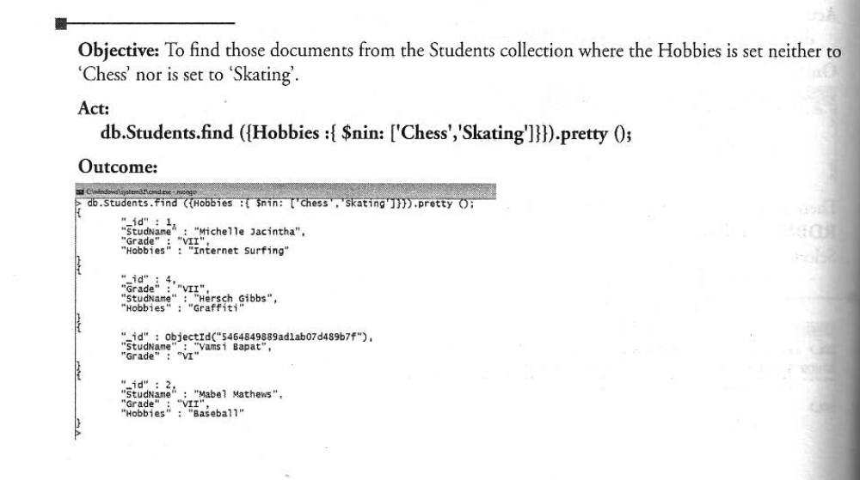

Slide 49
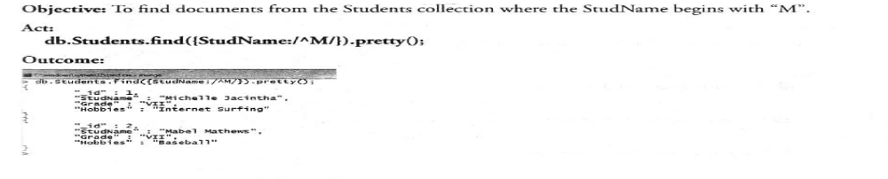
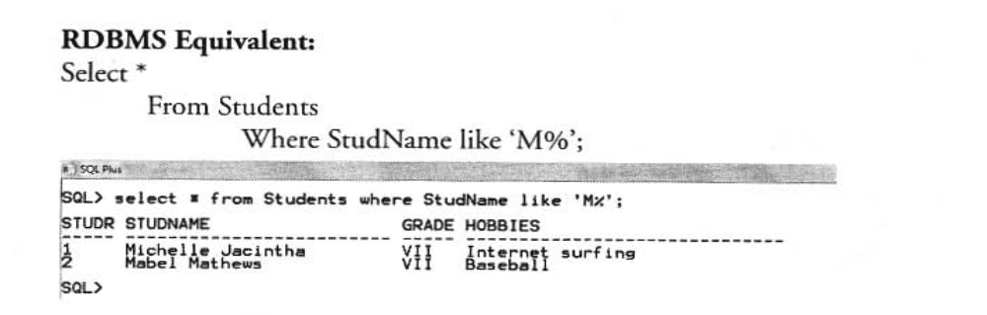

Slide 50
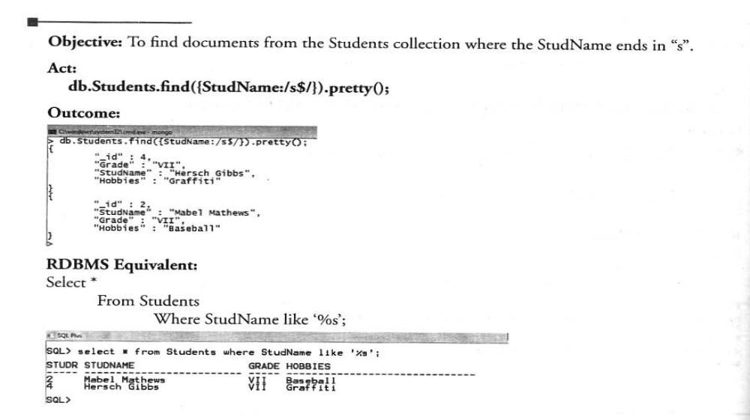

Slide 51
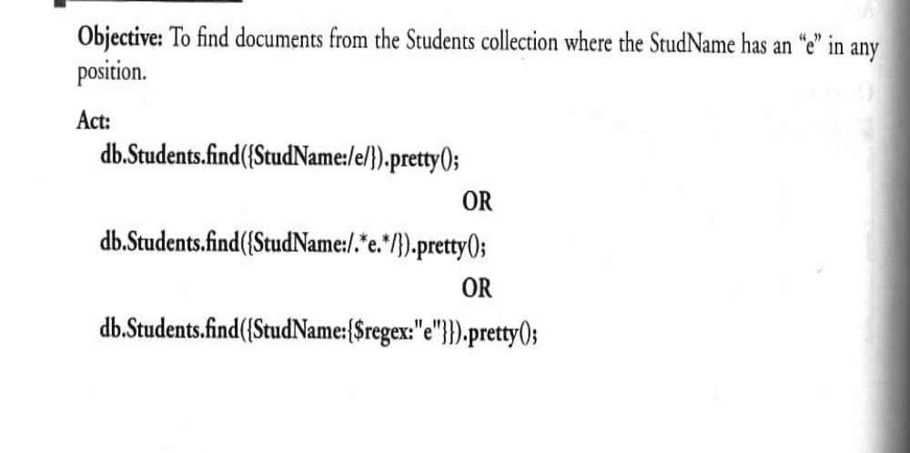

Slide 52
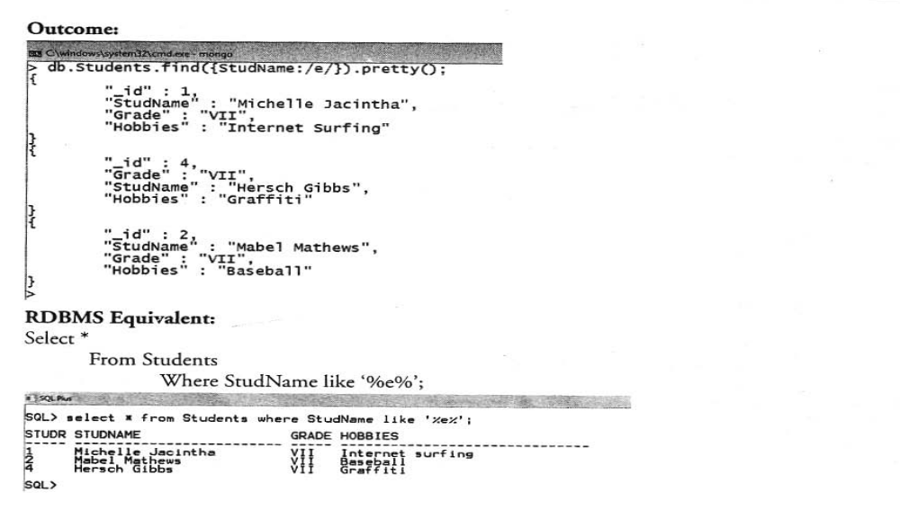

Slide 53
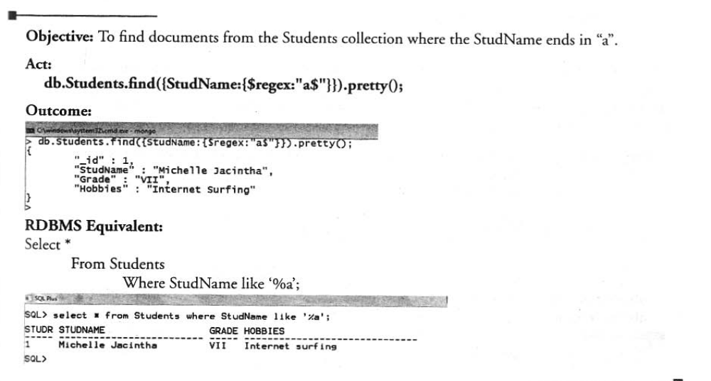

Slide 65
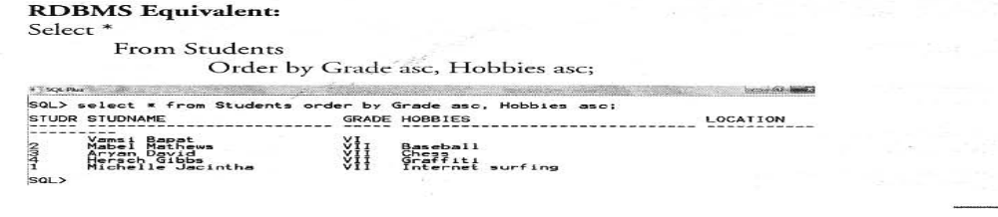

Slide 87
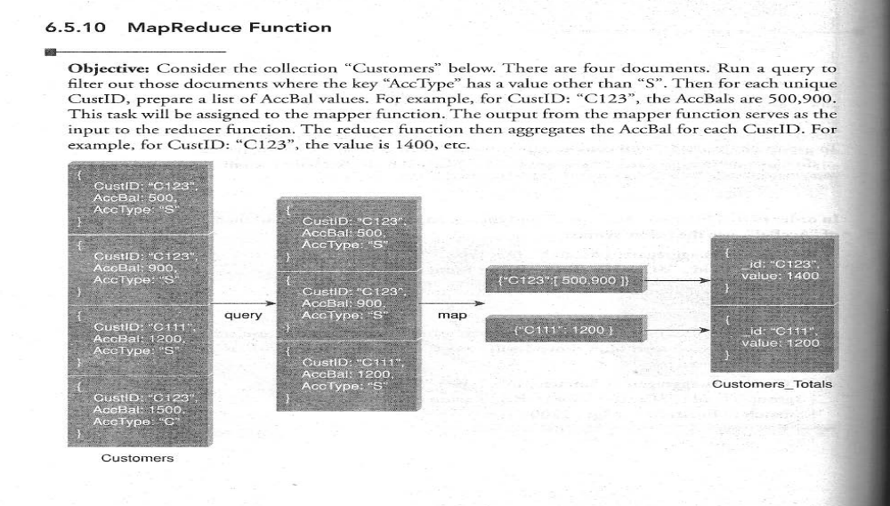

Slide 88
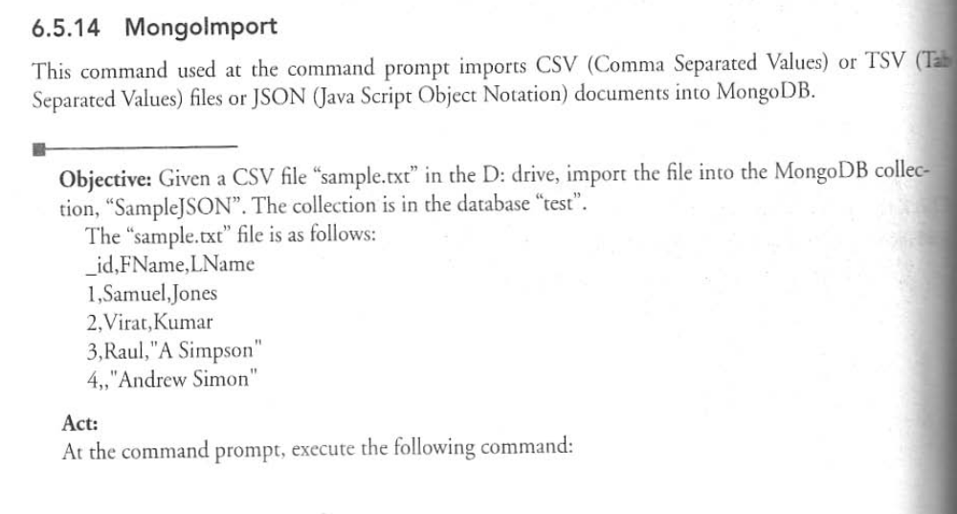

Slide 89
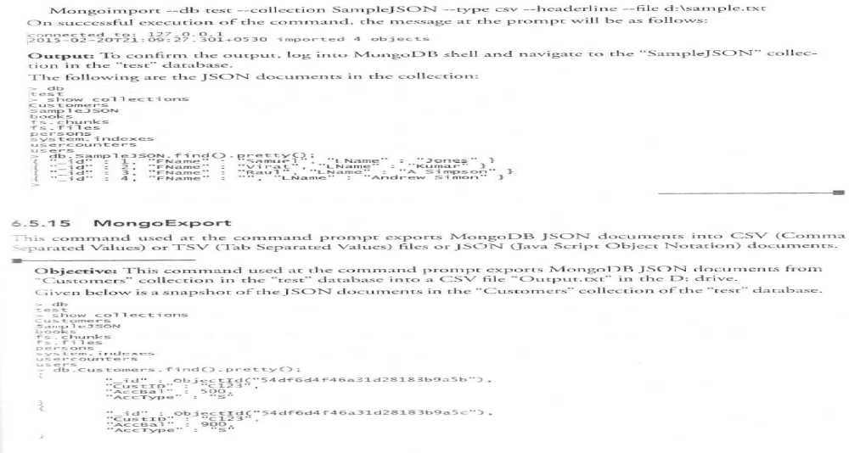

Slide 90
