Slide 1
MODULE 2:
SOLVING PROBLEMS BY SEARCHING

Slide 2
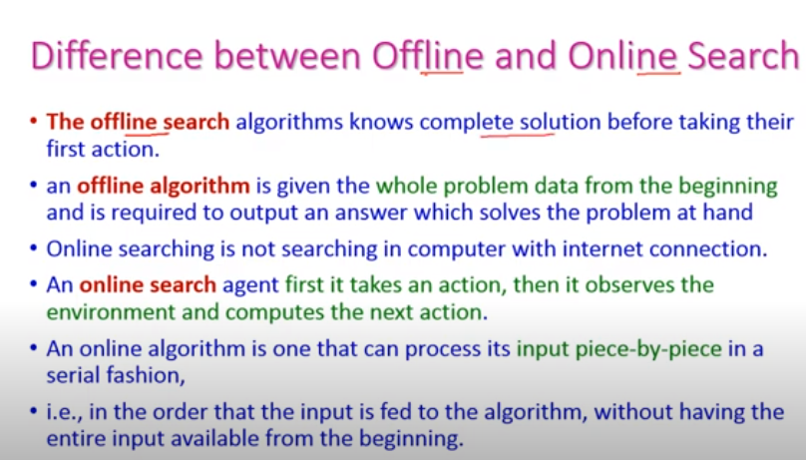
Input data

Slide 3
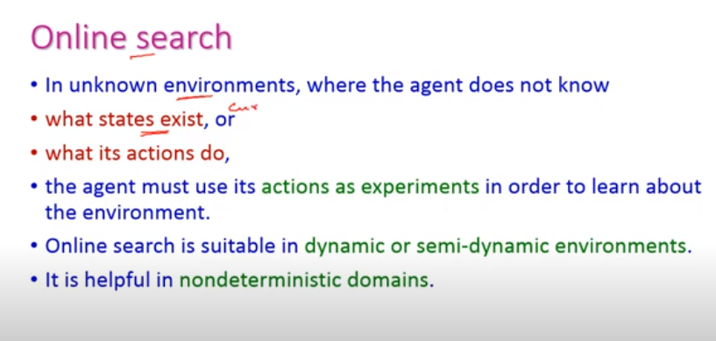
Current state
Next state
By experience only it can predict next state

Slide 4
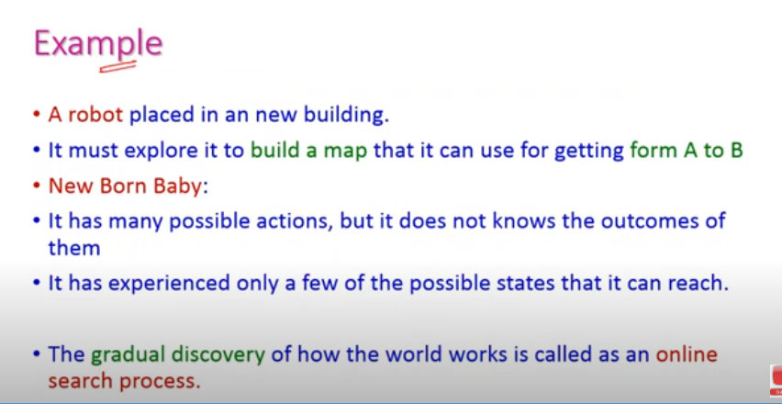
A
B

Slide 5
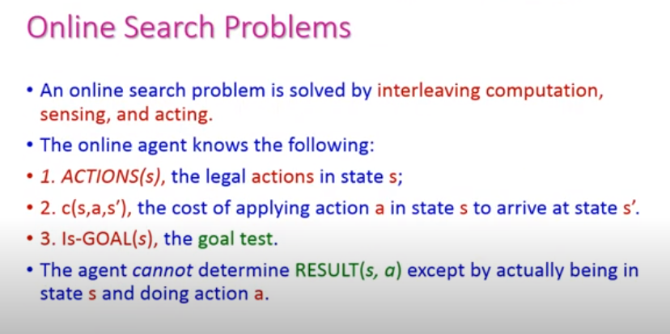

Slide 6
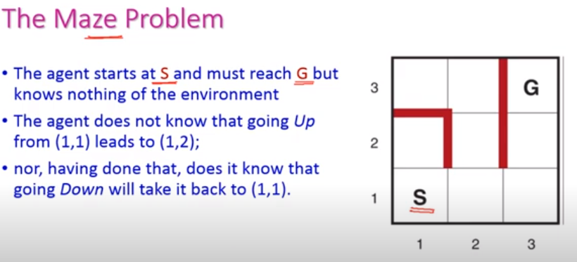
Actions are:
Left
Right
Up
Down

Slide 7
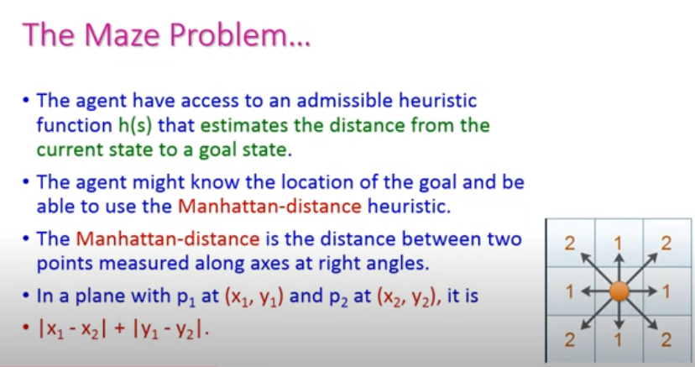

Slide 8
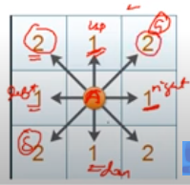

Slide 9
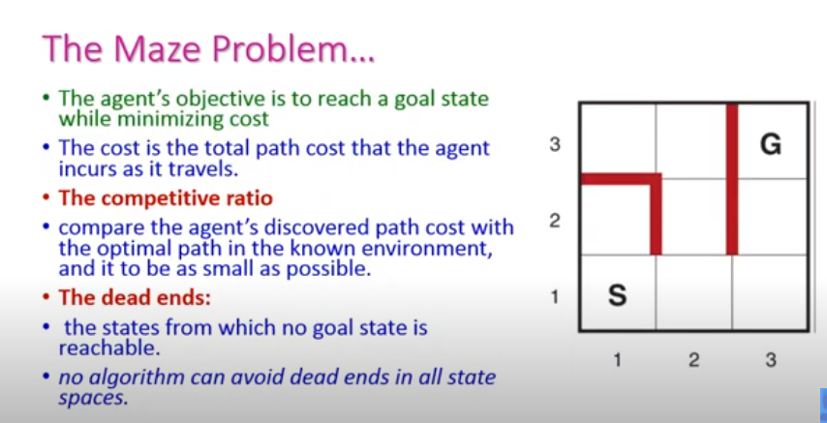

Slide 10
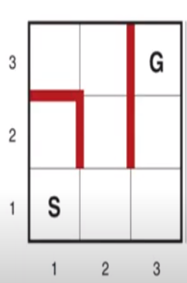
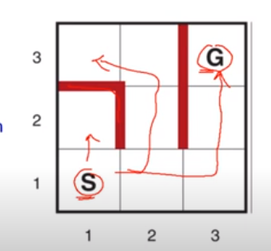

Slide 11
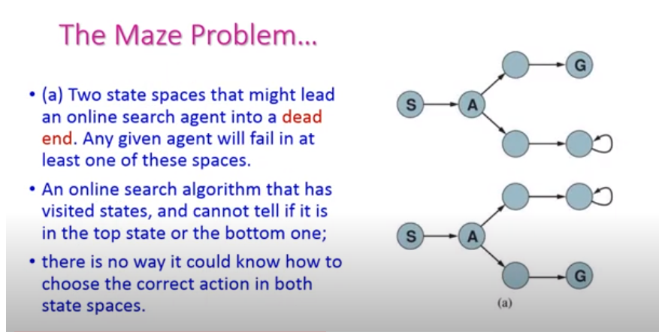

Slide 12
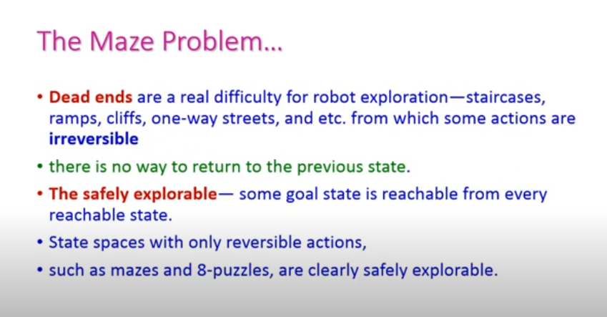

Slide 13
OVERVIEW:
Problem is solving by defining precisely the elements that constitute a “problem” and its “solution,” and give several examples to illustrate these definitions.
We then describe several general-purpose search algorithms that can be used to solve these problems.
Problem-solving agents use atomic representations, where states of the world are considered as wholes, with no internal structure visible to the problem-solving agent.
Goal formulation, based on the current situation and the agent’s performance measure, is the first step in problem solving.
Problem formulation is the process of deciding what actions and states to consider,
If the agent has no additional information—i.e., if the environment is unknown

Slide 14
We consider two general classes of search:
(1) uninformed search algorithms for which the algorithm is provided no information about the problem other than its definition;
(2) informed search, where the algorithm is given some guidance.

Slide 15
Intelligent agents are supposed to maximize their performance measure; achieving this is sometimes simplified if the agent can adopt a goal and aim to satisfy it.
Goals help organize behavior by limiting objectives.
We consider a goal to be a set of world states – exactly those states in which the goal is satisfied.
Here we consider environments that are known, observable, discrete and deterministic (i.e. each action has exactly one corresponding outcome).
The process of looking for a sequence of actions that reaches the goal is called search.
A search algorithm takes a problem as input and returns a solution in the form of an action sequence.

Slide 16
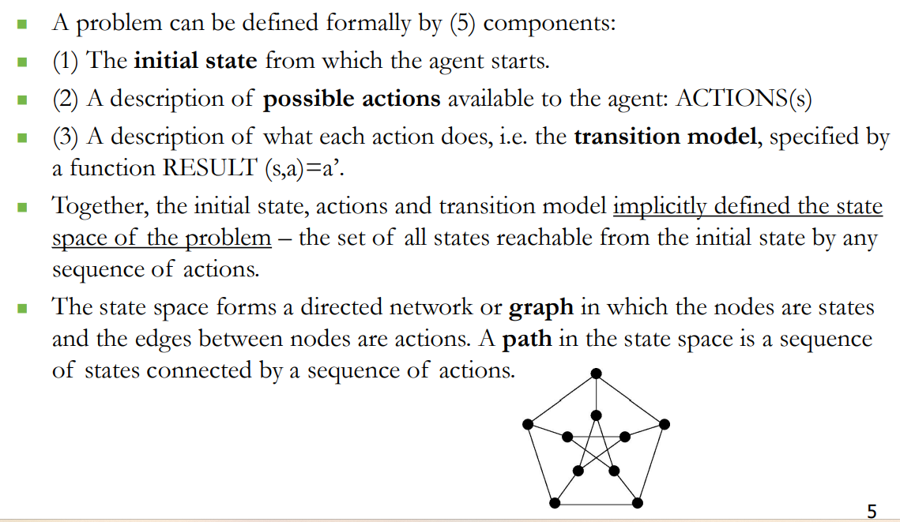
WELL DEFINED PROBLEMS AND SOLUTIONS

Slide 17
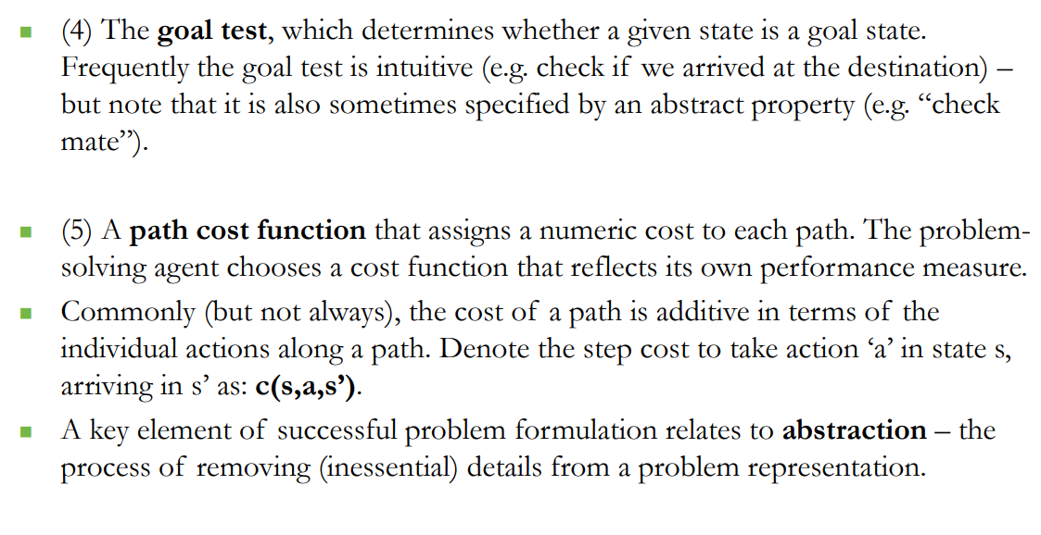

Slide 18
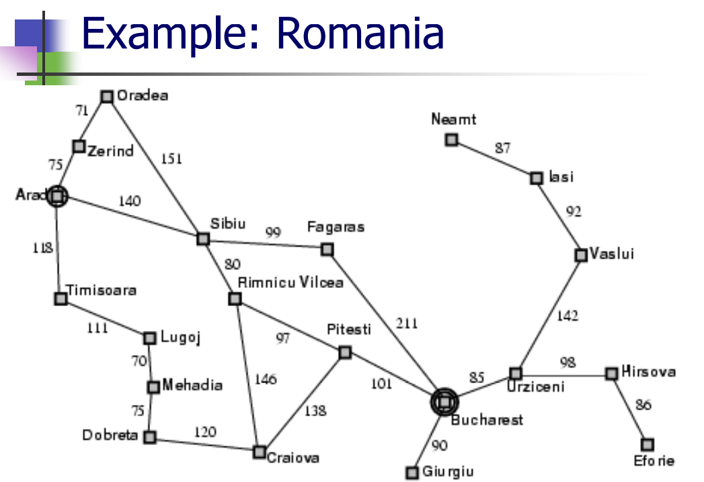

Slide 19


Slide 20
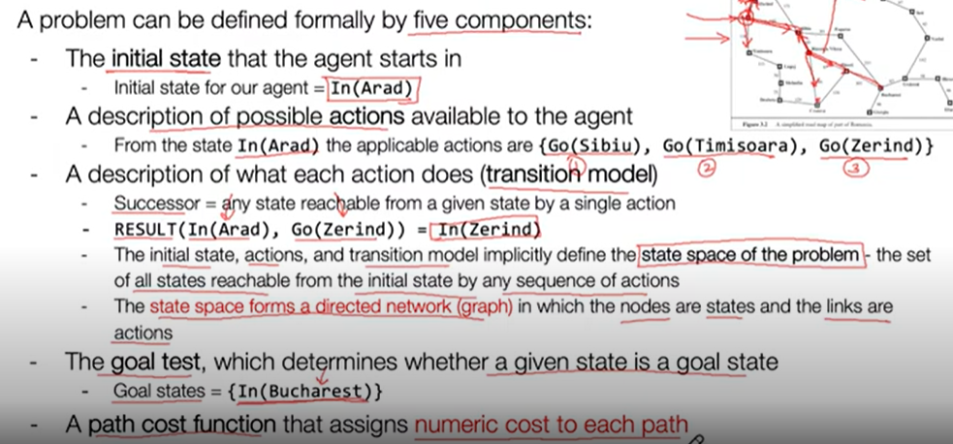

Slide 21
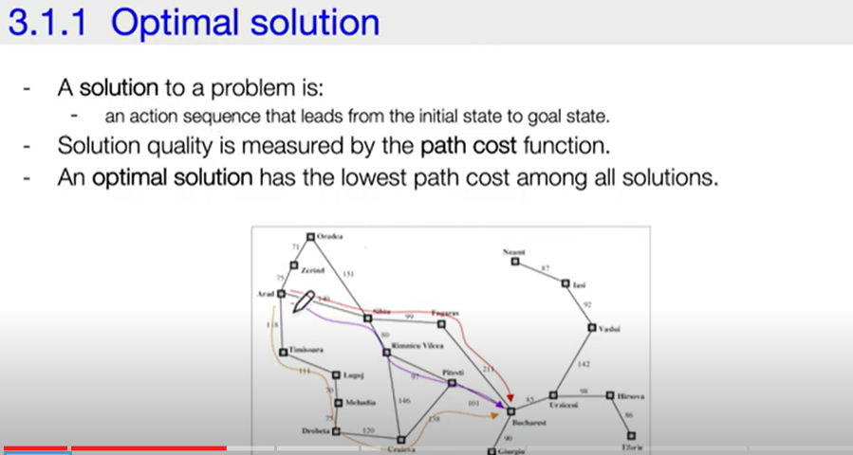

Slide 22
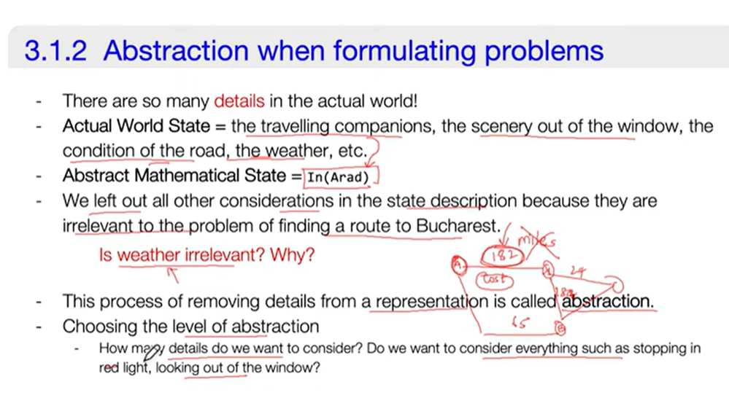

Slide 23
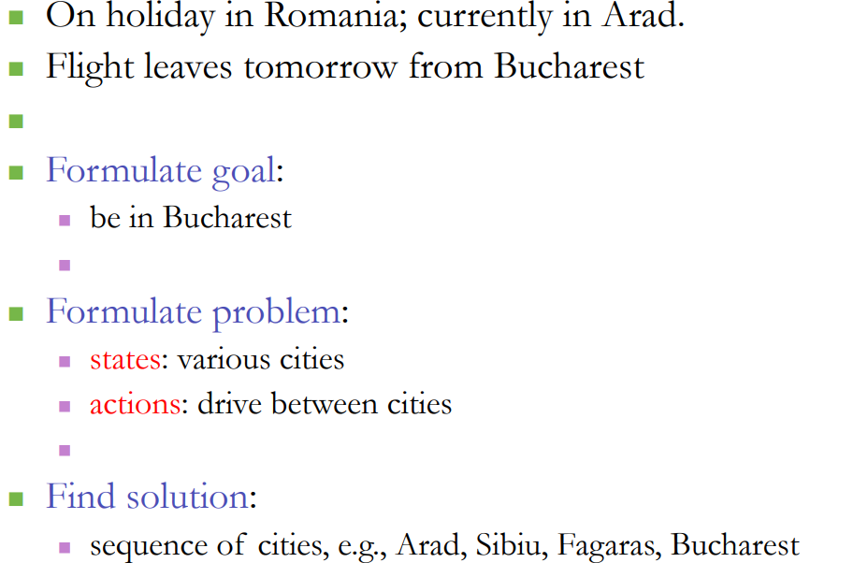

Slide 24
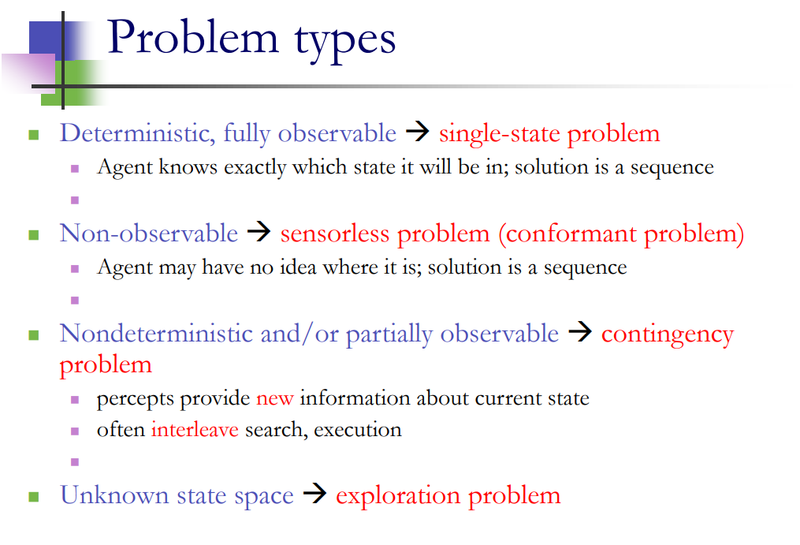

Slide 26
Example problems
The problem-solving approach has been applied to a vast array of task environments.
We distinguish toy and real-world problems.
. A toy problem is intended to illustrate or exercise various problem-solving methods. It can be given a concise, exact description and hence is usable by different researchers to compare the performance of algorithms.
A real-world problem is one whose solutions people actually care about. They tend not to have a single agreed-upon description.

Slide 27
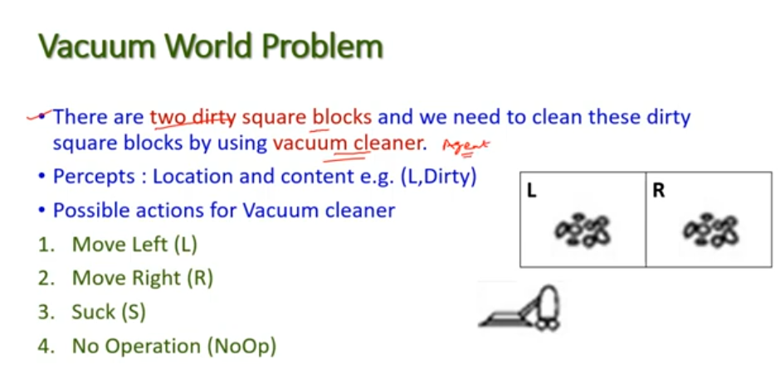
TOY PROBLEM

Slide 28
States: The state is determined by both the agent location and the dirt locations.
The agent is in one of two locations, each of which might or might not contain dirt. Thus there are 2 × 2ˆ2 = 8 possible world states.or 2 ˆ3=8
(2 blocks,3 actions)
A larger environment with n locations has n · 2 ˆ n states.
• Initial state: Any state can be designated as the initial state.
• Actions: In this simple environment, each state has just three actions: Left, Right, and Suck. Larger environments might also include Up and Down.
• Transition model: The actions have their expected effects, except that moving Left in the leftmost square, moving Right in the rightmost square, and Sucking in a clean square have no effect.
. • Goal test: This checks whether all the squares are clean.
• Path cost: Each step costs 1, so the path cost is the number of steps in the path.

Slide 29
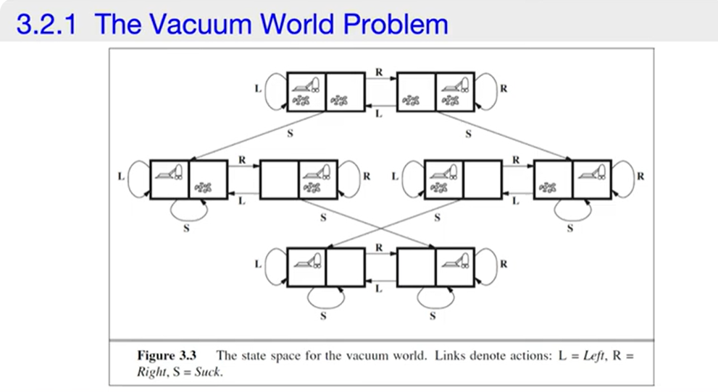
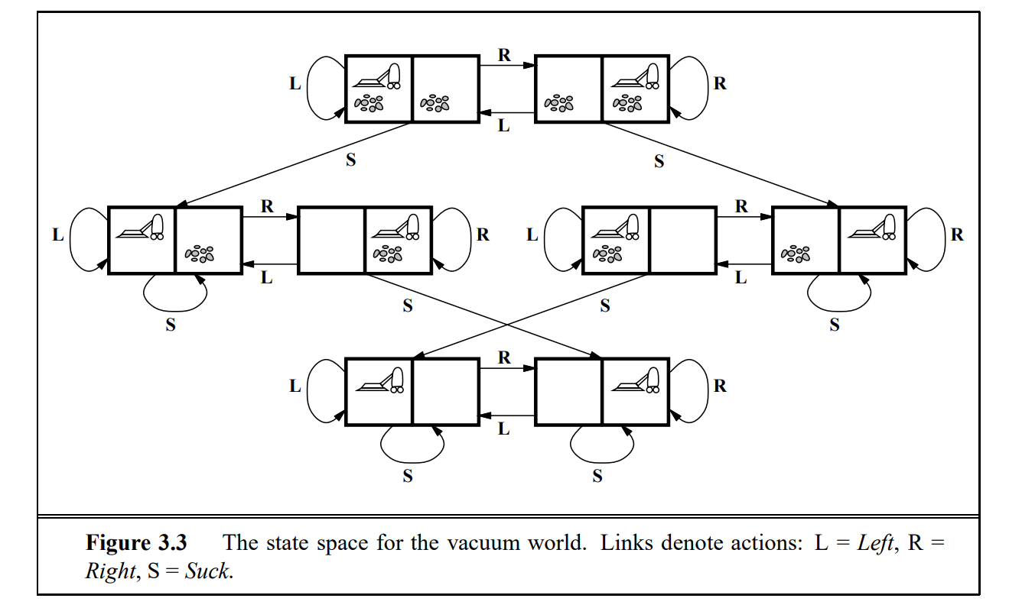
Minimum path cost is 3

Slide 30
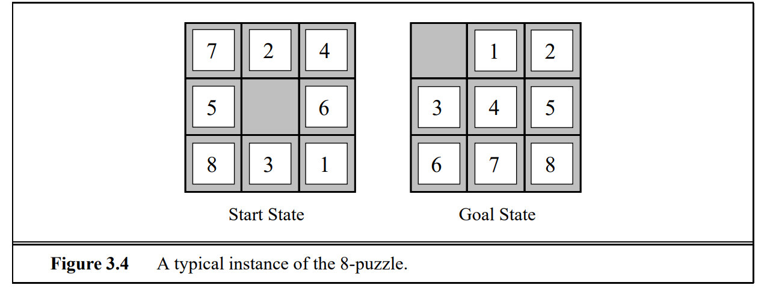
8-puzzle problem
It consists of 3*3 board and 8 numbered tiles and a blank space
A tile adjacent to the blank space can slide into the blank space.
The objective is to reach the goal state.

Slide 31
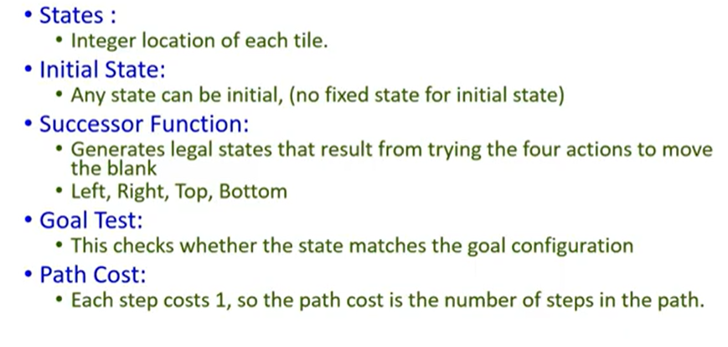
Number of steps from state S to goal state G

Slide 32
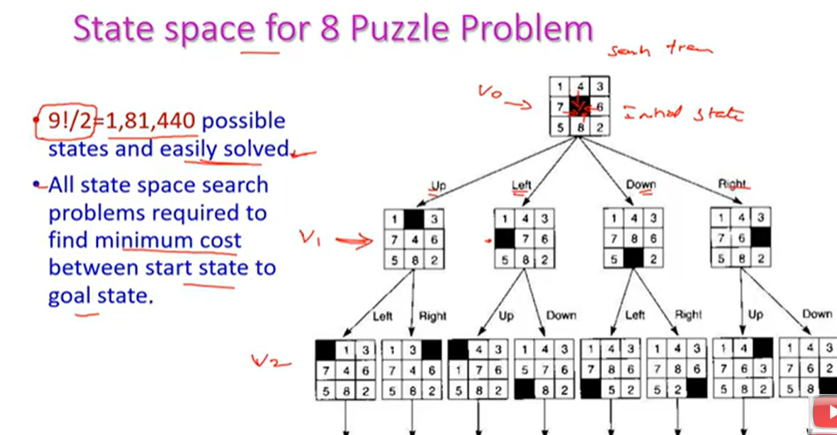

Slide 33
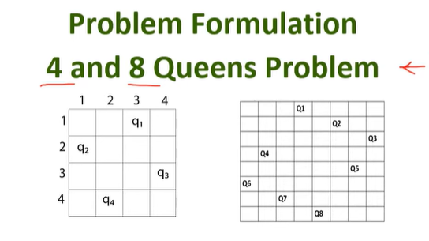

Slide 34
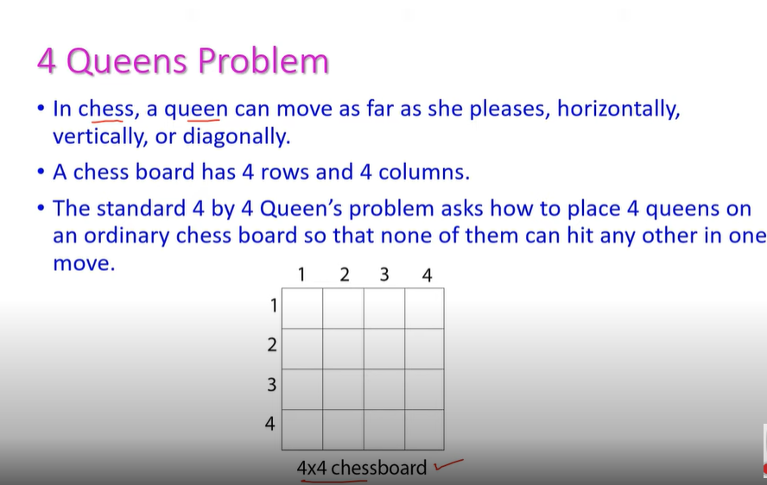

Slide 35
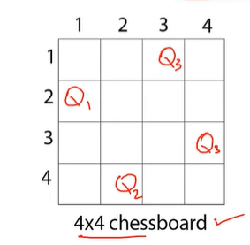

Slide 36
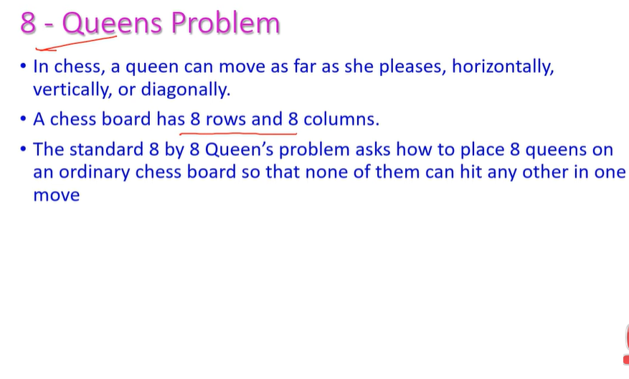

Slide 37
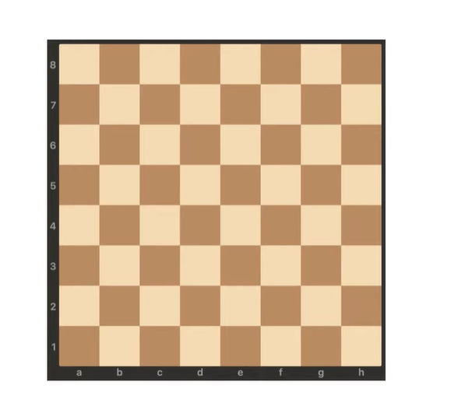

Slide 38
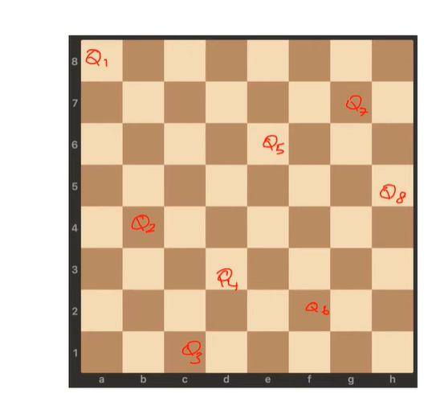

Slide 39
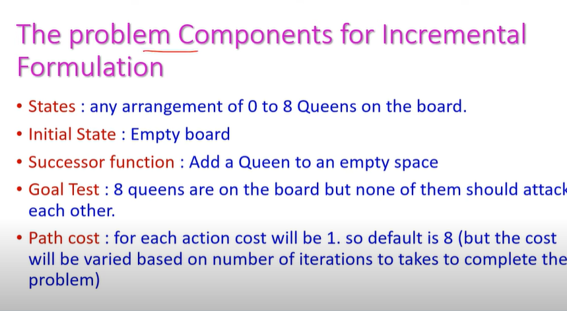

Slide 40
SEARCHING FOR PROBLEMS
Having formulated some problems, we now need to solve them.
A solution is an action sequence, so search algorithms work by considering various possible action sequences.
The possible action sequences starting at the initial state form a search tree with the initial state at the root; the branches are actions and the nodes correspond to states in the state space of the problem.
Figure 3.6 shows the first few steps in growing the search tree for finding a route from Arad to Bucharest.

Slide 41
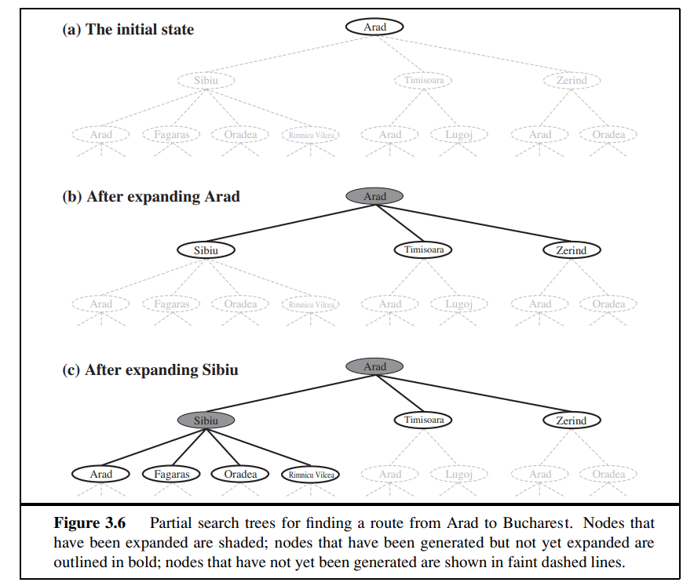

Slide 42
The root node of the tree corresponds to the initial state, In(Arad).
The first step is to test w
Then we need to consider taking various actions.
We do this by expanding the current state; that is, applying each legal action to the current state, thereby generating a new set of states. In this case, we add three branches from the parent node In(Arad) leading to three new child nodes: In(Sibiu), In(Timisoara), and In(Zerind).
Now we must choose which of these three possibilities to consider further.

Slide 43
Suppose we choose Sibiu first.
We check to see whether it is a goal state (it is not) and then expand it to get In(Arad), In(Fagaras), In(Oradea), and In(RimnicuVilcea).
We can then choose any of these four or go back and choose Timisoara or Zerind.
Each of these six nodes is a leaf node, that is, a node with no children in the tree.
Leaf node is a part of a frontier.
The set of all leaf nodes available for expansion at any given point is called the frontier.
Frontier is a set of all leaf nodes.
The process of expanding nodes on the frontier continues until either a solution is found or there are no more states to expand.

Slide 44
SEARCH
SEARCH
Tree search
Graph search

Slide 45
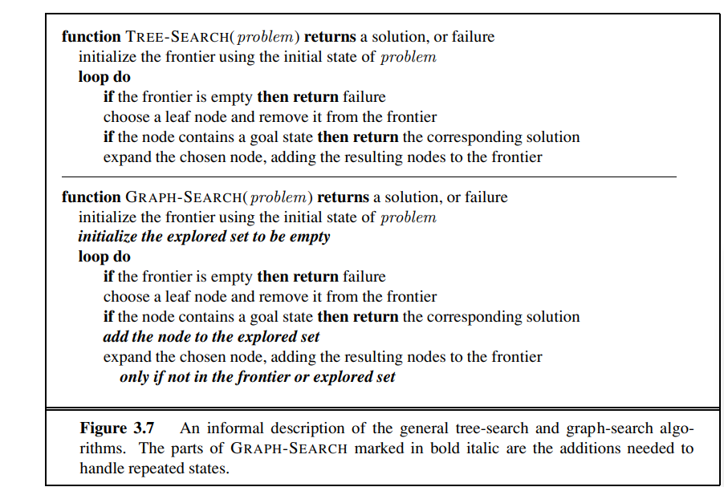

Slide 46
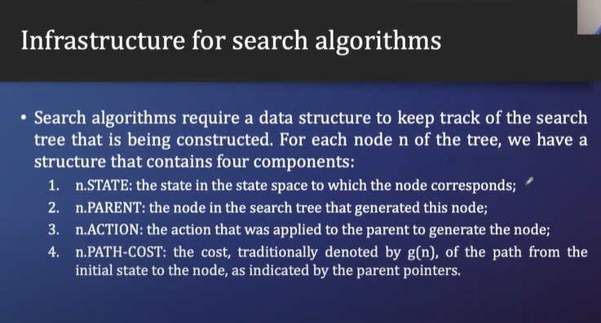
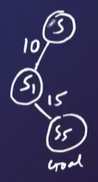

Slide 47
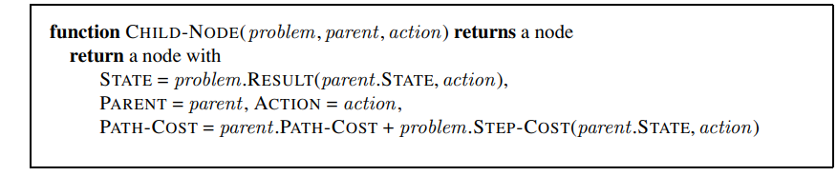

Slide 48
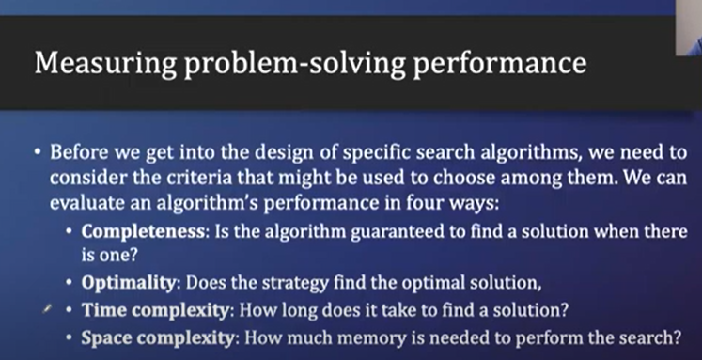

Slide 49
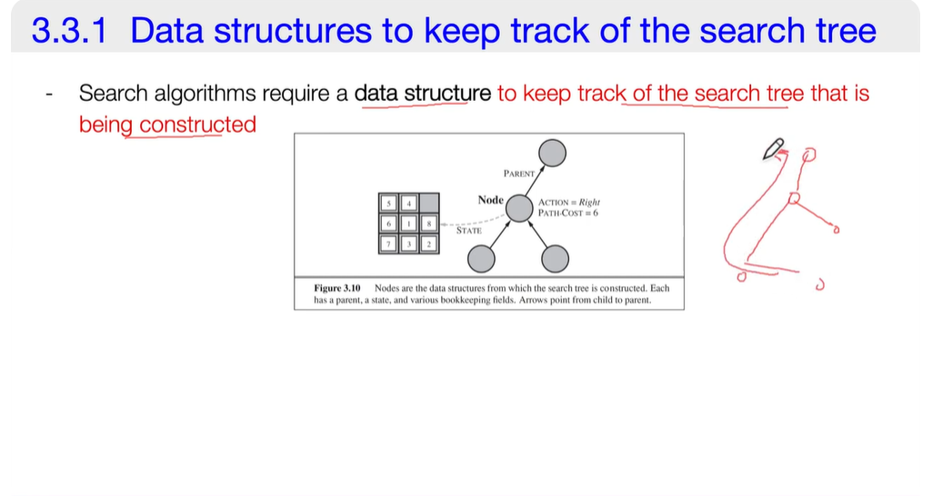

Slide 50
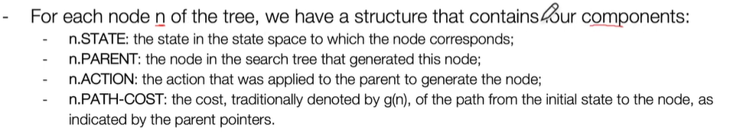
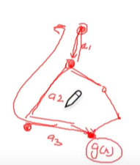

Slide 51
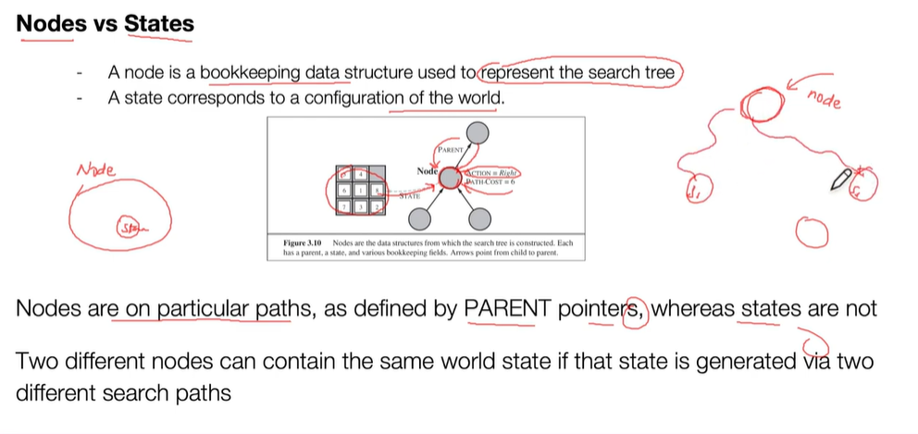

Slide 52
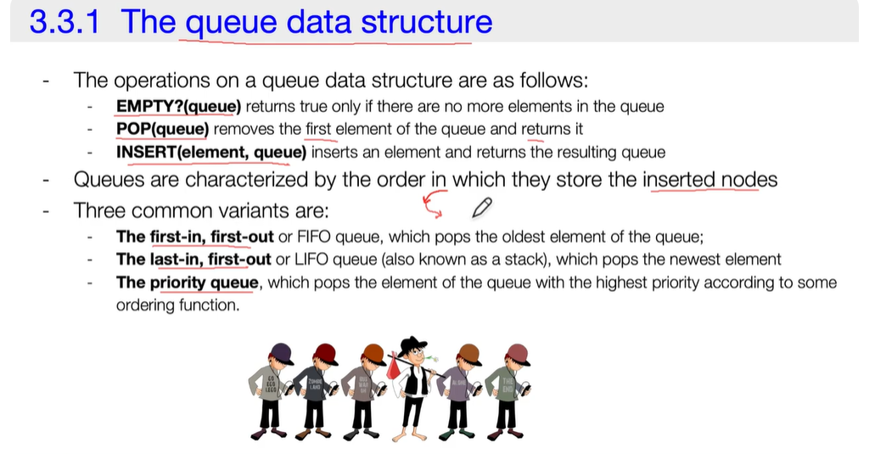

Slide 53
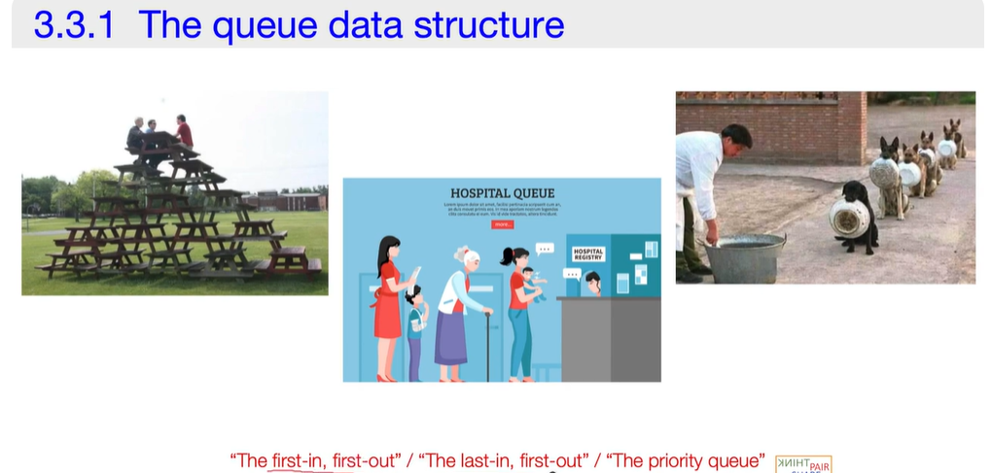
FIFO
LIFO
PRIORITY QUEUE

Slide 54
