Slide 1
INTELLIGECE SYSTEM AND MACHINE LEARNING
Prepared by,
Nikhitha C
Asst.Prof.
Dept. of ECE
BIT, Mangalore

Slide 2
MODULE 1
ARTIFICIAL INTELLIGENCE(AI)

Slide 3
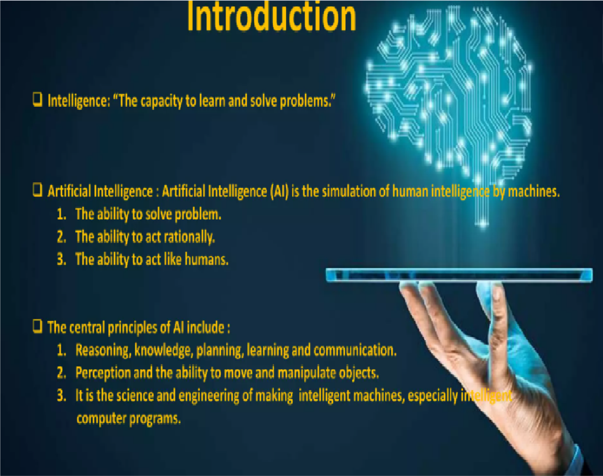

Slide 4
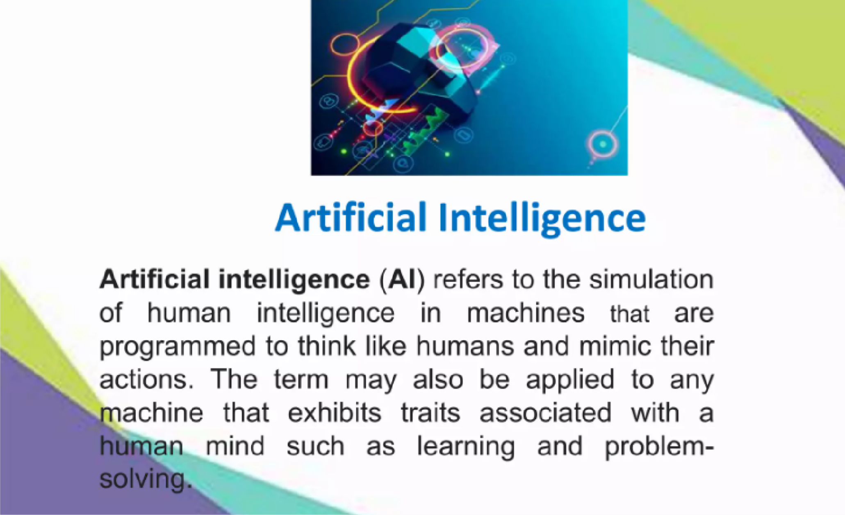

Slide 5
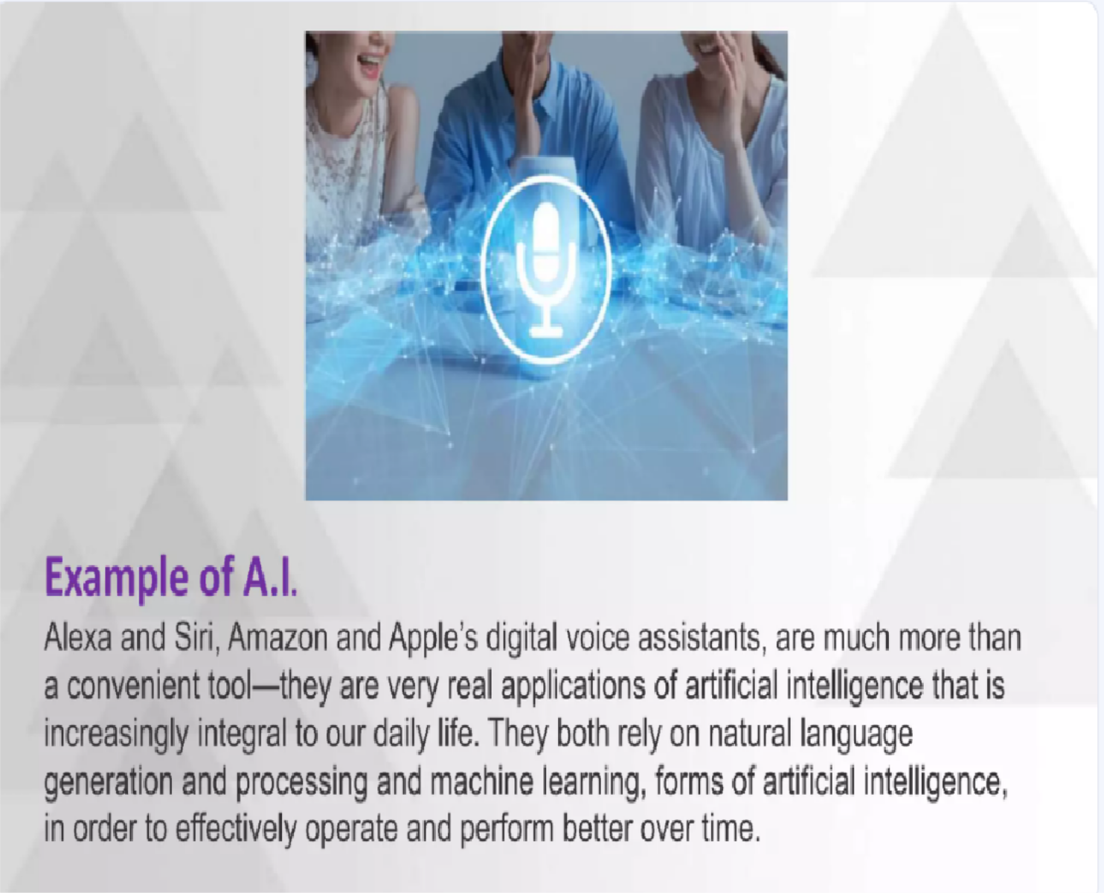

Slide 6
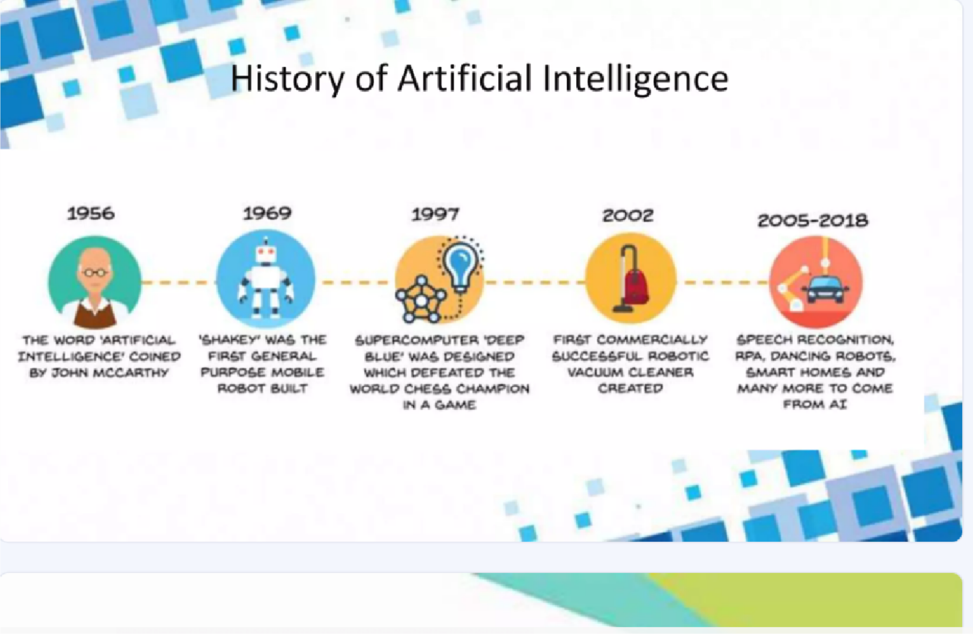

Slide 7
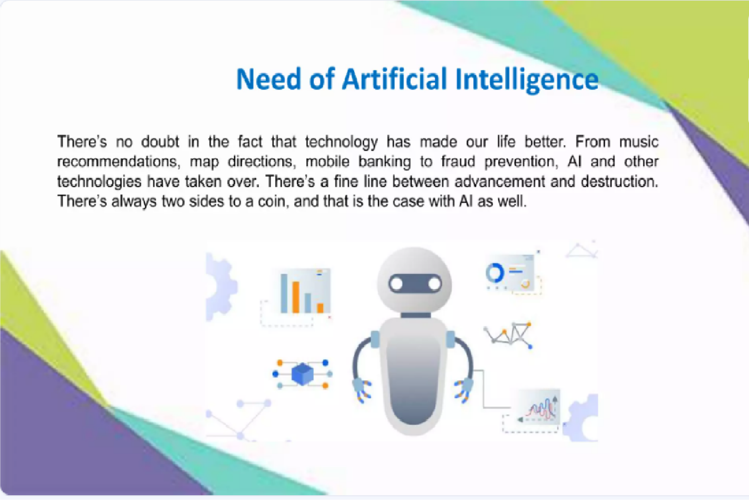

Slide 8
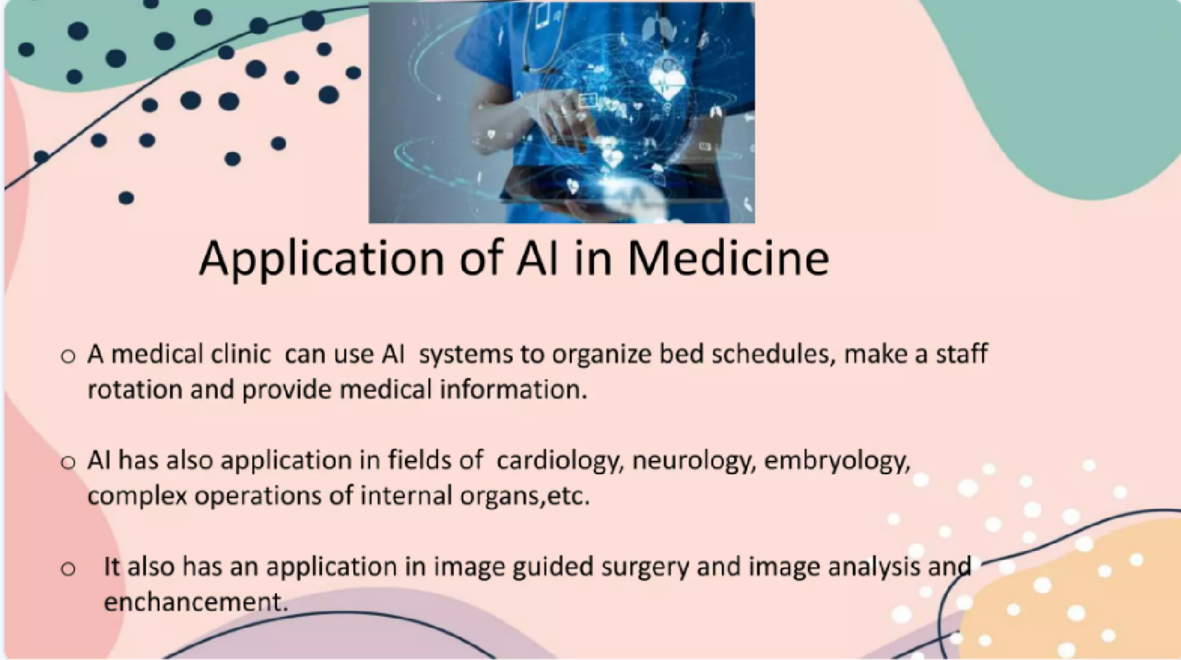

Slide 9


Slide 10
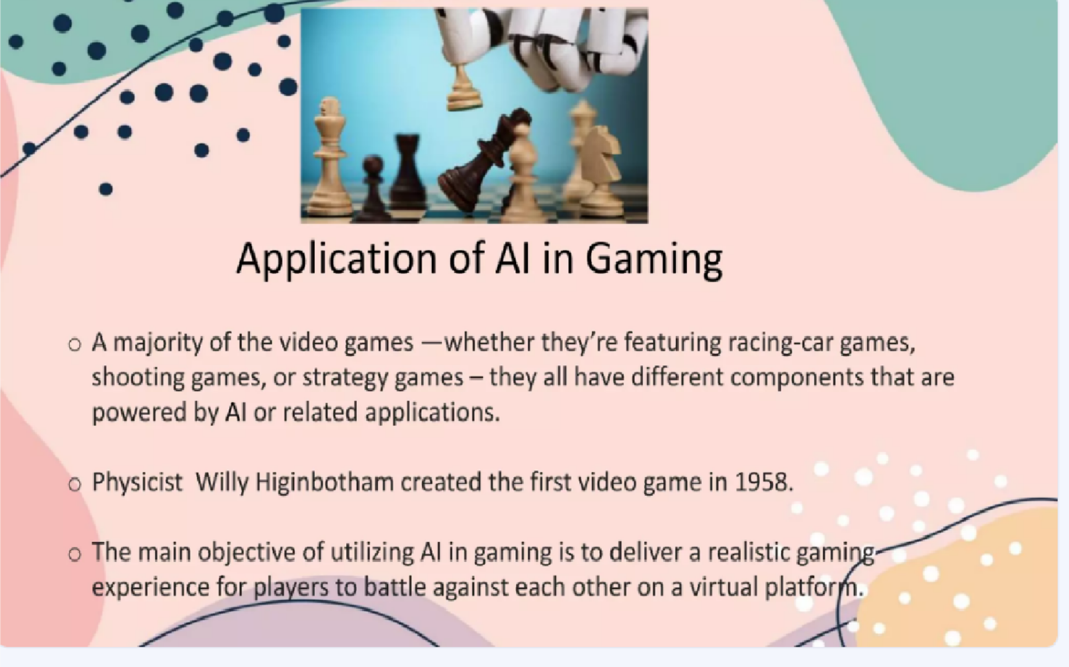

Slide 11
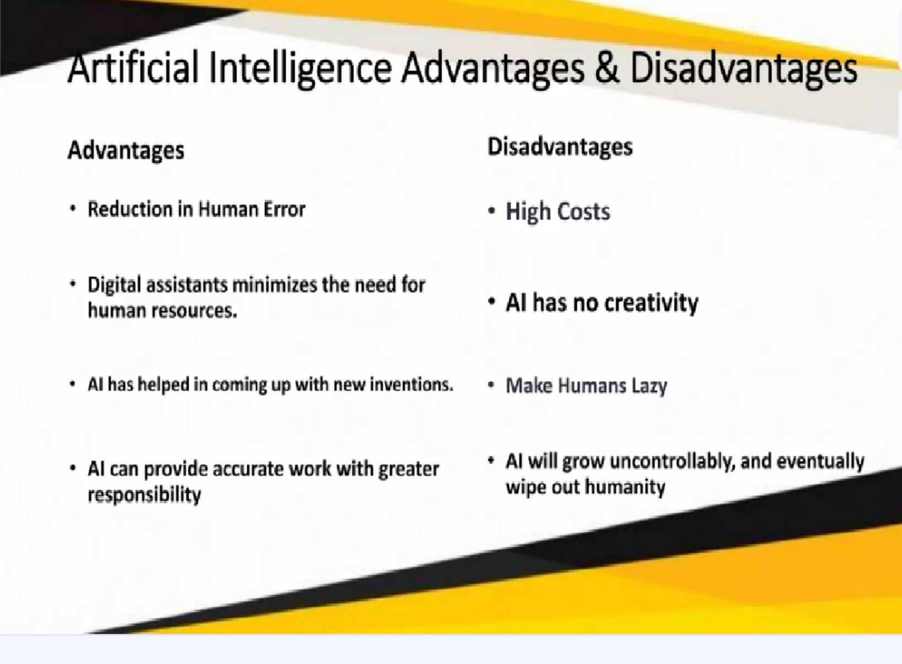

Slide 12
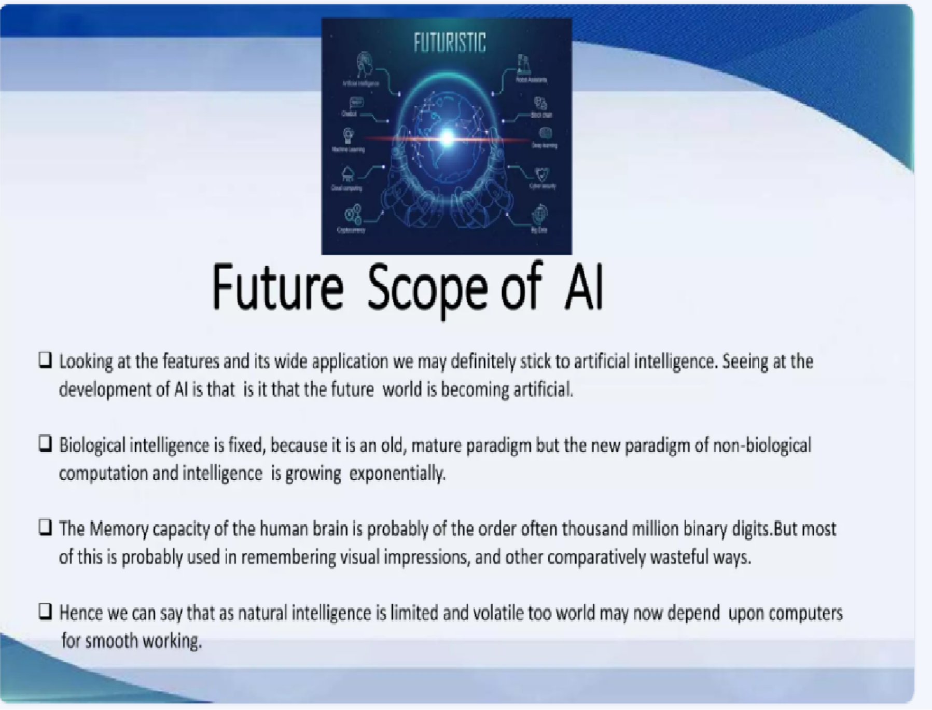

Slide 13
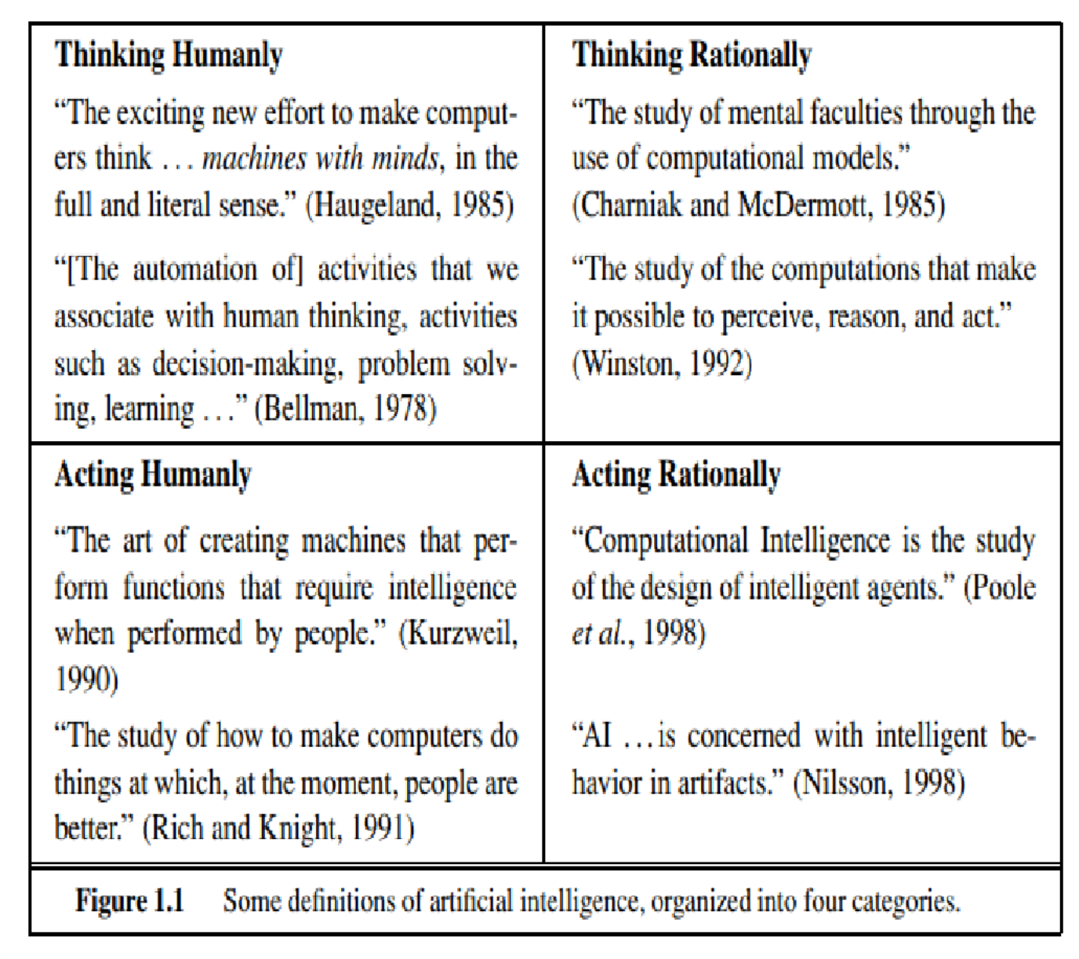

Slide 14
1. Acting Humanly: The Turing Test approach
The Turing Test is arguably one of the most well-known methods of evaluating how well artificial intelligence (AI) can think like a human.
The test was developed by British mathematician and computer scientist Alan Turing, who had been studying the concept of machine learning for several years beforehand.
Turing believed that a computer could be described as intelligent if it can mimic human responses under specific conditions.
The Turing Test, proposed by Alan Turing (1950), was designed to provide a satisfactory operational definition of intelligence
"The thing to remember is computers were giant room-based, vacuum- tube devices," Mark Reidl, associate director at the Georgia Tech Machine Learning Center, told ABC News. "But they were doing things that humans were doing, particularly breaking codes, solving math problems, things like that."
He continued, "So they started to think, 'Can this go further than that? What can they do that humans can do? Can they do what humans can

Slide 15
What is the Turing Test?
The Turing Test involves three players: a computer, a human respondent and a human interrogator. All three are placed in separate rooms or in the same room but physically separated by terminals.
The interrogator asks both players a series of questions and, after a period, tries to determine which player is the human and which is the computer.
•

Slide 16
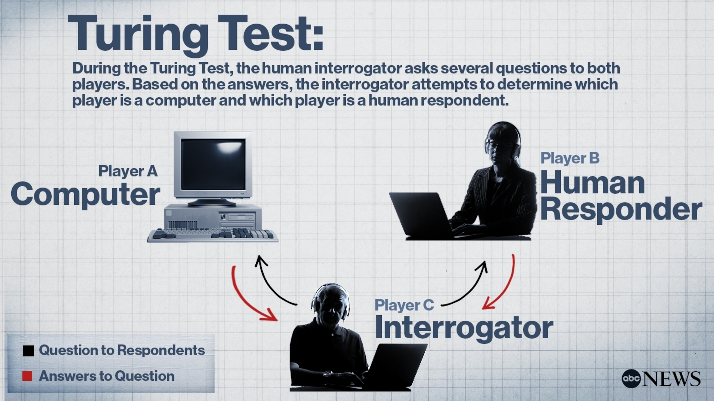

Slide 17
If the interrogator fails to determine which player is which, the computer is declared the winner and the machine is described as being able to think.
For now, we note that programming a computer to pass a rigorously applied test provides plenty to work on. The computer would need to possess the following capabilities:
natural language processing (NLP)to enable it to communicate successfully in English;
knowledge representation to store what it knows or hears;
automated reasoning to use the stored information to answer questions and to draw new conclusions;
machine learning to adapt to new circumstances and to detect and extrapolate patterns.

Slide 18
Turing’s test deliberately avoided direct physical interaction between the interrogator and the computer, because physical simulation of a person is unnecessary for intelligence. However, the so-called total Turing Test includes a video signal so that the interrogator can test the subject’s perceptual abilities, as well as the opportunity for the interrogator to pass physical objects “through the hatch.” To pass the total Turing Test, the computer will need
computer vision to perceive objects, and
robotics to manipulate objects and move about.

Slide 19
2. Thinking humanly: The cognitive modeling approach
If we are going to say that a given program thinks like a human, we must have some way of determining how humans think. We need to get inside the actual workings of human minds.
There are three ways to do this:
through introspection—trying to catch our own thoughts as
they go by;
through psychological experiments—observing a person in
action; and
through brain imaging—observing the brain in action.

Slide 20
For example, Allen Newell and Herbert Simon, who developed GPS,
the “General Problem Solver” (Newell and Simon, 1961), were not content merely to have their program solve problems correctly.
They were more concerned with comparing the trace of its reasoning steps to traces of human subjects solving the same problems.
The interdisciplinary field of cognitive science brings together
computer models from AI and experimental techniques from
psychology to construct precise and testable theories of the human mind.
Cognitive science is a fascinating field in itself, worthy of several textbooks and at least one encyclopedia.
In the early days of AI there was often confusion between the
approaches: an author would argue that an algorithm performs well on
a task and that it is therefore a good model of human performance, or vice versa.
Modern authors separate the two kinds of claims; this distinction has allowed both AI and cognitive science to develop more rapidly.
The two fields continue to fertilize each other, most notably in
computer vision, which incorporates neurophysiological evidence into computational models.

Slide 21
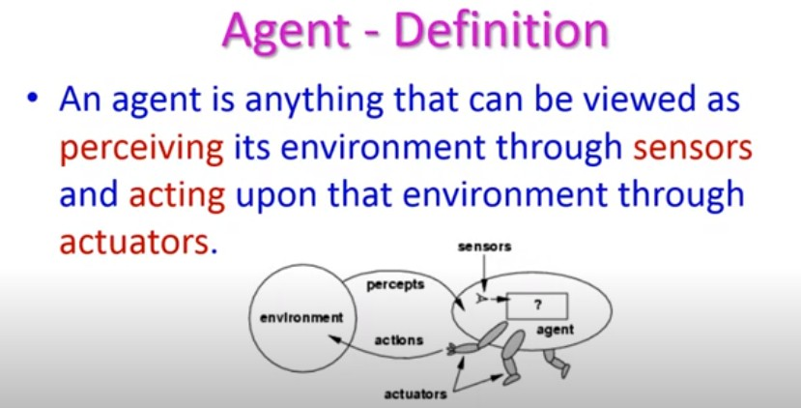

Slide 22
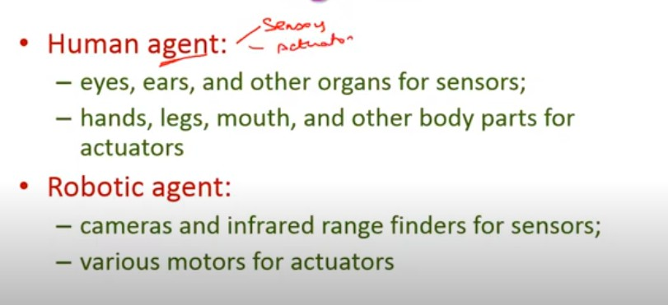
INPUT DEVICES --------SENSORS OUTPUT DEVICES-----ACTUATORS

Slide 23
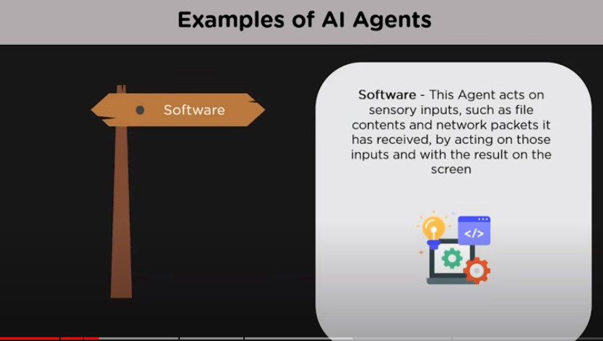

Slide 24
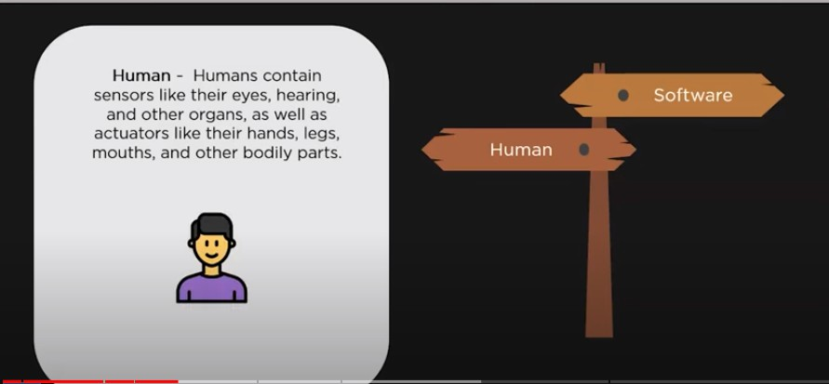

Slide 25
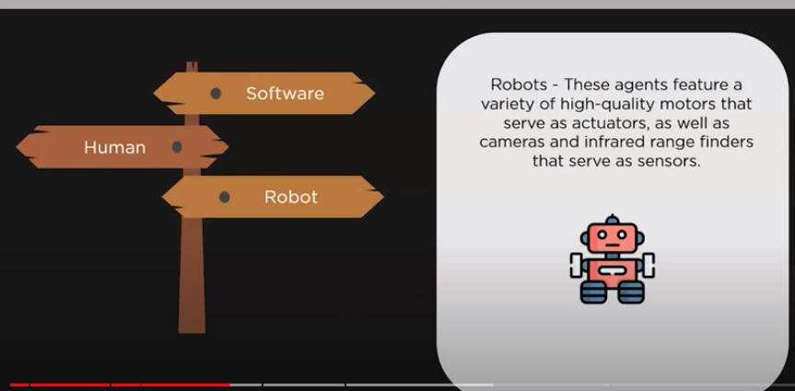

Slide 26
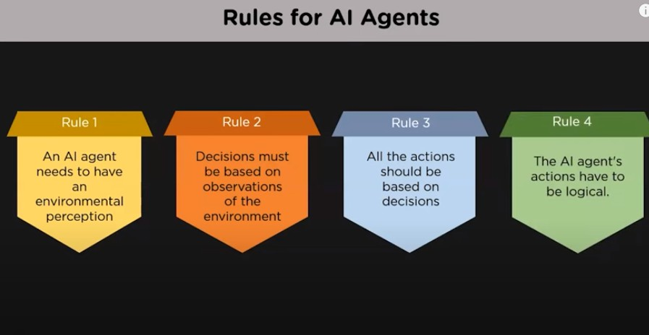

Slide 27
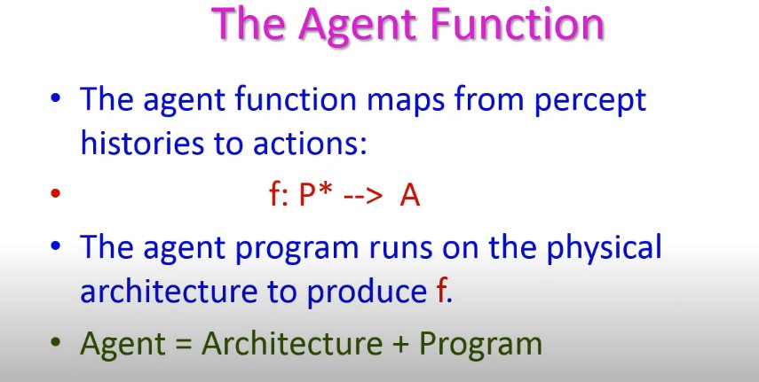
(History of past data) and current states of environment

Slide 28
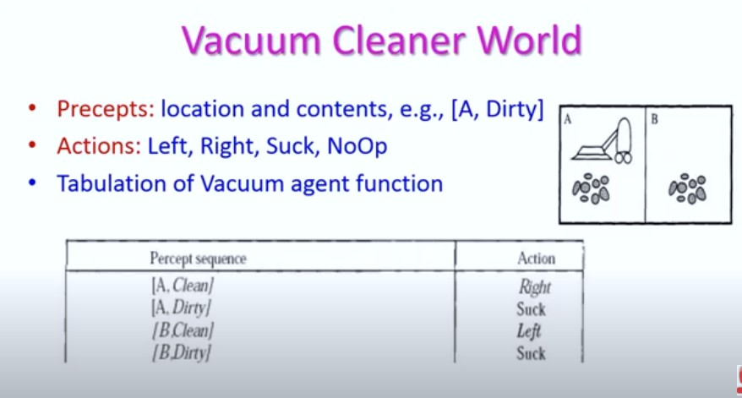
2
1
4
3
All clean –no op

Slide 29
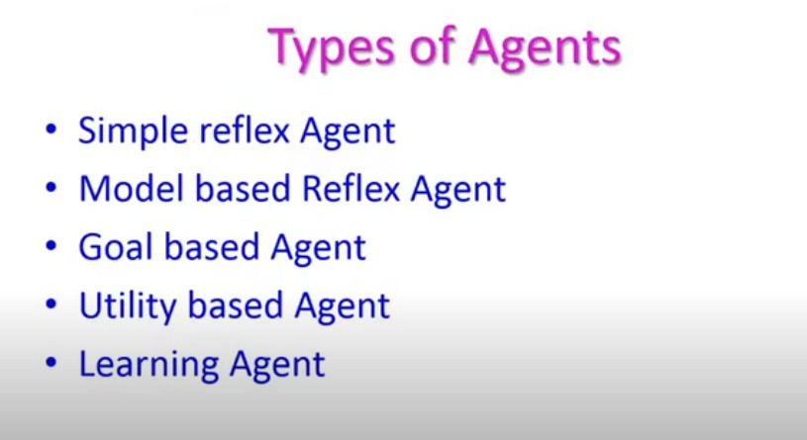

Slide 30
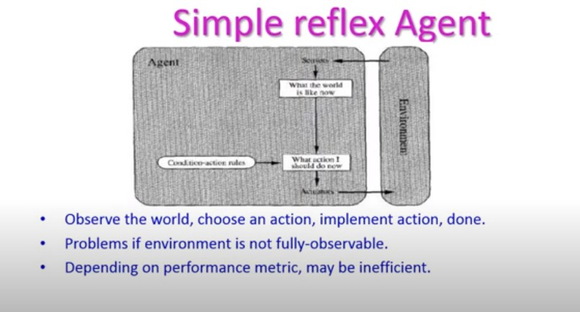
Cannot predict correct action

Slide 31
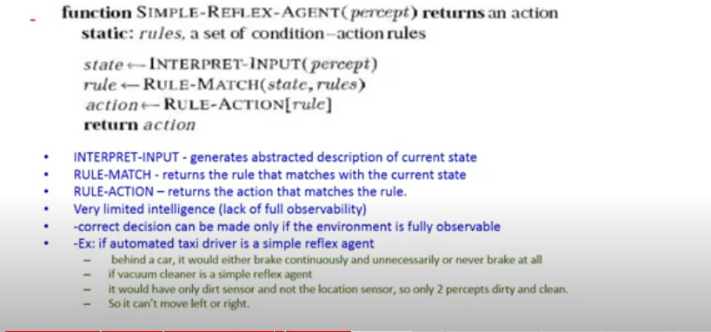

Slide 32
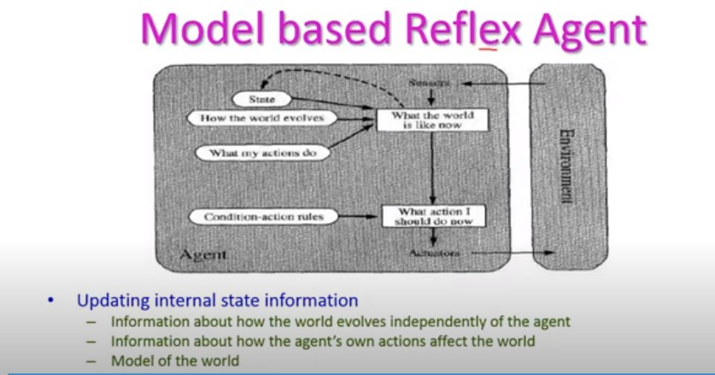
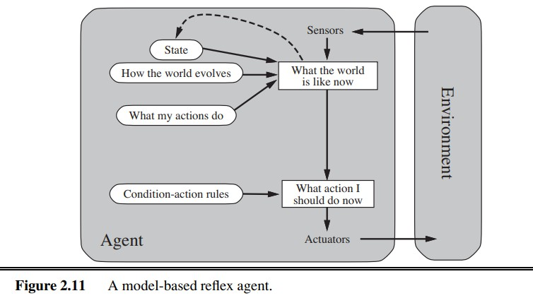

Slide 33
Simple reflex based: Work on fully observable condition(agent know about all knowledge of an environment)
If else condition(ex; AC)
Model based means knowledge based i.e past history of the environment
It works on current and past history(state)
Works on partial observable(agent does not know about all knowledge of an environment- Ex: self driving car)

Slide 34
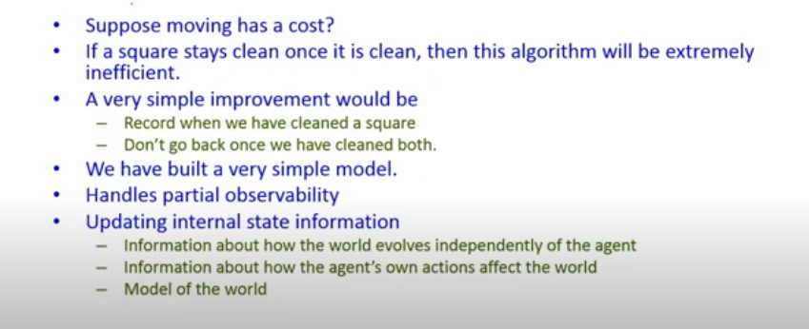

Slide 35
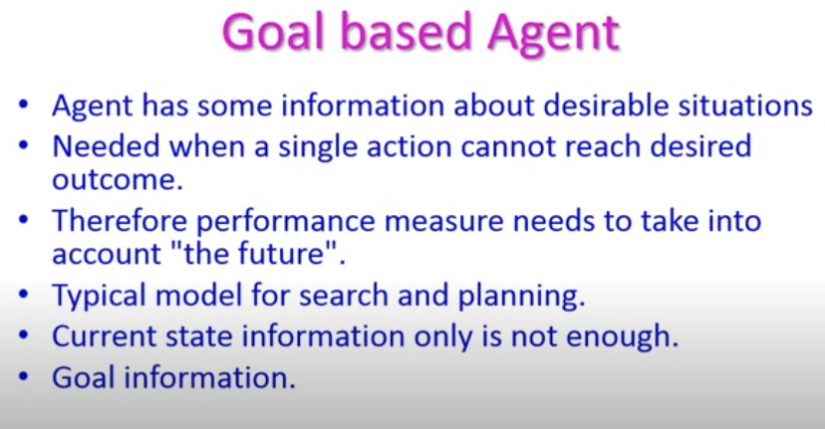

Slide 36
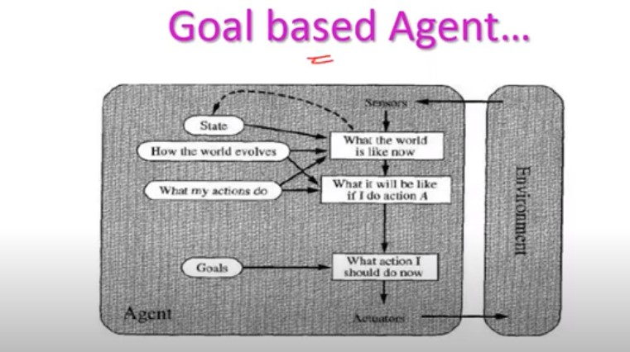
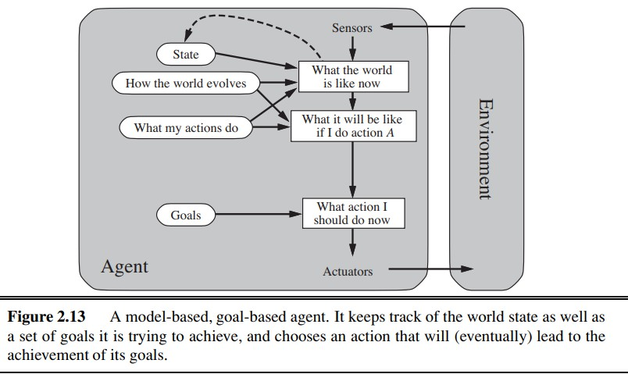

Slide 37
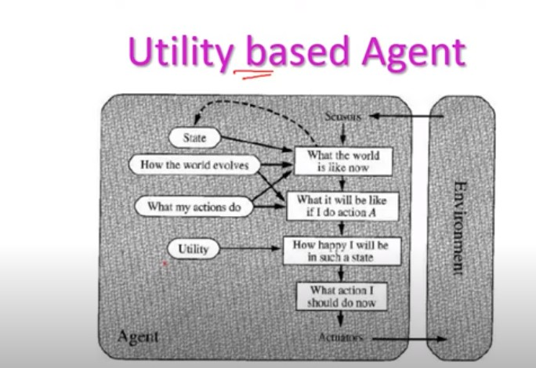
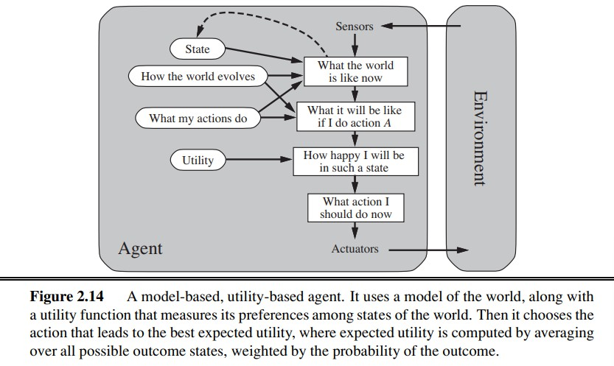

Slide 38
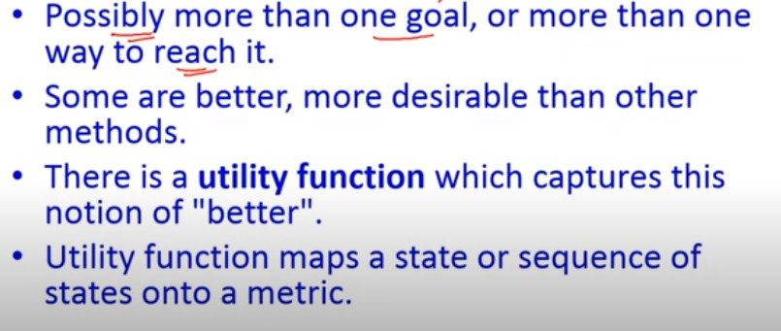

Slide 39
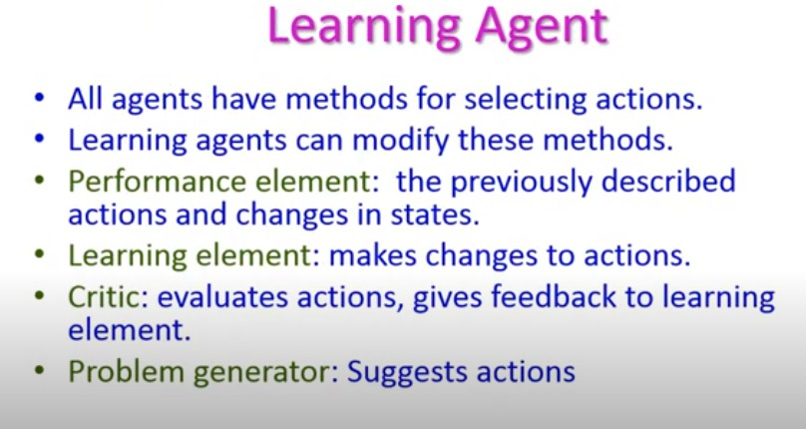

Slide 40
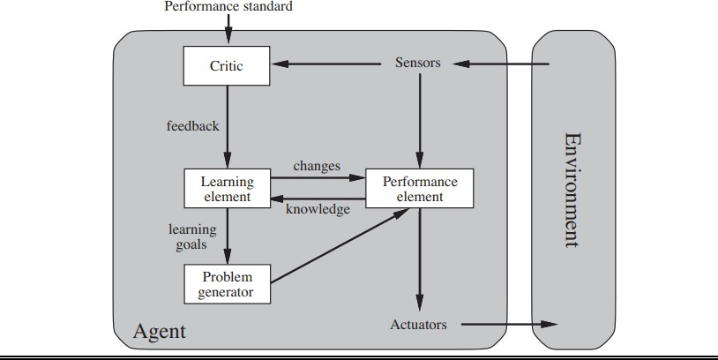

Slide 43
The nature of environment
Ø First, however, we must think about task environments, which are essentially the “problems” to which rational agents are the “solutions.”
Ø The flavor of the task environment directly affects the appropriate design for the agent program.
Specifying the task environment:
Ø In example of vacuum cleaner agent, we specified performance
measure, the environment, and the agent’s actuators and sensors.
Ø These all come under task environment.
Ø We call this as PEAS(Performance, Environment, Actuators, Sensors)

Slide 44
 Rationality in AI: Based on the idea of a rational agent, which is a theoretical
entity that makes decisions based on what's considered optimal. Rational
agents are used in AI to design intelligent systems and decision-making
processes. Some examples of how rationality is applied in AI include:
 Autonomous vehicles:
§ AI systems in autonomous vehicles use the principle of rationality to make
decisions about driving, such as changing lanes, adjusting speed, or stopping. These systems consider factors like traffic conditions, road rules, and obstacles to ensure the safest and most efficient route.
Ø Algorithmic Trading:
AI systems use the Principle of Rationality to make buy or sell decisions based on
market conditions, price trends, and financial indicators.
Ø Game theory and decision theory:
§ The concept of rational agents is used in these disciplines to help understand how people make decisions, which can then be applied to develop AI that can mimic human behavior.

Slide 45
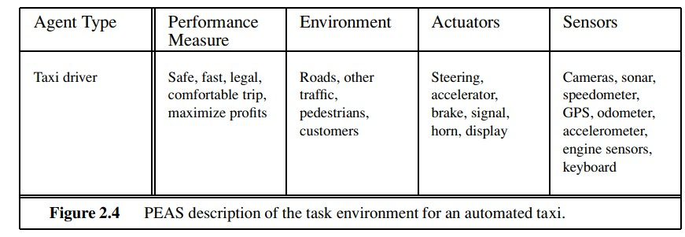
 Consider complex problem,an automated taxi driver.
 A fully automated taxi is currently somewhat beyond the capabilities of existing technology.
 The full driving task is extremely open-ended. There is no limit to the novel combinations of circumstances that can arise.

Slide 46
 1. performance measure: getting to the correct destination; minimizing fuel consumption and wear and tear; minimizing the trip time or cost; minimizing violations of traffic laws and disturbances to other drivers; maximizing safety and passenger comfort; maximizing profits.
 2. Environment:Any taxi driver must deal with a variety of roads, ranging from rural lanes and urban alleys to 12-lane freeways. The roads contain other traffic, pedestrians, stray animals, road works, police cars, puddles, and potholes.
 The taxi must also interact with potential and actual passengers. There are also some optional choices. The taxi might need to operate in Southern California, where snow is seldom a problem

Slide 47
Actuators:
 for an automated taxi include those available to a human driver: control over the engine through the accelerator and control over steering and braking. In addition, it will need output to a display screen or voice synthesizer to talk back to the passengers, and perhaps some way to communicate with other vehicles, politely.
Sensors:
Ø The basic sensors for the taxi will include one or more controllable video cameras so that it can see the road; it might augment these with infrared or sonar sensors to detect distances to other cars and obstacles.
Ø To avoid speeding tickets, the taxi should have a speedometer, and to control the vehicle properly, especially on curves, it should have an accelerometer. To determine the mechanical state of the vehicle, it will need the usual array of engine, fuel, and electrical system sensor.

Slide 48
 Like many human drivers, it might want a global positioning system
(GPS) so that it doesn’t get lost.
 Finally, it will need a keyboard or microphone for the passenger to request a destination.

Slide 49
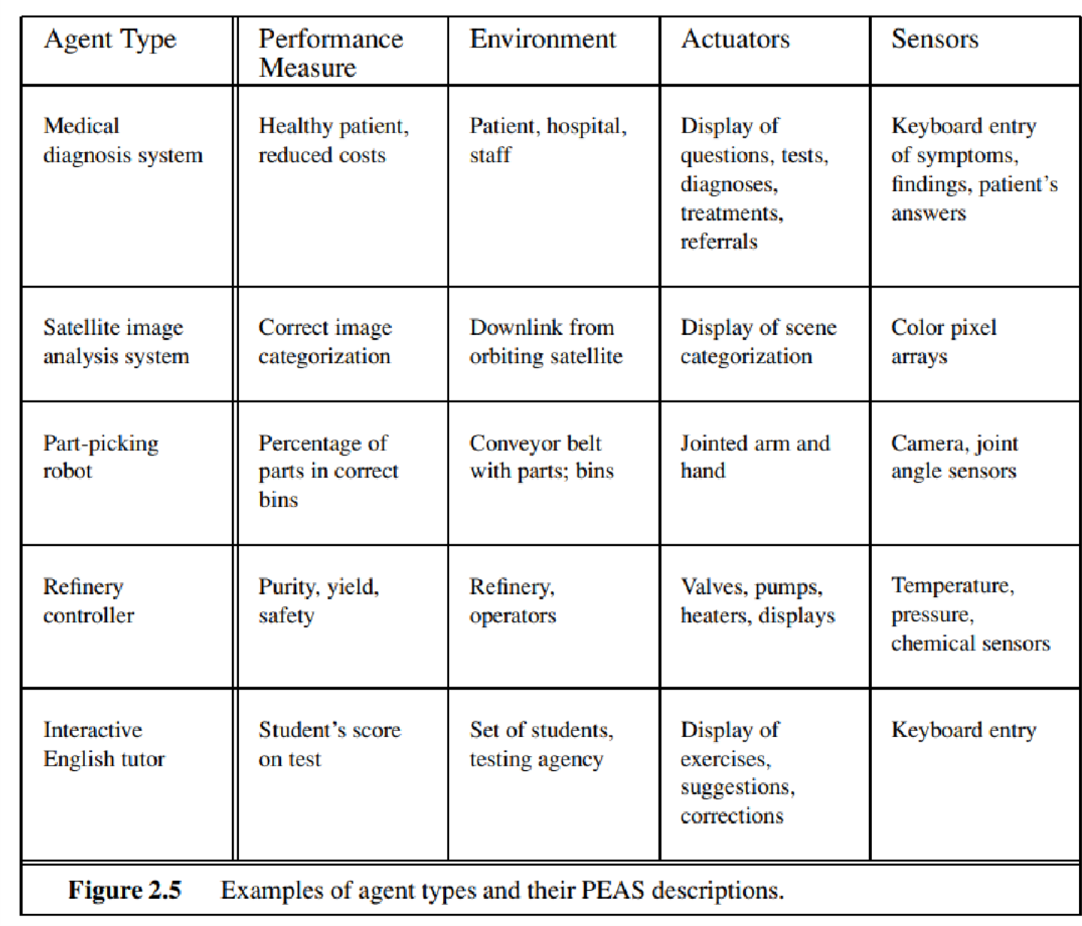
Examples of agent types and their PEAS descriptions.

Slide 50
 list of agent types includes some programs that operate in the entirely artificial environment defined by keyboard input and character output on a screen. “Surely,” one might say, “this is not a real environment, is it?”.
 Distinction between real and complexity distinction is complexity of the relationship among the behavior of the agent, the percept sequence generated by the environment, and the performance measure.

Slide 51
Properties of task environments
 Based on small number of dimensions along which task environments can be categorized.
 These dimensions determine, to a large extent, the appropriate agent design and the applicability of each of the principal families of techniques for agent implementation.
 1. Fully observable vs. partially observable
 2. Single agent vs. multiagent
 3. Deterministic vs. stochastic
 4. Episodic vs. sequential
 5. Static vs. dynamic
 6. Discrete vs. continuous
 7. Known Vs Unknown

Slide 52
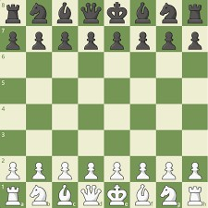
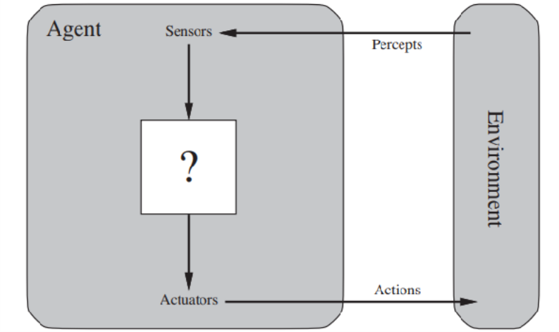
1. Fully observable vs. partially observable:
Ø If an agent’s sensor give it access to the complete state of the environment at each point in time, then we say that the task environment is fully observable.(An agent can always see the entire state of an environment. Ex: chess)
Ø A task environment is effectively fully observable if the sensors detect all aspects that are relevant to the choice of action;, depends on the performance measure.

Slide 53

Ø An environment might be partially observable because of noisy and inaccurate sensors or because parts of the state are simply missing from the sensor data.
Ø An agent can never see the entire state of an environment.
Ø EX: Card game

Slide 54
 for example, a vacuum agent with only a local dirt sensor cannot tell whether there is dirt in other squares, and an automated taxi cannot see what other drivers are thinking. If the agent has no sensors at all then the environment is unobservable.

Slide 55
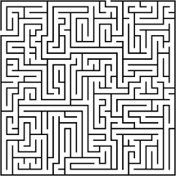
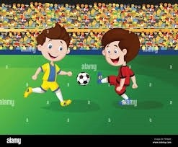
2. Single agent vs. multiagent:
 Single agent: if only one agent is involved in an environment and operating by itself
 Example : Maze
 Multiagent: if multiple agent are operating in an environment
 example: football

Slide 56
 Thus, chess is a competitive multiagent environment.
 In the taxi-driving environment, on the other hand, avoiding
of all agents, so it is a
collisions partially
maximizes the performance measure
cooperative multiagent environment. It is also partially competitive because, for example, only one car can occupy a parking space.
 The agent-design
problems in multiagent
environments environments;
are often for
quite
different from those in single-agent
often emerges as a rational
example, behavior in multiagent
communication
environments; in some competitive environments,

Slide 57
 For example, an agent solving a crossword puzzle by itself is clearly in a single-agent environment, whereas an agent playing chess is in a two agent environment.
 First we have to see how an entity may be viewed as an agent?
 Does an agent A (the taxi driver for example) have to treat an object B (another vehicle) as an agent, or can it be treated merely as an object behaving according to the laws of physics, analogous to waves at the beach or leaves blowing in the wind?
 The key distinction is whether B’s behavior is best described as maximizing a performance measure whose value depends on agent A’s behavior. For example, in chess, the opponent entity B is trying to maximize its performance measure, which, by the rules of chess, minimizes agent A’s performance measure.

Slide 58

3. Deterministic vs. stochastic.
 If the next state of the environment is completely determined by the current state and the action executed by the agent, then we say the environment is deterministic; otherwise, it is stochastic.
 Deterministic: An agent’s current state and selected action can be completely determine the next state of the environment.
 Ex: Tic Tac Toe

Slide 59
 Stochastic: A stochastic environment is random in nature and cannot be determined completely by an agent. Ex: Ludo
 If the environment is partially observable, however, then it could appear to be stochastic.
 Most real situations are so complex that it is impossible to keep track of all the unobserved aspects; for practical purposes, they must be treated as stochastic.

Slide 60
 Taxi driving is clearly stochastic in this sense, because one can never predict the behavior of traffic exactly; moreover, one’s tires blow out and one’s engine seizes up without warning.
 The vacuum world as we described it is deterministic, but variations can include stochastic elements such as randomly appearing dirt and an unreliable suction mechanism.
 environment is uncertain if it is not fully environment descriptions are usually associated with performance measures that require the agent to succeed for all possible outcomes of its actions.

Slide 61
 environment is uncertain if it is not fully observable or not deterministic.
 our use of the word “stochastic” generally implies that uncertainty
about outcomes is quantified in terms of probabilities; a
nondeterministic environment is one in which actions are
are
characterized by their possible outcomes, but no probabilities attached to them.
 Nondeterministic environment descriptions are usually associated with performance measures that require the agent to succeed for all possible outcomes of its actions.

Slide 62
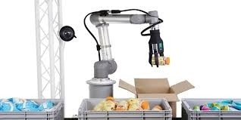
4. Episodic vs. sequential:
 Episodic: only the current percept is required for the action.
 Every episode is independent of each other.
 Ex: part picking robo
t
 Sequential: an agent requires memory of past actions to determine the next best actions.
 The current decision could affect all future decisions.
 Ex: chess

Slide 63
 In an episodic task environment, the agent’s experience is into atomic episodes.
 In each episode the agent receives a percept and then performs a single action. Crucially, the next episode does not depend on the actions taken in previous episodes. Many classification tasks are episodic.
 For example, an agent that has to spot defective parts on an assembly line bases each decision on the current part, regardless of previous decisions; moreover, the current decision doesn’t affect whether the next part is defective.

Slide 64
 in sequential environments, on the other hand, the current decision could affect all future decisions.
 Chess and taxi driving are sequential: in both cases, short-term actions can have long-term consequences. Episodic environments are much simpler than sequential environments because the agent does not need to think ahead.

Slide 65
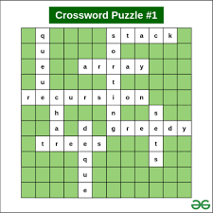

5. Static vs. dynamic:
 Static: the environment does not change while an agent is acting
 Ex: crossword puzzles.
 Dynamic: the environment may change over time.
 Ex: roller coaster ride taxi driving.

Slide 66
 If the environment can change while an agent is deliberating, then we say the environment is dynamic for that agent; otherwise, it is static.
 Static environments are easy to deal with because the agent need not keep looking at the world while it is deciding on an action, nor need it worry about the passage of time.
 Dynamic environments, on the other hand, are continuously asking the agent what it wants to do; if it hasn’t decided yet, that counts as deciding to do nothing.

Slide 67
 If the environment itself does not change with the passage of time but the agent’s performance score does, then we say the environment is semi-dynamic.
 Taxi driving is clearly dynamic: the other cars and the taxi itself keep moving while the driving algorithm dithers about what to do next. Chess, when played with a clock, is semi-dynamic.
 Crossword puzzles are static.

Slide 68
6. Discrete vs. continuous
 Discrete: the environment consists of finite number of actions that can be deliberated in the environment to obtain the output.
 ex: Chess
 Continuous: the environment in which the actions performed cannot be numbered i.e is not discrete
 Ex: self driving cars
 The discrete/continuous distinction applies to the state of the environment, to the way time is handled, and to the percepts and actions of the agent.
 For example, the chess environment has a finite number of distinct states (excluding the clock). Chess also has a discrete set of percepts and actions.

Slide 69
 Taxi driving is a continuous-state and continuous-time problem: the speed and location of the taxi and of the other vehicles sweep through a range of continuous values and do so smoothly over time.
 Taxi-driving actions are also continuous (steering angles, etc.). Input from digital cameras is discrete, strictly speaking, but is typically treated as representing continuously varying intensities and location.

Slide 70

7. Known Vs Unknown:
 Known: in a known environment, the results for all actions are known to the agent.
 Ex: card game
 Unknown: in an unknown environment, agent needs to learn how it works in order to perform an action
 Ex: a new video game

Slide 71
 Strictly speaking, this distinction refers not to the environment itself but to the agent’s (or designer’s) state of knowledge about the “laws of physics” of the environment.
 In a known environment, the outcomes (or outcome probabilities if the environment is stochastic) for all actions are given.
 Obviously, if the environment is unknown, the agent will have to learn how it works in order to make good decisions.
 Note that the distinction between known and unknown environments is not the same as the one between fully and partially observable environments.
 It is quite possible for a known environment to be partially observable—for example, in solitaire card games, I know the rules but am still unable to see the cards that have not yet been turned over.
 Conversely, an unknown environment can be fully observable—in a new video game, the screen may show the entire game state but I still don’t know what the buttons do until I try them.

Slide 72
