Slide 1


























Module 5
BASIC PROCESSING

Slide 2
Overview
Instruction Set Processor (ISP) – executes machine instructions and coordinates the activities of other cells.
  Also called Central Processing Unit (CPU)
A typical computing task consists of a series of steps specified by a sequence of machine instructions that constitute a program.
An instruction is executed by carrying out a sequence of more rudimentary operations.

Slide 3
Some Fundamental Concepts

Slide 4
Fundamental Concepts
Processor fetches one instruction at a time and performs the operation specified.
Instructions are fetched from successive memory locations until a branch or a jump instruction is encountered.
Processor keeps track of the address of the memory location containing the next instruction to be fetched using Program Counter (PC).
After fetching an instruction, the contents of the PC are updated to point to the next instruction in the sequence.
  A branch instruction may load a different value into the PC.

Slide 5
Steps in Executing an Instruction
Fetch the contents of the memory location pointed to by the PC. The contents of this location are loaded into the instruction register IR (fetch phase).
IR ← [[PC]]
Assuming that the memory is byte addressable, increment the contents of the PC by 4 (fetch phase).
PC ← [PC] + 4
Carry out the actions specified by the instruction in the IR (execution phase).

Slide 6

Processor Organization
Internal processor bus
Control signals
PC
Instruction decoder and control logic
Address lines
MDR HAS TWO INPUTS AND TWO OUTPUTS
MAR
Memory bus
Data lines
MDR
IR
Datapath
Y
Constant 4
R0
Select
MUX
Add
A
B
ALU
control lines
Sub
R ( n - 1)
ALU
XOR
Carry-in
TEMP
Textbook Page 413
Z

Slide 7
Processor Organization..
Figure 7.1 shows an organization in which the ALU and all the registers are interconnected via a single common bus.
This bus is internal to the processor.
The data and address lines of the external memory bus are connected to the internal processor bus via the memory data register, MDR, and the memory address register, MAR, respectively.
Register MDR has two inputs and two outputs.

Slide 8
Processor Organization..
Data may be loaded into MDR either from the memory bus or from the internal processor bus.
The data stored in MDR may be placed on either bus.
The input of MAR is connected to the internal bus, and its output is connected to the external bus.
The control lines of the memory bus are connected to the instruction decoder and control logic block.
  This unit is responsible for issuing the signals that control the operation of all the units inside the processor and for interacting with the memory bus.

Slide 9
Processor Organization..
The number and use of the processor registers R0 through R(n - 1) vary considerably from one processor to another.
Registers may be provided for general-purpose use by the programmer.
  Some may be dedicated as special-purpose registers, such as index registers or stack pointers.
The registers, Y, Z, and TEMP are used by the processor for temporary storage during execution of some instructions.
  These registers are never used for storing data generated
by one instruction for later use by another instruction.

Slide 10
Processor Organization..
The multiplexer MUX selects either the output of register Y or a constant value 4 to be provided as input A of the ALU.
  The constant 4 is used to increment the contents of the
program counter.
We will refer to the two possible values of the MUX control input Select as Select4 and SelectY for selecting the constant 4 or register Y, respectively.

Slide 11
Processor Organization..
As instruction execution progresses, data are transferred from one register to another, often passing through the ALU to perform some arithmetic or logic operation.
The instruction decoder and control logic unit is responsible for implementing the actions specified by the instruction loaded in the IR register.
The decoder generates the control signals needed to select the registers involved and direct the transfer of data.
The registers, the ALU, and the interconnecting bus are collectively referred to as the datapath.

Slide 12
Sequence of Steps in Executing an Instruction
Transfer a word of data from one processor register to another or to the ALU.
Perform an arithmetic or a logic operation and store the result in a processor register.
Fetch the contents of a given memory location and load them into a processor register.
Store a word of data from a processor register into a given memory location.

Slide 13
Register Transfers
Instruction execution involves a sequence of steps in which data are transferred from one register to another.
For each register, two control signals are used to place the contents of that register on the bus or to load the data on the bus into the register.
This is represented symbolically in Figure 7.2.
The input and output of register Ri are connected to the bus via switches controlled by the signals Ri_{in} and Ri_{out} respectively.

Slide 14
Register Transfers..
When Ri_{in} is set to 1, the data on the bus are loaded into Ri.
Similarly, when Ri_{out} is set to 1, the contents of register Ri are placed on the bus.
While Ri_{out} is equal to 0, the bus can be used for transferring data from other registers.

Slide 15
Register Transfers..
Internal processor bus
R i_{in}
R i
Riout
Y in
Y
Constant 4
Select
MUX
A
B
ALU
Z in
Z
Z out
Figure 7.2. Input and output gating for the registers in Figure 7.1.

Slide 16
Register Transfers..
Suppose that we wish to transfer the contents of register R1 to register R4.
This can be accomplished as follows:
  Enable the output of register R1 by setting R1_{out} to 1. This places the contents of R1 on the processor bus.
  Enable the input of register R4 by setting R4_{in} to 1. This loads data from the processor bus into register R4.
All operations and data transfers within the processor take place within time periods defined by the processor clock.

Slide 17
Register Transfers..
An implementation for one bit of register Ri is shown in Figure 7.3 as an example.
A two-input multiplexer is used to select the data applied to the input of an edge-triggered D flip- flop.
When the control input Ri_{in} is equal to 1, the multiplexer selects the data on the bus.
  This data will be loaded into the flip-flop at the rising edge of the clock.
When Ri_{in} is equal to 0, the multiplexer feeds back the value currently stored in the flip-flop.

Slide 18
Register Transfers..
The Q output of the flip-flop is connected to the bus via a tri-state gate.
When Ri_{out} is equal to 0, the gate's output is in the high-impedance (electrically disconnected) state.
  This corresponds to the open-circuit state of a switch.
When Ri_{out} = 1, the gate drives the bus to 0 or 1, depending on the value of Q.

Slide 19
Register Transfers..
Bus
0
D
Q
1
Q
^{Ri}iout
Ri_{in}
Clock
Figure 7.3. Input and output gating for one register bit.

Slide 20
Performing an Arithmetic or Logic Operation
The ALU is a combinational circuit that has no internal storage.
  It performs arithmetic and logic operations on the two operands applied to its A and B inputs.
ALU gets the two operands from MUX and bus. The result is temporarily stored in register Z.
The sequence of operations to add the contents of register R1 to those of R2 and store the result in R3.
1.
^{R1}out^{, Y}in
2. R2_{out}, SelectY, Add, Z_{in}
3.
^{Z}out^{, R3}in

Slide 21
Performing an Arithmetic or Logic Operation..
The signals whose names are given in any step are activated for the duration of the clock cycle corresponding to that step.
  All other signals are inactive.
In step 1, the output of register R1 and the input of register Y are enabled, causing the contents of RI to be transferred over the bus to Y.

Slide 22
Performing an Arithmetic or Logic Operation..
In step 2, the multiplexer's Select signal is set to SelectY, causing the multiplexer to gate the contents of register Y to input A of the ALU.
  At the same time, the contents of register R2 are gated
onto the bus and, hence, to input B.
  The Add line is set to 1, causing the output of the ALU to be the sum of the two numbers at inputs A and B.
  This sum is loaded into register Z because its input
control signal is activated.
In step 3, the contents of register Z are transferred to the destination register, R3.

Slide 23
Fetching a Word from Memory
To fetch a word of information from memory, the processor has to specify the address of the memory location where this information is stored and request a Read operation.
The information to be fetched may be an instruction in a program or an operand specified by an instruction.
The processor transfers the required address to the MAR, whose output is connected to the address lines of the memory bus.

Slide 24
Fetching a Word from Memory..
At the same time, the processor uses the control lines of the memory bus to indicate that a Read operation is needed.
When the requested data are received from the memory they are stored in register MDR,
From MDR, they can be transferred to other registers in the processor.

Slide 25
Fetching a Word from Memory..
Memory-bus data lines
Internal processor bus
^{MDR}outE
MDR_{out}
MDR
MDR_{inE}
MDR_{in}
Figure 7.4. Connection and control signals for register MDR.

Slide 26
Fetching a Word from Memory..
The connections for register MDR are illustrated in Figure 7.4.
It has four control signals:
  MDR_{in} and MDR_{out} control the connection to the
internal bus.
  MDR_{inE} and MDR_{outE} control the connection to the external bus.

Slide 27
Fetching a Word from Memory..
During memory Read and Write operations, the timing of internal processor operations must be coordinated with the response of the addressed device on the memory bus.
The processor completes one internal data transfer in one clock cycle.

Slide 28
Fetching a Word from Memory..
The response time of each memory access varies (based on cache miss, memory-mapped I/O, etc).
To accommodate this, the processor waits until it receives an indication that the requested operation has been completed.
A control signal called Memory-Function-Completed (MFC) is used for this purpose.
The addressed device sets this signal to 1 to indicate that the contents of the specified location have been read and are available on the data lines of the memory bus.

Slide 29
Fetching a Word from Memory..
Consider the instruction Move (R1), R2
The actions needed to execute this instruction are:
MAR ← [R1]
Start a Read operation on the memory bus
Wait for the MFC response from the memory
Load MDR from the memory bus
R2 ← [MDR]

Slide 30
Fetching a Word from Memory..
The memory read operation requires three steps, which can be described by the signals being activated as follows:
R1_{out}, MAR_{in}, Read
MDR_{inE}, WMFC
MDR_{out}, R2_{in}

Slide 31
Timing
Step
1
2
3
Clock
 |  |  |  |  | ← [R1]
 |  |  |  | MAR
MAR
in
Assume MAR
is always available on the address lines of the memory bus.
Address
Start a Read operation on the memory bus
Read
MR
MDR _{inE}
Data
Wait for the MFC response from the memory
MFC
MDR _{out}
Load MDR from the memory bus
R2 ← [MDR]
Figure 7.5.
T iming of a memory Read operation.

Slide 32
Storing a Word in Memory
The desired address is loaded into MAR.
The data to be written are loaded into MDR and a Write command is issued.
Executing the instruction Move R2,(R1) requires the following sequence:
R1_{out}, MAR_{in}
R2_{out}, MDR_{in}, Write
MDR_{outE},WMFC

Slide 33
Execution of a Complete Instruction
Consider the instruction Add (R3), R1
Executing this instruction requires the following actions:
Fetch the instruction
Fetch the first operand (the contents of the memory location pointed to by R3)
Perform the addition
Load the result into R1

Slide 34
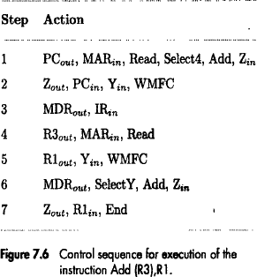
Execution of a Complete Instruction..
Add (R3), R1

Slide 35
Execution of a Complete Instruction..
Figure 7.6 gives the sequence of control steps required to perform these operations for the single-bus architecture of Figure 7.1.
Steps 1 through 3 constitute the instruction fetch phase,
This is the same for all instructions.
The instruction decoding circuit interprets the contents of the IR at the beginning of step 4.
This enables the control circuitry to activate the control signals for steps 4 through 7, which constitute the execution phase.

Slide 36
Execution of Branch Instructions
A branch instruction replaces the contents of PC with the branch target address
This address is usually obtained by adding an offset X given in the branch instruction, to the updated value of the PC.

Slide 37
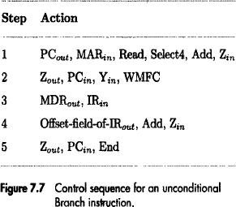
Execution of Branch Instructions..

Slide 38
Execution of Branch Instructions..
Figure 7.7 gives a control sequence that implements an
unconditional branch instruction.
Processing starts with the fetch phase.
This phase ends when the instruction is loaded into the
IR in step 3.
The offset value is extracted from the IR by the instruction decoding circuit, which will also perform sign extension if required.
Since the value of the updated PC is already available in register Y, the offset X is gated onto the bus in step 4, and an addition operation is performed.
The result, which is the branch target address, is loaded into the PC in step 5.

Slide 39
Execution of Branch Instructions..
The offset X is usually the difference between the branch target address and the address immediately following the branch instruction.
  For example, if the branch instruction is at location 2000 and if the branch target address is 2050, the value of X must be 46.

Slide 40
Execution of Branch Instructions..
Consider now a conditional branch.
In this case, we need to check the status of the condition codes before loading a new value into the PC.
For example, for a Branch-on-negative (Branch <0) instruction, step 4 in Figure 7.7 is replaced with
Thus, if N = 0 the processor returns to step 1 immediately after step 4.
If N = 1, step 5 is performed to load a new value into the PC, thus performing the branch operation.

Slide 41
Multiple-Bus Organization
To reduce the number of steps needed, most commercial processors provide multiple internal paths that enable several transfers to take place in parallel.
Figure 7.8 depicts a three-bus structure used to connect the registers and the ALU of a processor.

Slide 42

Multiple-Bus Organization..
Bus A Bus B Bus C
Incrementer
PC
Register file
Constant 4
MUX
A
ALU R
B
Instruction decoder
IR
MDR
MAR
Memory b us data lines
Address lines

Slide 43
Multiple-Bus Organization..
All general-purpose registers are combined into a single block called the register file.
  Implemented in the form of an array of memory cells.
The register file in Figure 7.8 is said to have three ports.
  There are two outputs, allowing the contents of two different registers to be accessed simultaneously and have their contents placed on buses A and B.
  The third port allows the data on bus C to be loaded into a third register during the same clock cycle.

Slide 44
Multiple-Bus Organization..
Buses A and B are used to transfer the source operands to the A and B inputs of the ALU, where an arithmetic or logic operation may be performed.
The result is transferred to the destination over bus C.
If needed, the ALU may simply pass one of its two input operands unmodified to bus C.
  We will call the ALU control signals for such an operation R=A or R=B.

Slide 45
Multiple-Bus Organization..
The Incrementer unit is used to increment the PC by 4.
  Using the Incrementer eliminates the need to add 4 to the PC using the main ALU.
The source for the constant 4 at the ALU input multiplexer is still useful.
  It can be used to increment other addresses, such as the memory addresses in LoadMultiple and StoreMultiple instructions.

Slide 46
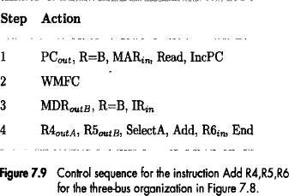
Multiple-Bus Organization..
Consider the three-operand instruction Add R4, R5, R6

Slide 47
Multiple-Bus Organization..
In step 1, the contents of the PC are passed through the ALU, using the R=B control signal, and loaded into the MAR to start a memory read operation.
  At the same time the PC is incremented by 4.
In step 2, the processor waits for MFC and loads the data received into MDR, then transfers them to IR in step 3.
Finally, the execution phase of the instruction requires only one control step to complete, step 4.

Slide 48
Hardwired Control

Slide 49
Overview
To execute instructions, the processor must have some means of generating the control signals needed in the proper sequence.
Two categories:
  Hardwired control
  Microprogrammed control
Hardwired system can operate at high speed; but with little flexibility.

Slide 50
Hardwired Control – Control Unit Organization
Consider the sequence of control signals given in Figure 7.6.
Each step in this sequence is completed in one clock period.
A counter may be used to keep track of the control steps, as shown in Figure 7.10.
Each state, or count, of this counter corresponds to one control step.

Slide 51
Control Unit Organization
Clock
CLK
Control step counter
Decoder/ encoder
External inputs
IR
Condition codes
Control signals
Figure 7.10. Control unit organization.

Slide 52
Control Unit Organization..
The required control signals are determined by the following information:
  Contents of the control step counter
  Contents of the instruction register
  Contents of the condition code flags
  External input signals, such as MFC and interrupt requests

Slide 53
Control Unit Organization..
The decoder/encoder block in Figure 7.10 is a combinational circuit that generates the required control outputs, depending on the state of all its inputs.
By separating the decoding and encoding functions, we obtain the more detailed block diagram in Figure 7.11.

Slide 54
Control Unit Organization - Detailed Block Description
Clock
CLK
Control step counter
Reset
Step decoder
T ₁ T₂ T _{n}
IR
Instruction decoder | INS ₁
 | INS ₂
 | INS _{m}
Encoder
 | External inputs
 | Condition codes
Run
End
Control signals
Figure 7.11.
Separation of the decoding and encoding functions.

Slide 55
Control Unit Organization..
The step decoder provides a separate signal line for each step, or time slot, in the control sequence.
Similarly, the output of the instruction decoder consists of a separate line for each machine instruction.
For any instruction loaded in the IR, one of the output lines INS₁ through INS_{m} is set to 1, and all other lines are set to 0.
The input signals to the encoder block are combined to generate the individual control signals Y_{in}, PC_{out}, Add, End, and so on.

Slide 56
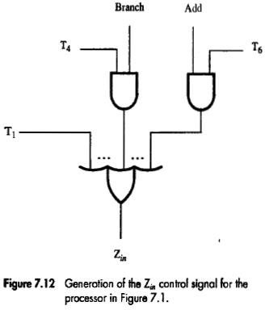
Generating Z_{in}
Z_{in} = T₁ + T₆ • ADD + T₄ • BR + …
This signal is asserted during time slot T1 for all instructions, during T6 for an Add instruction, during T4 for an unconditional branch instruction, and so on.

Slide 57
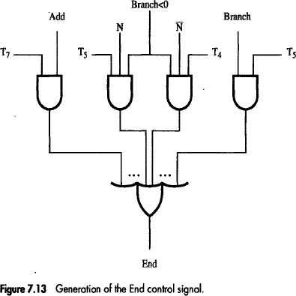
Generating End
End = T₇ • ADD + T₅ • BR + (T₅ • N + T₄ • N) • BRN +…
The End signal starts a new instruction fetch cycle by resetting the control step counter to its starting value.

Slide 58
Control Unit Organization..
Figure 7.11 contains another control signal called RUN.
When set to 1, RUN causes the counter to be incremented by one at the end of every clock cycle.
When RUN is equal to 0, the counter stops counting.
  This is needed whenever the WMFC signal is issued, to
cause the processor to wait for the reply from the memory.

Slide 59
Control Unit Organization..
The control hardware shown in Figure 7.10 or 7.11 can be viewed as a state machine that changes from one state to another in every clock cycle,
  Depends on the contents of the instruction register, the
condition codes, and the external inputs.
  The outputs of the state machine are the control signals.
The sequence of operations carried out by this machine is determined by the wiring of the logic elements, hence the name "hardwired.“
  A controller that uses this approach can operate at high speed.
  However, it has little flexibility, and the complexity of the
instruction set it can implement is limited.

Slide 60
A Complete Processor

Slide 61
A Complete Processor
Instruction unit
Integer unit
Floating-point unit
Instruction cache
Data cache
Bus interface
Processor
System bus
Main memory
Input/ Output
Figure 7.14. Block diagram of a complete processo. r

Slide 62
A Complete Processor..
A complete processor can be designed using the structure shown in Figure 7.14.
This structure has an instruction unit that fetches instructions from an instruction cache or from the main memory when the desired instructions are not already in the cache.
It has separate processing units to deal with integer data and floating-point data.
A data cache is inserted between these units and the main memory.

Slide 63
A Complete Processor..
A single cache can be used to store both instructions and data or separate caches can be used for instructions and data.
The processor is connected to the system bus and, hence, to the rest of the computer, by means of a bus interface.
A processor may include several integer or floating-point units to increase the potential for concurrent operations.

Slide 64
Microprogrammed Control

Slide 65
Overview
Control signals are generated by a program similar to machine language programs.
A control word (CW) is a word whose individual bits represent the various control signals.
A sequence of CWs corresponding to the control sequence of a machine instruction constitutes the microroutine for that instruction.
The individual control words in this microroutine are referred to as microinstructions.

Slide 66
Microprogrammed Control
Each of the control steps in the control sequence of an instruction defines a unique combination of 1s and 0s in the CW.
The CWs corresponding to the 7 steps of Figure 7.6 are shown in Figure 7.15.
We have assumed that SelectY is represented by Select=0 and Select4 by Select=1.

Slide 67
Microprogrammed Control..
icro - nstruction |  | PC _{in} | ^{PC} out | MAR _{in} | Read | MDR _{out} | IR _{in} | ^{Y} in | Select | Add | ^{Z}in | ^{Z} out | ^{R1}out | R1 _{in} | ^{R3}out | WMFC | End
1 |  | 0 | 1 | 1 | 1 | 0 | 0 | 0 | 1 | 1 | 1 | 0 | 0 | 0 | 0 | 0 | 0
2 |  | 1 | 0 | 0 | 0 | 0 | 0 | 1 | 0 | 0 | 0 | 1 | 0 | 0 | 0 | 1 | 0
3 |  | 0 | 0 | 0 | 0 | 1 | 1 | 0 | 0 | 0 | 0 | 0 | 0 | 0 | 0 | 0 | 0
4 |  | 0 | 0 | 1 | 1 | 0 | 0 | 0 | 0 | 0 | 0 | 0 | 0 | 0 | 1 | 0 | 0
5 |  | 0 | 0 | 0 | 0 | 0 | 0 | 1 | 0 | 0 | 0 | 0 | 1 | 0 | 0 | 1 | 0
6 |  | 0 | 0 | 0 | 0 | 1 | 0 | 0 | 0 | 1 | 1 | 0 | 0 | 0 | 0 | 0 | 0
7 |  | 0 | 0 | 0 | 0 | 0 | 0 | 0 | 0 | 0 | 0 | 1 | 0 | 1 | 0 | 0 | 1
M
i
Figure 7.15
An e xample of microinstructions for Figure 7.6.

Slide 68
Microprogrammed Control..
The microroutines for all instructions in the instruction set of a computer are stored in a special memory called the control store.
The control unit can generate the control signals for any instruction by sequentially reading the CWs of the corresponding microroutine from the control store.
Figure 7.16 shows the basic organization of a microprogrammed control unit.

Slide 69
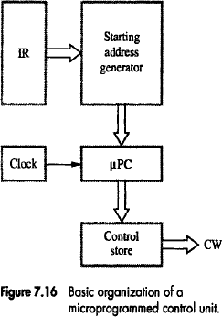
Microprogrammed Control..

Slide 70
Microprogrammed Control..
To read the control words sequentially from the control store, a microprogram counter (µPC) is used.
Every time a new instruction is loaded into the IR, the output of the block labeled "starting address generator'' is loaded into the µPC.
The µPC is then automatically incremented by the clock, causing successive microinstructions to be read from the control store.
Hence, the control signals are delivered to various parts of the processor in the correct sequence.

Slide 71
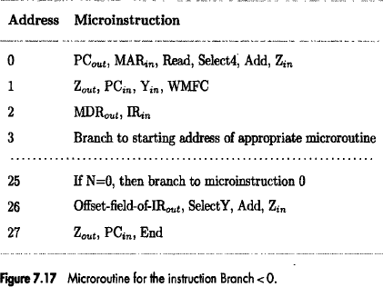
Microprogrammed Control..
The previous organization cannot handle the situation when the control unit is required to check the status of the condition codes or external inputs to choose between alternative courses of action.
  Can be handled by using conditional branch microinstruction.

Slide 72
Microprogrammed Control..
The instruction Branch<0 can be implemented by a microroutine
such as that shown in Figure 7.17.
After loading this instruction into IR, a branch microinstruction transfers control to the corresponding microroutine, which is assumed to start at location 25 in the control store.
  This address is the output of the starting address generator block in
Figure 7.16.
The microinstruction at location 25 tests the N bit of the condition codes.
  If this bit is equal to 0, a branch takes place to location 0 to fetch a new machine instruction.
  Otherwise, the microinstruction at location 26 is executed to put the branch target address into register Z.
The microinstruction in location 27 loads this address into the PC.

Slide 73
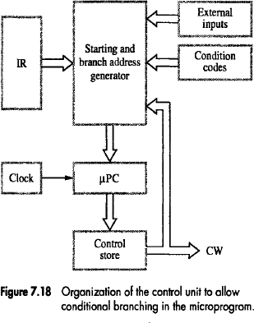
Microprogrammed Control..

Slide 74
Microprogrammed Control..
To support microprogram branching, the organization of the control unit should be modified as shown in Figure 7.18.
The starting address generator block of Figure 7.16 becomes the starting and branch address generator.
  This block loads a new address into the µPC when a microinstruction instructs it to do so.
To allow implementation of a conditional branch, inputs to this block consist of the external inputs and condition codes as well as the contents of the instruction register.

Slide 75
Microprogrammed Control..
In this control unit, the µPC is incremented every time a new microinstruction is fetched from the microprogram memory, except in the following situations:
When a new instruction is loaded into the IR, the µPC is loaded with the starting address of the microroutine for that instruction.
When a Branch microinstruction is encountered and the branch condition is satisfied, the µPC is loaded with the branch address.
When an End microinstruction is encountered, the µPC is loaded with the address of the first CW in the microroutine for the instruction fetch cycle.

