Slide 1
INPUT/OUTPUT ORGANIZATION
Module 3

Slide 2
Introduction
One of the basic features of a computer is its ability to exchange
data with other devices.
  Enables a human operator to use a keyboard and a display screen to process text and graphics.
Computers are an integral part of home appliances, manufacturing equipment, transportation systems, banking and point-of-sale terminals.
  Input to a computer may come from a sensor switch, a digital camera, a
microphone, or a fire alarm.
  Output may be a sound signal to be sent to a speaker or a digitally coded command to change the speed of a motor, open a valve, or cause a robot to move in a specified manner.
In short, a general-purpose computer should have the ability to exchange information with a wide range of devices in varying environments.

Slide 3
Accessing I/O Devices

Slide 4
Accessing I/O devices
A simple arrangement to connect I/O devices to a computer is to use a single bus arrangement.
The bus enables all the devices connected to it to exchange information.
It consists of three sets of lines used to carry address, data, and control signals.
Each I/O device is assigned a unique set of addresses.

Slide 5
Accessing I/O devices..
Processor
Memory
Bus
I/O device 1
I/O device n

Slide 6
Accessing I/O devices..
To access an I/O device, the processor places the address on the address lines.
The device recognizes the address, and responds to the control signals.
The processor requests either a read or a write operation, and the requested data are transferred over the data lines.

Slide 7
Accessing I/O devices..
When I/O devices and the memory share the same address space, the arrangement is called memory-mapped I/O.
Any machine instruction that can access memory can be used to transfer data to or from an I/O device.
Simpler software.
For example,
  Move DATAIN,R0
  Move R0,DATAOUT

Slide 8
Accessing I/O devices..
When I/O devices and the memory have different address spaces, the arrangement is called I/O-mapped I/O.
Special In and Out instructions to perform I/O transfers.
I/O devices may have to deal with fewer address lines.
I/O address lines need not be physically separate from
memory address lines.
In fact, address lines may be shared between I/O devices and memory, with a control signal to indicate whether it is a memory address or an I/O address.

Slide 9
Accessing I/O devices..
Address lines Data lines Control lines
Bus
Address decoder
Control circuits
Data and status registers
I/O
interface
Input device

Slide 10
Accessing I/O devices..
Figure 4.2 illustrates the hardware required to connect an I/O device to the bus.
I/O device is connected to the bus using an I/O interface circuit which has:
  Address decoder
  Control circuit
  Data and status registers.

Slide 11
Accessing I/O devices..
Address decoder enables the device to recognize its address when this address appears on the address lines.
Data register holds the data being transferred to or from
the processor.
The status register contains information relevant to the
operation of the I/O device.
Data and status registers are connected to the data bus,
and have unique addresses.
I/O interface circuit coordinates I/O transfers.

Slide 12
Accessing I/O devices..
Recall that the rate of transfer to and from I/O devices is slower than the speed of the processor.
  This creates the need for mechanisms to synchronize data
transfers between them.
To review the basic concepts, let us consider a simple example of I/O operations involving a keyboard and a display device in a computer system.
The four registers shown in Figure 4.3 are used in the
data transfer operations.

Slide 13
Accessing I/O devices..
Register STATUS contains two control flags, SIN and SOUT, which provide status information for the keyboard and the display unit, respectively.
The two flags KIRQ and DIRQ in this register are used in
conjunction with interrupts.
The KEN and DEN bits are in register CONTROL.
Data from the keyboard are made available in the DATAIN register, and data sent to the display are stored in the DATAOUT register.

Slide 14
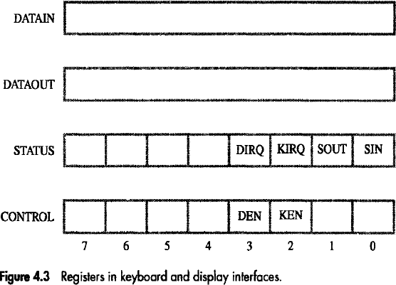
Accessing I/O devices..

Slide 15
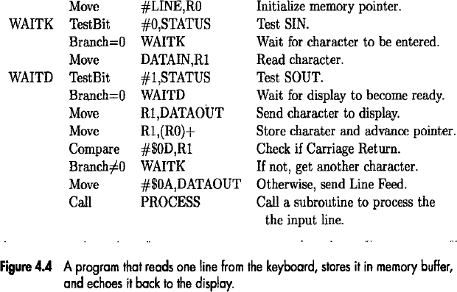
Accessing I/O devices..

Slide 16
Accessing I/O devices..
This program reads a line of characters from the keyboard and stores it in a memory buffer starting at location LINE.
Then, it calls a subroutine PROCESS to process the input line.
As each character is read, it is echoed back to the display.
Register R0 is used as a pointer to the memory buffer area.

Slide 17
Accessing I/O devices..
The contents of R0 are updated using the Autoincrement addressing mode so that successive characters are stored in successive memory locations.
Each character is checked to see if it is the Carriage Return (CR) character, which has the ASCII code 0D (hex).
  If it is, a Line Feed character (ASCII code 0A) is sent to move the cursor one line down on the display and subroutine PROCESS is called.
  Otherwise, the program loops back to wait for another character
from the keyboard.

Slide 18
Accessing I/O devices..
Program-controlled I/O
  Processor repeatedly monitors a status flag to achieve the
necessary synchronization.
  Processor polls the I/O device.
Two other mechanisms used for synchronizing data
transfers between the processor and memory:
  Interrupts
    Synchronization is achieved by having the I/0 device send a special signal over the bus whenever it is ready for a data transfer operation.
  Direct Memory Access
    Used for high-speed I/0 devices.
    It involves having the device interface transfer data directly to or from the
memory, without continuous involvement by the processor.

Slide 19













Interrupts

Slide 20
Interrupts
In program-controlled I/O, when the processor continuously monitors the status of the device, it does not perform any useful tasks.
An alternate approach would be for the I/O device to
alert the processor when it becomes ready.
  Do so by sending a hardware signal called an interrupt to the processor.
  At least one of the bus control lines, called an interrupt-request line is dedicated for this purpose.
Processor can perform other useful tasks while it is waiting for the device to be ready.

Slide 21
Interrupts (contd..)
Program 1
Interrupt Service routine
1
2
Interrupt occurs here
i
i + 1
M

Slide 22
Interrupts..
Processor is executing the instruction located at address i when an interrupt occurs.
Routine executed in response to an interrupt request is
called the interrupt-service routine.
When an interrupt occurs, control must be transferred to
the interrupt service routine.
But before transferring control, the current contents of
the PC (i+1), must be saved in a known location.
This will enable the return-from-interrupt instruction to
resume execution at i+1.
Return address, or the contents of the PC are usually
stored on the processor stack.

Slide 23
Example..
Consider a task that requires some computations to be performed and the results to be printed on a line printer.
Let the program consist of two routines, COMPUTE and
PRINT.
Assume that COMPUTE produces a set of n lines of
output, to be printed by the PRINT routine.
First, the COMPUTE routine is executed to produce the
first n lines of output.
Then, the PRINT routine is executed to send the first line
of text to the printer.

Slide 24
Example..
At this point, instead of waiting for the line to be printed; the PRINT routine may be temporarily suspended and execution of the COMPUTE routine continued.
Whenever the printer becomes ready, it alerts the
processor by sending an interrupt-request signal.
In response, the processor interrupts execution of the COMPUTE routine and transfers control to the PRINT routine.
The PRINT routine sends the second line to the printer
and is again suspended.
Then the interrupted COMPUTE routine resumes
execution at the point of interruption.

Slide 25
Example..
This process continues until all n lines have been printed and the PRINT routine ends.
The PRINT routine will be restarted whenever the next
set of n lines is available for printing.
If COMPUTE takes longer to generate n lines than the time required to print them, the processor will be performing useful computations all the time.

Slide 26

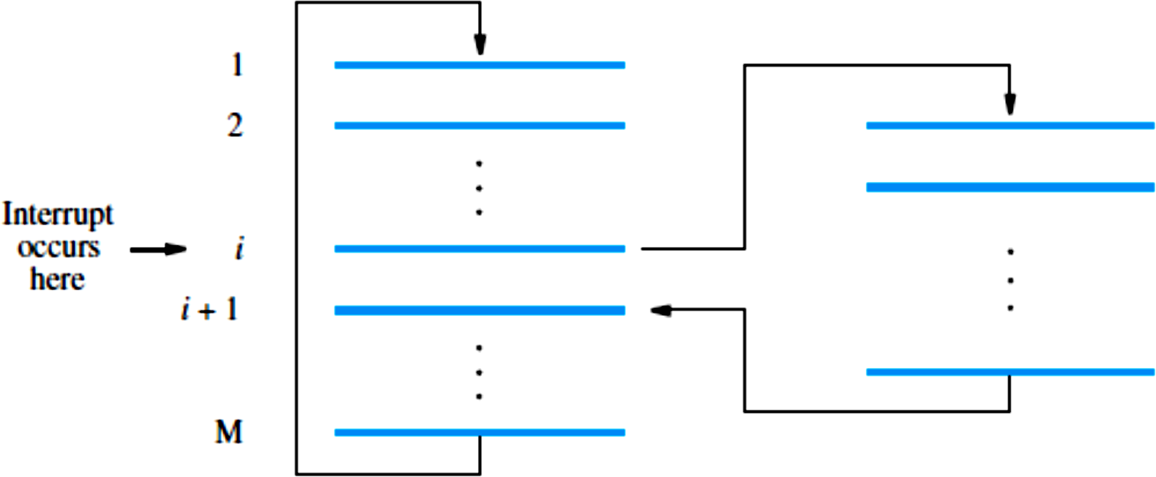
Example..

Slide 27
Interrupts..
When a processor receives an interrupt-request, it must branch to the interrupt service routine.
It must also inform the device that it has recognized the interrupt request.
This can be accomplished in two ways:
  Some processors have an explicit interrupt-
acknowledge signal for this purpose.
  In other cases, the data transfer that takes place between the device and the processor can be used to inform the device.

Slide 28
Interrupts..
Treatment of an interrupt-service routine is very similar to that of a subroutine.
However there are significant differences:
  A subroutine performs a task that is required by the calling program.
  Interrupt-service routine may not have anything in common with the
program it interrupts.
  Interrupt-service routine and the program that it interrupts may belong to
different users.
  As a result, before branching to the interrupt-service routine, not only the PC, but other information such as condition code flags, and processor registers used by both the interrupted program and the interrupt service routine must be stored.
    This will enable the interrupted program to resume execution upon return from
interrupt service routine.

Slide 29
Interrupts..
Saving and restoring information can be done automatically
by the processor or explicitly by program instructions.
Saving and restoring registers involves memory transfers:
  Increases the total execution time.
  Increases the delay between the time an interrupt request is received, and the start of execution of the interrupt-service routine. This delay is called interrupt latency.
In order to reduce the interrupt latency, most processors save
only the minimal amount of information:
  This minimal amount of information includes Program Counter and processor status registers.
  Any additional information that must be saved, must be saved explicitly by the program instructions at the beginning of the interrupt service routine.

Slide 30
Interrupts..
An interrupt is more than a simple mechanism for coordinating I/O transfers.
The concept of interrupts is used in operating systems and in many control applications where processing of certain routines must be accurately timed relative to external events.
  Real-time processing.

Slide 31
Interrupt Hardware
An I/O device requests an interrupt by activating a bus line called interrupt-request.
Most computers are likely to have several I/O devices that can request an interrupt.
A single interrupt-request line may be used to serve n devices as depicted in Figure 4.6.
All devices are connected to the line via switches to ground.

Slide 32
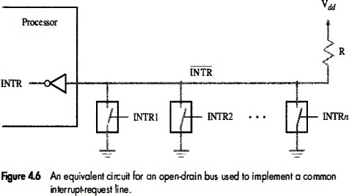
Interrupt Hardware..

Slide 33
Interrupt Hardware..
To request an interrupt, a device closes its associated switch.
Thus, if all interrupt-request signals INTR₁ to
INTR_{n} are inactive, that is, if all switches are open, the voltage on the interrupt-request line will be equal to 𝑉_{𝑑𝑑}.
  This is the inactive state of the line.
When a device requests an interrupt by closing its switch, the voltage on the line drops to 0, causing the interrupt-request signal, INTR, received by the processor to go to 1.

Slide 34
Interrupt Hardware..
Since the closing of one or more switches will cause the line voltage to drop to 0, the value of INTR is the logical OR of the requests from individual devices, that is,
INTR = INTR₁ + INTR₂ + ⋯ + INTR_{n}
It is customary to use the complemented form,
INTR, to name the interrupt-request signal on the common line, because this signal is active when in the low-voltage state.

Slide 35
Interrupt Hardware..
In the electronic implementation of the circuit in Figure 4.6, special gates known as open-collector (for bipolar circuits) or open-drain (for MOS circuits) are used to drive the INTR line.
The output of an open-collector or an open-drain gate is equivalent to a switch to ground that is open when the gate's input is in the 0 state and closed when it is in the 1 state.
The voltage level, hence the logic state, at the output of the gate is determined by the data applied to all the gates connected to the bus.
Resistor R is called a pull-up resistor because it pulls the line voltage up to the high-voltage state when the switches are open.

Slide 36
Enabling and Disabling Interrupts
The arrival of an interrupt request from an external device causes the processor to suspend the execution of one program and start the execution of another.
Because interrupts can arrive at any time, they may alter the intended sequence of events
  Sometimes such alterations may be undesirable, and must not be
allowed.
  For example, the processor may not want to be interrupted by the
same device while executing its interrupt-service routine.

Slide 37
Enabling and Disabling Interrupts..
There are many situations in which the processor should ignore interrupt requests.
For example, in the case of the Compute-Print program of Figure 4.5, an interrupt request from the printer should be accepted only if there are output lines to be printed.
After printing the last line of a set of n lines, interrupts should be disabled until another set becomes available for printing.

Slide 38
Enabling and Disabling Interrupts..
In another case, it may be necessary to guarantee that a particular sequence of instructions is executed to the end without interruption.
  The interrupt-service routine may change some of the data used by the instructions in question.
Processors generally provide the ability to enable and disable such interruptions as desired.
One simple way is to provide machine instructions such as Interrupt-enable and Interrupt-disable for this purpose.

Slide 39
Enabling and Disabling Interrupts..
Consider the specific case of a single interrupt request from one device.
When a device activates the interrupt-request signal, it keeps this signal activated until acknowledgement.
  This means that the interrupt-request signal will be active during execution of the interrupt-service routine.
It is essential to ensure that this active request signal does not lead to successive interruptions, causing the system to enter an infinite loop from which it cannot recover.
Several mechanisms are available to solve this problem.

Slide 40
Enabling and Disabling Interrupts..
The first possibility is to have the processor hardware ignore the interrupt-request line until the execution of the first instruction of the interrupt-service routine has been completed.
First instruction of an interrupt service routine can be Interrupt-disable.
Last instruction of an interrupt service routine before the Return-from-interrupt instruction can be Interrupt-enable.
The processor must guarantee that execution of the Return-from-interrupt instruction is completed before further interruption can occur.

Slide 41
Enabling and Disabling Interrupts..
The second option is to have the processor automatically disable interrupts before starting the execution of the interrupt-service routine.
One bit in the PS (Program Status) register, called Interrupt-enable, indicates whether interrupts are enabled.
  An interrupt request received while this bit is equal to 1 will be accepted.
After saving the contents of the PS on the stack, with the Interrupt- enable bit equal to 1, the processor clears the Interrupt-enable bit in its PS register, thus disabling further interrupts.
When a Return-from-interrupt instruction is executed, the contents of the PS are restored from the stack, setting the Interrupt-enable bit back to 1.
Hence, interrupts are again enabled.

Slide 42
Enabling and Disabling Interrupts..
In the third option, the processor has a special interrupt- request line for which the interrupt-handling circuit responds only to the leading edge of the signal.
  Such a line is said to be edge-triggered.
In this case, the processor will receive only one request, regardless of how long the line is activated.
Hence, there is no danger of multiple interruptions and no need to explicitly disable interrupt requests from this line.

Slide 43
Enabling and Disabling Interrupts..
Let us summarize the sequence of events involved in handling an interrupt request from a single device (Assuming that interrupts are enabled):
The device raises an interrupt request.
The processor interrupts the program currently being executed.
Interrupts are disabled by changing the control bits in the PS (except in the case of edge-triggered interrupts).
The device is informed that its request has been recognized, and in response, it deactivates the interrupt-request signal.
The action requested by the interrupt is performed by the interrupt-
service routine.
Interrupts are enabled and execution of the interrupted program is
resumed.

Slide 44
Handling Multiple Devices
Consider the situation where a number of devices capable of
initiating interrupts are connected to the processor.
These devices are operationally independent.
  There is no definite order in which they will generate interrupts.
  Several devices may request interrupts at exactly the same time.
How can the processor recognize the device requesting an interrupt?
Given that different devices are likely to require different interrupt- service routines, how can the processor obtain the starting address of the appropriate routine in each case?
Should a device be allowed to interrupt the processor while another
interrupt is being serviced?
How should two or more simultaneous interrupt requests be handled?

Slide 45
Handling Multiple Devices..
When a request is received over the common interrupt- request line in Figure 4.6, additional information is needed to identify the particular device that activated the line.
Furthermore, if two devices have activated the line at the same time, it must be possible to break the tie and select one of the two requests for service.
When the interrupt-service routine for the selected device has been completed, the second request can be serviced.

Slide 46
Handling Multiple Devices..
The information needed to determine whether a device is
requesting an interrupt is available in its status register.
The status register of each device has an IRQ bit which it sets
to 1 when it requests an interrupt.
For example, bits KIRQ and DIRQ in Figure 4.3 are the interrupt request bits for the keyboard and the display, respectively.
Interrupt service routine can poll the I/O devices connected to
the bus.
  The first device with IRQ equal to 1 is the one that is serviced.
Polling mechanism is easy, but time consuming to query the
status bits of all the I/O devices connected to the bus.

Slide 47
Vectored Interrupts
A device requesting an interrupt can identify itself by sending
a special code to the processor over the bus.
  This enables the processor to identify individual devices even if they
share a single interrupt-request line.
The code supplied by the device may represent the starting
address of the interrupt-service routine for that device.
  The code length is typically in the range of 4 to 8 bits.
  The remainder of the address is supplied by the processor based on the area in its memory where the addresses for interrupt-service routines are located.
This arrangement implies that the interrupt-service routine for
a given device must always start at the same location.

Slide 48
Vectored Interrupts..
Usually the location pointed to by the interrupting device is used to store the starting address of the interrupt-service routine.
The processor reads this address, called the
interrupt vector, and loads it into the PC.
In most computers, I/0 devices send the interrupt-vector code over the data bus.
The interrupting device must wait to put data on the bus only when the processor is ready to receive it.

Slide 49
Vectored Interrupts..
When the processor is ready to receive the interrupt-vector code, it activates the interrupt- acknowledge line, INTA.
The I/0 device responds by sending its interrupt- vector code and turning off the INTR signal.

Slide 50
Interrupt Nesting
Previously, before the processor started executing the interrupt service routine for a device, it disabled the interrupts from the device.
In general, same arrangement is used when multiple devices can send interrupt requests to the processor.
  During the execution of an interrupt service routine of device, the processor does not accept interrupt requests from any other device.
  Since the interrupt service routines are usually short, the delay
that this causes is generally acceptable.
However, for certain devices this delay may not be
acceptable.

Slide 51
Interrupt Nesting..
I/O devices are organized in a priority structure.
  An interrupt request from a high-priority device is accepted while the processor is executing the interrupt service routine of a low priority device.
A priority level is assigned to a processor that can be
changed under program control.
  Priority level of a processor is the priority of the program that is
currently being executed.
  When the processor starts executing the interrupt service
routine of a device, its priority is raised to that of the device.
  If the device sending an interrupt request has a higher priority than the processor, the processor accepts the interrupt request.

Slide 52
Interrupt Nesting..
Processor’s priority is encoded in a few bits of the processor status register.
  Priority can be changed by instructions that write into the processor status register.
Usually, these are privileged instructions, or instructions that can be executed only in the supervisor mode.
  Privileged instructions cannot be executed in the user mode.
  Prevents a user program from accidentally or intentionally
changing the priority of the processor.
  If there is an attempt to execute a privileged instruction in the user mode, it causes a special type of interrupt called as privilege exception.

Slide 53
Interrupt Nesting..
A multiple-priority scheme can be implemented easily by using separate interrupt-request and interrupt- acknowledge lines for each device, as shown in Figure 4.7.
Each of the interrupt-request lines is assigned a different priority level.
Interrupt requests received over these lines are sent to a priority arbitration circuit in the processor.
A request is accepted only if it has a higher priority level
than that currently assigned to the processor.

Slide 54
Interrupt Nesting..
IN T R 1
I N T R p
Processor
Device 1
Device 2
Device p
INTA1
INTA p
Priority arbitration

Slide 55
Simultaneous Requests
Consider the problem of simultaneous arrivals of interrupt requests from two or more devices.
The processor must have some means of deciding which request to service first.
Using a priority scheme such as that of Figure 4.7, the solution is straightforward.
  The processor simply accepts the request having the highest priority.
If several devices share one interrupt-request line, as in Figure 4.6, some other mechanism is needed.

Slide 56
Simultaneous Requests..
Polling scheme:
If the processor uses a polling mechanism to poll the status registers of I/O devices to determine which device is requesting an interrupt.
In this case the priority is determined by the order in which the devices are polled.
The first device with status bit set to 1 is the device whose interrupt request is accepted.

Slide 57
Simultaneous Requests..
Daisy chain scheme:
Devices are connected to form a daisy chain.
The interrupt-request line INTR is common to all devices
Interrupt-acknowledge line INTA is connected in a daisy-chain fashion.
When devices raise an interrupt request, the interrupt-request line
INTR is activated.
  The processor responds by setting INTA line to 1
This signal is received by device 1; if device 1 does not need service, it passes the signal to device 2.
If device 1 has a pending request for interrupt, it blocks the INTA
signal and proceeds to put its identifying code on the data lines.
Device that is electrically closest to the processor has the highest
priority.

Slide 58
Simultaneous Requests..
I N T R
Processor
Device 1
Device 2
Device n
INTA

Slide 59
Simultaneous Requests..
When I/O devices were organized into a priority structure, each device had its own interrupt-request and interrupt-acknowledge line.
When I/O devices were organized in a daisy chain fashion, the devices shared an interrupt-request line, and the interrupt-acknowledge propagated through the devices.
A combination of priority structure and daisy chain
scheme can also used.

Slide 60

Simultaneous Requests..
Devices are organized into groups.
Each group is assigned a different priority level.
All the devices within a single group share an interrupt- request line, and are connected to form a daisy chain.
I NT R 1
INTA1
Device
Device
Processor
IN T R p
Device
Device
INTA p
Priority arbitration
circuit

Slide 61
Controlling Device Requests
Only those devices that are being used in a program should
be allowed to generate interrupt requests.
To control which devices are allowed to generate interrupt requests, the interface circuit of each I/O device has an interrupt-enable bit.
If the interrupt-enable bit in the device interface is set to 1, then the device is allowed to generate an interrupt-request.
Interrupt-enable bit in the device’s interface circuit determines whether the device is allowed to generate an interrupt request.
Interrupt-enable bit in the processor status register or the priority structure of the interrupts determines whether a given interrupt will be accepted.

Slide 62
Controlling Device Requests..
For example, keyboard interrupt-enable, KEN, and display interrupt-enable, DEN, flags in register CONTROL in Figure 4.3.
If either of these flags is set, the interface circuit generates an interrupt request whenever the corresponding status flag in register STATUS is set.
At the same time, the interface circuit sets bit KIRQ or DIRQ to indicate that the keyboard or display unit, respectively, is requesting an interrupt.
If an interrupt-enable bit is equal to 0, the interface circuit will not generate an interrupt request, regardless of the state of the status flag.

Slide 63
Controlling Device Requests..
To summarize, there are two independent mechanisms for controlling interrupt requests:
At the device end, an interrupt-enable bit in a control register determines whether the device is allowed to generate an interrupt request.
At the processor end, either an interrupt enable bit in the PS register or a priority structure determines whether a given interrupt request will be accepted.

Slide 64
Example
Consider a processor that uses the vectored interrupt scheme, where the starting address of the interrupt- service routine is stored at memory location INTVEC.
Interrupts are enabled by setting to 1 an interrupt-enable bit, IE, in the processor status word, which we assume is bit 9.
A keyboard and a display unit connected to this processor have the status, control, and data registers shown in Figure 4.3.
Assume that at some point in a program called Main we wish to read an input line from the keyboard and store the characters in successive byte locations in the memory, starting at location LINE.

Slide 65
Example..
To perform this operation using interrupts, we need to initialize the interrupt process, as follows:
Load the starting address of the interrupt-service routine
in location INTVEC.
Load the address LINE in a memory location PNTR. The interrupt-service routine will use this location as a pointer to store the input characters in the memory.
Enable keyboard interrupts by setting bit 2 in register
CONTROL to 1.
Enable interrupts in the processor by setting to 1 the IE
bit in the processor status register, PS.

Slide 66
Example..
Once this initialization is completed, typing a character on the keyboard will cause an interrupt request to be generated by the keyboard interface.
The program being executed at that time will be interrupted and the interrupt-service routine will be executed.

Slide 67
Example..
This routine has to perform the following tasks:
Read the input character from the keyboard input data register. This will cause the interface circuit to remove its interrupt request.
Store the character in the memory location pointed to by PNTR, and increment PNTR.
When the end of the line is reached, disable keyboard interrupts and inform program Main.
Return from interrupt.

Slide 68
Example..
The instructions needed to perform these tasks are shown in Figure 4.9.
When the end of the input line is detected, the interrupt-service routine clears the KEN bit in register CONTROL as no further input is
expected.
It also sets to 1 the variable EOL (End Of Line).
  This variable is initially set to 0.
  We assume that it is checked periodically by program Main to determine when the input line is ready for processing.

Slide 69
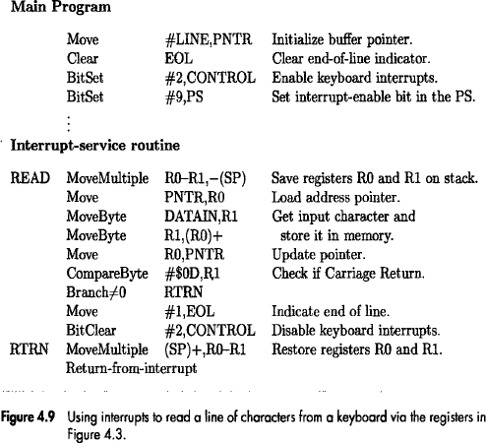
Example..

Slide 70
Direct Memory Access

Slide 71
Direct Memory Access
A special control unit may be provided to transfer a block of data directly between an I/O device and the main memory, without continuous intervention by the processor.
  This approach is called direct memory access, or DMA.
DMA transfers are performed by DMA controller, which is a control circuit that is a part of the I/O device interface.
DMA controller performs functions that would be normally carried out by the processor:
  For each word, it provides the memory address and all the control
signals.
  To transfer a block of data, it increments the memory addresses and
keeps track of the number of transfers.

Slide 72
Direct Memory Access..
DMA controller can transfer a block of data from an external device to the processor, without any intervention from the processor.
  However, the operation of the DMA controller must be under the control of a program executed by the processor. That is, the processor must initiate the DMA transfer.
To initiate the DMA transfer, the processor informs the DMA controller of:
  Starting address,
  Number of words in the block.
  Direction of transfer (I/O device to the memory, or memory to the I/O
device).
Once the DMA controller completes the DMA transfer, it
informs the processor by raising an interrupt signal.

Slide 73
Direct Memory Access..
While a DMA transfer is taking place, the program that requested the transfer cannot continue, and the processor can be used to execute another program.
  After the DMA transfer is completed, the processor can return
to the program that requested the transfer.
For an I/O operation involving DMA, the OS puts the program that requested the transfer in the Blocked state, initiates the DMA operation, and starts the execution of another program.
  When the transfer is completed, the DMA controller informs the processor by sending an interrupt request.
  In response, the OS puts the suspended program in the Runnable state so that it can be selected by the scheduler to continue execution.

Slide 74
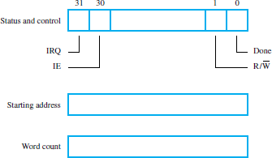
Direct Memory Access..

Slide 75
Direct Memory Access..
Figure 4.18 shows an example of the DMA controller registers that are accessed by the processor to initiate transfer operations.
Two registers are used for storing the starting address
and the word count.
The third register contains status and control flags.
The R/W^{ഥ} bit determines the direction of the transfer.
  When this bit is set to 1 by a program instruction, the controller
performs a read operation.
  Otherwise, it performs a write operation.

Slide 76
Direct Memory Access..
When the controller has completed transferring a block of data and is ready to receive another command, it sets the Done flag to 1.
Bit 30 is the Interrupt-enable flag, IE.
  When this flag is set to 1, it causes the controller to raise an
interrupt after it has completed transferring a block of data.
Finally, the controller sets the IRQ bit to 1 when it has
requested an interrupt.

Slide 77
Direct Memory Access..
An example of a computer system is given in Figure 4.19, showing how DMA controllers may be used.
DMA controller connects a high-speed network to the computer bus.
Disk controller, which controls two disks also has DMA capability.
  It provides two DMA channels.
It can perform two independent DMA operations, as if each disk has its own DMA controller.
The registers to store the memory address, word count and status and control information are
duplicated.

Slide 78
Direct Memory Access..
Processor
Main memory
System bus
Disk/DMA
controller
DMA
controller
Printer
Keyboard
Disk
Disk
Network Interface

Slide 79
Direct Memory Access..
To start a DMA transfer of a block of data from the main memory to
one of the disks, a program writes the address and word count
information into the registers of the corresponding channel of the disk controller.
It also provides the disk controller with information to identify the
data for future retrieval.
The DMA controller proceeds independently to implement the specified operation.
When the DMA transfer is completed, this fact is recorded in the status and control register of the DMA channel by setting the Done bit.
At the same time, if the IE bit is set, the controller sends an interrupt request to the processor and sets the IRQ bit.
The status register can also be used to record other information, such as whether the transfer took place correctly or errors occurred.

Slide 80
Direct Memory Access..
Processor and DMA controllers have to use the bus in an interwoven
fashion to access the memory.
  DMA devices are given higher priority than the processor to access the bus.
  Among different DMA devices, high priority is given to high-speed
peripherals such as a disk or a graphics display device.
Processor originates most memory access cycles on the bus.
  DMA controller can be said to “steal” memory access cycles from the
bus.
  This interweaving technique is called “cycle stealing”.
An alternate approach is the provide a DMA controller an exclusive capability to initiate transfers on the bus, and hence exclusive access to the main memory.
  This is known as the block or burst mode.

Slide 81
Direct Memory Access..
Most DMA controllers incorporate a data storage buffer.
In the case of the network interface in Figure 4.19, for example, the DMA controller reads a block of data from the main memory and stores it into its input buffer.
This transfer takes place using burst mode at a speed appropriate to the memory and the computer bus.
Then, the data in the buffer are transmitted over the network at
the speed of the network.
A conflict may arise if both the processor and a DMA controller or two DMA controllers try to use the bus at the same time to access the main memory.
To resolve these conflicts, an arbitration procedure is implemented on the bus to coordinate the activities of all devices requesting memory transfers.

