Slide 1
COMPUTER ORGANIZATION

Slide 2
Course objectives: This course will enable students to
Understand the basics of computer organization: structure and operation
of computers and their peripherals.
Understand the concepts of programs as sequences or machine
instructions.
Expose different ways of communicating with I/O devices and standard I/O interfaces.
Describe hierarchical memory systems including cache memories and virtual memory.
Describe arithmetic and logical operations with integer and floating-
point operands.
Understand basic processing unit and organization of simple processor,
concept of pipelining and other large computing systems.

Slide 3
Module - 1
Basic Structure
of ComputersBasic Structure of Computers: Basic
Operational Concepts, Bus Structures, Performance – Processor Clock, Basic Performance Equation, Clock Rate, Performance Measurement. Machine Instructions and Programs: Memory Location and Addresses, Memory Operations, Instructions and Instruction Sequencing,
Module - 2
Addressing Modes, Assembly Language, Basic Input and Output Operations, Stacks and Queues, Subroutines, Additional Instructions
Module-3
Input/Output Organization: Accessing I/O Devices, Interrupts – Interrupt Hardware, Enabling and Disabling Interrupts, Handling Multiple Devices, Controlling Device Requests, Exceptions, Direct Memory Access
Module - 4
Memory System: Basic Concepts, Semiconductor RAM Memories, Read Only Memories, Speed, Size, and Cost, Cache Memories – Mapping Functions, Replacement Algorithms, Performance Considerations, Virtual Memories, Secondary Storage.

Slide 4
Module-5
Basic Processing Unit: Some Fundamental Concepts, Execution of a Complete Instruction, Multiple Bus Organization, Hard-wired Control, Micro programmed Control. Pipelining, Embedded Systems and Large Computer Systems: Basic Concepts of pipelining, Examples of Embedded Systems, Processor chips for embedded applications, Simple Microcontroller, Forms of parallel processing, Array Processors, The structure of General-Purpose Multiprocessors.

Slide 5
Text Books:
1. Carl Hamacher, ZvonkoVranesic, SafwatZaky: Computer Organization, 5th Edition, Tata McGraw Hill, 2002. (Listed topics only from Chapters 1, 2, 4, 5, 6, 7, 8, 9 and12)
Reference Books:
William Stallings: Computer Organization & Architecture, 7th Edition, PHI, 2006.

Slide 6
MODULE-1
Chapter 1. Basic Structure of Computers

Slide 7
Computer Types
Computer is a fast electronic calculating machine that accepts digitized input information, processes it according to a list of internally stored instructions, and produces the resulting output information
Computer Organization: deals with function and design of various units
of digital computer
Computer Architecture: deals with specification of instruction set and the
hardware unit that implement instructions
Computer Types:
Desktop computers
Notebook computers
Workstations
Enterprise Systems & Servers – low end range
Super Computers- high end

Slide 8
Functional Units

Slide 9
Functional Units
I/O
Processor
Input
Arithmetic and logic
Memory
Output
Control
Figure 1.1. Basic functional units of a computer.

Slide 10
Information Handled by a Computer
Information is categorized into Instructions & Data
Instructions (machine instructions) – explicit commands that
  Govern the transfer of information within a computer as well as
between the computer and its I/O devices
  Specify the arithmetic and logic operations to be performed
Program: list of instructions that performs a task, A computer is
completely controlled by the stored program
Data – numbers & encoded characters that are used as operands by
the instructions
Source program may be considered as data if it is processed by
another program- ex. Compiler
Information handled by computer is encoded in binary code ( 0 and 1) Numbers are represented in positional binary notation and BCD (4 bits) Characters are represented by ASCII / EBCDIC

Slide 11
Input Unit
Computers accept coded information through input devices
Keyboard: Most well known i/p device, Whenever a key is pressed, the corresponding letter or digit is translated into its equivalent binary code and transmitted over a cable to either memory or processor.
Graphic input devices: joystick/trackball/mouse
Microphone: to capture audio input

Slide 12
Memory Unit
Function of memory unit is to Store programs and data
Two classes of storage
Primary storage
  Fast memory operates at electronic speeds, expensive
  Programs must be stored in memory while they are being
executed
  Contains large number of semiconductor storage cells
  Memory cells are processed in words
  Address – to access any word in memory, distinct address is
associated with each word
  Word length- Number of of bits in each word, range from 16 to
64 bits
  RAM , ROM
  memory access time: time required to access one word
  Memory hierarchy with different speeds and sizes – cache,
main memory
Secondary storage – to store large amount of data, and cheaper
Magnetic disks, tapes, optical disks (CD-ROMs), floppies etc.,

Slide 13
Arithmetic and Logic Unit (ALU)
Most computer operations are executed in ALU of the processor, Like addition, subtraction, division, multiplication, comparision, etc.
An example of addition operation: Load the operands into memory – bring them to the processor – perform operation in ALU – store the result back to memory or retain in the processor.
Registers: When the operands are brought into the ALU from memory, they are stored in high speed storage elements called register.
Control unit & ALU are faster than other devices connected to a computer system. This enables processor to control a number of external devices

Slide 14
Output Unit
Counterpart of input unit
The function of output unit is to send processed results to the
outside world
Examples- display (monitor)/printers , speakers, etc
Some units, graphic displays provide both an input and output
function and hence the single name I/O unit in many cases

Slide 15
Control Unit
All computer operations are coordinated and controlled by
the control unit.
It is the nerve center that sends signals to other units and
senses their states.
The timing signals that govern the I/O transfers are also
generated by the control unit.
Timing signals are signals that determine when a given action
is to take place
Data transfers between processor & memory are controlled by
control unit through timing signals
Control unit is usually distributed throughout the machine , and large set of control lines carries the signals used for timing and synchronization of events in all units

Slide 16
Summary- Operations of a computer
Computer accepts information in the form of programs and
data through an input unit and stores it in the memory
Fetches the information stored in the memory, under program
control, into an ALU, where the information is processed
Produces the processed information through an output unit
Controls all activities inside the machine through a control unit

Slide 17
Basic Operational
Concepts

Slide 18
Basic Operational Concepts
Activity in a computer is governed by instructions.
To perform a task, an appropriate program consisting of a list of instructions is stored in the memory.
Individual instructions are brought from the memory into the processor, which executes the specified operations.
Data to be used as operands are also stored in the
memory.

Slide 19
Basic Operational Concepts
Consider an instruction: Add LOCA, R0
Add the operand at memory location LOCA to the operand in a
register R0 in the processor.
Instruction is fetched from the memory into the processor – the operand at LOCA is fetched and added to the contents of R0 – the resulting sum is stored in register R0.
Place the sum into register R0.
The original contents of LOCA are preserved.
The original contents of R0 is overwritten.

Slide 20
Basic Operational Concepts
Separate Memory Access and ALU Operation
Load LOCA, R1 Add R1, R0
Whose contents will be overwritten?
Transfers between the memory and the processor are started by sending the address of the memory location to be accessed to the memory unit and issuing the appropriate signals. The data are then transferred to or from the memory

Slide 21
Connection Between the Processor and the Memory

Slide 22
Registers
Instruction register (IR)
Program counter (PC)
General-purpose register (R₀ – R_{n-1})
Memory address register (MAR)
Memory data register (MDR)

Slide 23
Typical Operating Steps
Programs reside in the memory through input devices
PC is set to point to the first instruction
The contents of PC are transferred to MAR
A Read signal is sent to the memory
The first instruction is read out and loaded into MDR
The contents of MDR are transferred to IR
Decode and execute the instruction

Slide 24
Typical Operating Steps (Contd’)
Get operands for ALU
  General-purpose register
  Memory (address to MAR – Read – MDR to ALU)
Perform operation in ALU
Store the result back
  To general-purpose register
  To memory (address to MAR, result to MDR – Write)
During the execution, PC is incremented to the next
instruction

Slide 25
Interrupt
Normal execution of programs may be preempted if some
device requires urgent servicing.
The normal execution of the current program must be
interrupted – the device raises an interrupt signal.
Interrupt-service routine
Current system information backup and restore (PC, general-
purpose registers, control information, specific information)

Slide 26
Exercise
Give a short sequence of m/c instructions. Add the contents of memory location A to those of location B, and place the result in loc C.
Assume Load LOC, Ri and Store Ri, Loc are the instructions available to transfer data between memory and general purpose register.
Do not destroy the contents of loc A or loc B

Slide 27
Bus Structures
There are many ways to connect different parts inside a
computer together.
To achieve a reasonable speed of operation, a computer must be organized so that all its units can handle one full word of data at a given time
A group of lines that serves as a connecting path for several
devices is called a bus.
Address/data/control: In addition to the lines that carry the data, the bus must have lines for address and control purpose.

Slide 28
Bus Structures
Single-bus structure: All units are connected in this bus and the bus can be used for only one transfer at a time, only two units can actively use the bus at any given time.
Single bus structure is
Low cost
Very flexible for attaching peripheral devices
Multiple bus structure certainly increases, the performance but also increases the cost significantly

Slide 29
Speed Issue
Different devices have different transfer/operate speed.
If the speed of bus is bounded by the slowest device
connected to it, the efficiency will be very low.
How to solve this? A common approach to solve this is: using
buffers.

Slide 30
Performance

Slide 31
Performance
The most important measure of a computer is how quickly it can execute programs.
Three factors affect performance:
Hardware design
Instruction set
Compiler
For best performance, it is necessary to design the compiles, the
machine instruction set, and the hardware in a coordinated way.

Slide 32
Performance: The processor cache
Processor time to execute a program depends on the hardware
involved in the execution of individual machine instructions.
Main memory
Processor
Cache memory
Bus
Figure 1.5. The processor cache.
The processor and a relatively small cache memory can be
fabricated on a single integrated circuit chip.

Slide 33
Processor Clock
Clock, clock cycle, and clock rate
Clock is a timing signal used for controlling processor circuits.
Clock defines regular time intervals called clock cycle.
The execution of each instruction is divided into several basic
steps, each of which completes in one clock cycle.
P= length of one clock cycle
Clock rate R=1/P measured in cycles per second
Hertz – cycles per second
Ex- 500 MHz means 500 million cycles per second
1.25 GHz means 1250 million cycles per second

Slide 34
Basic Performance Equation
T – processor time required to execute a program that has been prepared in high-level language
N – number of actual machine language instructions needed to complete the execution (note: loop)
S – average number of basic steps needed to execute one machine
instruction. Each step completes in one clock cycle
R – clock rate
The program execution time T is given by
_{T =} N × S
R
This is referred to as the basic performance equation
Note: N, S and R are not independent parameters, changing one may
affect other
How to improve T?

Slide 35
Exercise
A program contain 1000 instructions. Out of that 25% instructions require 4 clock cycles, 40% instructions require 5 clock cycles and remaining requires 3 clock cycles for execution. Find the total time required to execute the program running in a 1 GHz machine.

Slide 36
Clock Rate
There are two possibilities for increasing the clock rate ‘R’.
Improving the IC technology makes logical circuit faster, which reduces the time of execution of basic steps. This allows the clock period P, to be reduced and the clock rate R to be increased.
Reducing the amount of processing done in one basic step also makes it possible to reduce the clock period P. however if the actions that have to be performed by an instructions remain the same, the number of basic steps needed may increase.

Slide 37
Performance Measurement
It is very important to be able to access the performance of a computer
the performance of a computer is given by the execution time T.
T is difficult to compute, and the parameters like the clock speed and various architectural features are not reliable indicators of the expected performance.
Measure computer performance using benchmark programs.
System Performance Evaluation Corporation (SPEC) selects and publishes representative application programs for different application domains, together with test results for many commercially available computers.
Reference computer:
For SPEC95, the reference computer is SUN SPARC Workstation 10/40
For SPEC2000, the reference computer is Ultra SPARC10 workstation
with 300 MHz Ultra SPARC-IIi Processor

Slide 38

Performance Measurement
If the SPEC rating = 50
Means that the computer under test is 50 times as fast as the ultra sparc 10. This is repeated for all the programs in the SPEC suit, and the geometric mean of the result is computed.
Test is repeated for all the programs in the SPEC suite and the geometric mean of the results is computed.
Let SPEC_{i} is the rating for program i in the suite and n is the number of programs in the suite, then overall SPEC rating for the computer is given by:

Slide 39
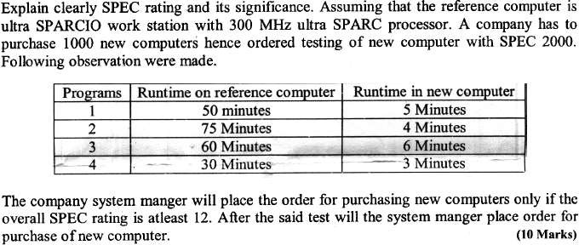
Exercise:

Slide 40
Historical Perspective - Generation of Computers
Development of technologies used to fabricate the processors, memories and I/O units of the computers has been divided into various generations as given below:
First generation -1945 to 1955
Second generation - 1955 to1965
Third generation - 1965 to 1975
Fourth generation - 1975 -1985
Beyond the fourth generation -1985 to the present

Slide 41
FIRST GENERATION (1945 –1955)
Program and data reside in the same memory (stored
program concepts –John von Neumann)
ALP was made used to write programs
Vacuum tubes were used to implement the functions
(ALU & CU design)
Magnetic core and magnetic tape storage devices are
used
Using electronic vacuum tubes, as the switching components

Slide 42
SECOND GENERATION (1955 –1965)
Transistor were used to design ALU & CU
Magnetic core memories & magnetic drum storage devices
were used
HLL is used (FORTRAN)
To convert HLL to MLL compiler were used
Separate I/O processor were developed to operate in parallel
with CPU, thus improving the performance
Invention of the transistor which was faster, smaller and
required considerably less power to operate
IBM became major computer manufacturer

Slide 43
THIRD GENERATION (1965‐1975)
IC technology improved
Improved IC technology helped in designing low cost, high
speed processor and memory modules
Microprogramming, parallelism, pipelining concepts were incorporated
OS allowed efficient and coordinate operation of computer
system with multiple users
Cache and virtual memory concepts were developed
More than one circuit on a single silicon chip became
available
Ex- System 360 from IBM, PDP mini computer from DEC

Slide 44
FOURTH GENERATION (1975‐1985)
VLSI Technology
Complete processor fabricated on a single Chip-Termed as
microprocessor
Intel, Motorola, Texas, National semiconductors started
developing microprocessor
Workstations, Desktop PC, & Notebook computers were
developed
Interconnection of different computer for better
communication LAN,WAN and the Internet
Concurrency, pipelining, caches, virtual memory evolved to produce high performance computing
Specialized processors like Digital Signal Processor were also
developed

Slide 45
BEYOND THE FOURTH GENERATION
(1985 –till date)
Artificial Intelligence
Massively parallel machines
Extensively distributed systems
High speed processor ‐GHz speed
E‐Commerce, E‐banking, home office
Because of IC technology lot of added features in small size
Computer industry is fueled by increasingly powerful desktop computers and widespread use of information resources on the Internet

Slide 46
End of Chapter-1

Slide 47
Chapter 2. Machine Instructions and
Programs

Slide 48
Objectives
To study the Machine instructions and program execution, including branching and subroutine call and return operations.
To study the Addressing methods for accessing register and
memory operands.
To study the Assembly language for representing machine
instructions, data, and programs.
To study the Program-controlled Input/Output operations.

Slide 49
Memory Locations and
Addresses

Slide 50
Memory Locations and Addresses
nbits
Memory consists of many millions of storage cells, each of which can store 1 bit.
Data is usually accessed in n- bit groups. Each group of n bits is referred to as a word of information, and n is called the word length.
The memory of a computer can be schematically represented as a collection of words as shown in Figure
first word second word
•
•
•
i th word
•
•
•
last word
Figure 2.5.
Memory words.

Slide 51
Memory Locations and Addresses
32-bit word length example
32 bits
^{b}31 | ^{b}30 | • • | b₁ | b₀
•
Sign bit: b₃₁= 0 for positive numbers
b₃₁= 1 for negative numbers
(a) A signed integer
8 bits | 8 bits | 8 bits | 8 bits
ASCII
character
ASCII
character
ASCII
character
ASCII
character
(b) Four characters

Slide 52
Memory Locations and Addresses
To retrieve information from memory, either for one word or one byte
(8-bit), addresses for each location are needed.
A k-bit address memory has 2^{k} memory locations, namely 0 to 2^{k}-1,
called address space of the computer.
24-bit memory: address space of 2²⁴ = 16,777,216 = 16M (1M=2²⁰)
32-bit memory: address space of 2³² = 4G (1G=2³⁰)
1K (Kilo)=2¹⁰
1M (Mega)= 2²⁰
1G (Giga)=2³⁰
1T (Tera)=2⁴⁰

Slide 53
Memory Locations and Addresses
Byte Addressability:
It is impractical to assign distinct addresses to individual bit locations in the memory.
The most practical assignment is to have successive addresses refer to successive byte locations in the memory – byte-addressable memory.
Byte locations have addresses 0, 1, 2, …..
If the word length of the machine is 32 bits, the successive words are located at addresses 0, 4, 8,…… with each word consisting of four bytes.

Slide 54
Big-Endian and Little-Endian Assignments
Two ways that byte addresses can be assigned across words.
Big-Endian: lower byte addresses are used for the most significant bytes of the word
(the leftmost bytes)
Little-Endian: lower byte addresses are used for the less significant bytes of the word
(the rightmost bytes) ( For strings memory representation in increasing address order).
Word address
Byte address Byte address
0
0 | 1 | 2 | 3
4 | 5 | 6 | 7
• • •
2^{k} - 4 | 2^{k} - 3 | k 2 - 2 | 2^{k} - 1
0
3 | 2 | 1 | 0
7 | 6 | 5 | 4
• • •
k 2 - 1 | 2^{k} - 2 | 2^{k}- 3 | 2^{k} - 4
4
4
k
k
2 - 4
2 - 4
(a) Big-endian assignment (b) Little-endian assignment
Figure 2.7. Byte and word addressing.

Slide 55
Exercise
Store the number 90AB12CD₁₆ in big-endian and little- endian
Represent the number 64243848H in 32 bits big-endian and little-
endian memory.
Consider a computer that has a byte addressable memory organized in 32-bit words according to big-endian scheme. A program reads ASCII characters entered at a keyboard and stores them in successive byte locations, starting at location 1000. Show the contents of the two memory words at locations 1000 and 1004 after the name “Johnson” has been entered. (Mark XX if the location is unchanged.)
(ASCII values for A to Z are in the range: 41H to 5A
for a to z , the range 61H to 7A )

Slide 56
Memory Locations and Addresses
Word alignment
  Words are said to be aligned in memory if they begin at a byte address, that is a multiple of the num of bytes in a word.
    16-bit word: word addresses: 0, 2, 4,….
    32-bit word: word addresses: 0, 4, 8,….
    64-bit word: word addresses: 0, 8,16,….
Access numbers, characters, and character strings
  A number usually occupies one word and can be accessed by
specifying its word address.
  Individual characters can be accessed by their byte address
  Special control character used to indicate “end of string”

Slide 57
Memory Operations
Both program instructions and data operands are stored in the
memory.
To execute an instruction, the word (or words) containing the instruction to be transferred from the memory to the processor. Operands and results must also be moved between the memory and the processor.
For this, two basic operations involving the memory are needed,
namely, Load (or Read or Fetch) and Store (or Write).

Slide 58
Memory Operations
Load operation (or Read or Fetch)
Copy of the contents of memory transferred to the processor. The
memory content doesn’t change.
Processor sends the Address of the location to the memory and
requests for read operation
Registers can be used for data transfer
Store operation (or Write)
The Store operation transfers an item of information from the processor to a specific memory location. Overwrite the content in memory
Processor sends the Address and Data to memory for “Store”
Registers can be used for data transfer

Slide 59
Instructions and Instruction Sequencing

Slide 60
Instructions and Instruction Sequencing
A Computer must have instructions capable of performing four types
of operations
Data transfers between the memory and the processor registers
Arithmetic and logic operations on data
Program sequencing and control
I/O transfers

Slide 61
Register Transfer Notation (RTN)
It is needed to transfer of information from one location in the computer to another. Possible locations that may be involved in such transfers are memory locations, processor registers, or registers in the I/O subsystem.
A location is identified by a symbolic name standing for its hardware binary address (LOC, PLACE, A, VAR2,…), Register names may be R0, R3…, I/O register names may be DATAIN, OUTSTATUS…
Contents of a location are denoted by placing square brackets
around the name of the location (R1←[LOC], R3 ←[R1]+[R2])
Above notation is called Register Transfer Notation (RTN) - RHS is the Value and LHS is the name of a location where the value is to be placed

Slide 62
Assembly Language Notation
We need another type of notation to represent machine instructions
and programs. For this, we use an assembly language format.
For example, an instruction that causes the transfer from memory location LOC to processor register R1, is specified by the statement Move LOC, R1 ( => R1←[LOC] )
adding two numbers contained in processor registers R1 and R2 and placing their sum in R3 can be specified by the assembly language statement
Add R1, R2, R3 ( => R3 ←[R1]+[R2] )

Slide 63
BASIC INSTRUCTION TYPES
Consider the Operation of adding two numbers C = A + B
meaning of the above is C ← [A] + [B]
Assume this action is to be performed by a single instruction, where A, B, C are the memory addresses of the three operands then three address instruction can be represented symbolically as Add A, B, C
Operands A and B are called the source operands, C is called the destination operand, and Add is the operation to be performed on the operands. A general instruction of this type has the format.
Operation Source1, Source 2, Destination

Slide 64
BASIC INSTRUCTION TYPES
If k bits are needed to specify the memory address of each operand, the encoded form of the above instruction must contain 3k bits for addressing purposes in addition to the bits needed to denote the Add operation.
An alternative approach is to use a sequence of simpler instructions to perform the same task, with each instruction having only one or two operands. Suppose that two address instructions of the form
Operation Source, Destination
are available, An Add instruction of this type is Add A, B
Which performs the operation B ← [A] + [B].

Slide 65
BASIC INSTRUCTION TYPES
A single two-address instruction cannot be used to solve the original problem, which is to add the contents of locations A and B, without destroying either of them, and to place the sum in location C.
The problem can be solved by using another two-address instruction
that copies the contents of one memory location into another.
The instruction is Move B, C
Which performs the operations C ← [B], leaving the contents of
location B unchanged.
the operation C ← [A] + [B] can be performed by executing two
instruction sequence
Move B, C
Add A,C

Slide 66
BASIC INSTRUCTION TYPES
Sometimes even two-address instructions will not fit into one word
for usual word lengths and address sizes.
Another possibility is to have machine instruction that specify only one memory operand,. When second operand is required, it is understood implicitly to be in a unique location.
A processor register called accumulator is used for this purpose.
Example: 1) Add A 2) Store A
Using only one-address instructions, the operation
C ← [A] + [B] can be performed by executing the sequence of
instructions
Load A
Add B
Store C

Slide 67
Exercise
Mention four types of operations to be performed by instructions in a computer.
Explain with basic types of instruction formats to carry out C ← [A] + [B]
Show how the operation C=A+B can be implemented in a single accumulator computer by a) Three address instruction b) Two address instruction c) One address instruction
Ans for ( c ): Using only one-address instructions, the operation C ← [A] + [B] can be performed by executing the sequence of instructions
Load A
Add B
Store C
4.

Slide 68
CPU Organization
Single Accumulator
  Result usually goes to the Accumulator
  Accumulator has to be saved to memory quite often
General Register
  Registers hold operands thus reduce memory traffic
  Register bookkeeping
Stack
  Operands and result are always in the stack

Slide 69
Instruction Formats
Three-Address Instructions
  ADD R2, R3,R1
Two-Address Instructions
  ADD R2,R1
One-Address Instructions
R1 ← R2 + R3
R1 ← R1 + R2
ADD M
Zero-Address Instructions
  ADD
RISC Instructions
AC ← AC + M[AR]
TOS ← TOS + (TOS – 1)
Lots of registers. Memory is restricted to Load & Store
Opcode
Operand(s) or Address(es)

Slide 70
Instruction Formats
Example: Evaluate (A+B) ∗ (C+D)
Three-Address
ADD
ADD
MUL
A, B,R1
C, D,R2 R1, R2, X
; R1 ← M[A] + M[B]
; R2 ← M[C] + M[D]
; M[X] ← R1 ∗ R2

Slide 71
Instruction Formats
Example: Evaluate (A+B) ∗ (C+D)
Two-Address
1. MOV A,R1 | ; R1 ← M[A]
2. ADD B,R1 | ; R1 ← R1 + M[B]
3. MOV C,R2 | ; R2 ← M[C]
4. ADD D,R2 | ; R2 ← R2 + M[D]
5. MUL R2,R1 | ; R1 ← R1 ∗ R2
6. MOV R1,X | ; M[X] ← R1

Slide 72
Instruction Formats
Example: Evaluate (A+B) ∗ (C+D)
One-Address
  LOAD A
  ADD B
  STORE T
  LOAD C
  ADD D
  MUL T
  STORE X
; AC ← M[A]
; AC ← AC + M[B]
; M[T] ← AC
; AC ← M[C]
; AC ← AC + M[D]
; AC ← AC ∗ M[T]
; M[X] ← AC

Slide 73
Instruction Formats
Example: Evaluate (A+B) ∗ (C+D)
Zero-Address
  PUSH A
  PUSH B
  ADD
  PUSH C
  PUSH D
  ADD
  MUL
  POP X
; TOS ← A
; TOS ← B
; TOS ← (A + B)
; TOS ← C
; TOS ← D
; TOS ← (C + D)
; TOS ← (C+D)∗(A+B)
; M[X] ← TOS

Slide 74
Instruction Formats
Example: Evaluate (A+B) ∗ (C+D)
RISC LOAD LOAD | A,R1 B,R2 | ; R1 ← M[A] ; R2 ← M[B]
3. LOAD | C,R3, | ; R3 ← M[C]
4. LOAD | D,R4 | ; R4 ← M[D]
5. ADD | R2,R1, R1 | ; R1 ← R1 + R2
6. ADD | R4,R3, R3 | ; R3 ← R3 + R4
7. MUL | R3,R1, R1 | ; R1 ← R1 ∗ R3
8. STORE | R1,X | ; M[X] ← R1

Slide 75
Using Registers
Registers are faster
Shorter instructions
  The number of registers is smaller (e.g. 32 registers need 5
bits)
Minimize the frequency with which data is moved back and forth between the memory and processor registers.

Slide 76
Using Registers
Let Ri represent a general-purpose register. The instructions
Load A, Ri Store Ri, A Add A, Ri
Are generalizations of the Load, Store, and Add instructions for the single-accumulator case, in which register Ri performs the function of the accumulator..

Slide 77
Using Registers
When a processor has several general-purpose registers, many instructions involve only operands that are in the register. In fact, in many modern processors, computations can be performed directly only on data held in processor registers.
Instructions such as Add Ri, Rj
Or
Add Ri, Rj, Rk
In both of these instructions, the source operands are the contents of registers Ri and Rj. In the first instruction, Rj also serves as the destination register, whereas in the second instruction, a third register, Rk, is used as the destination..

Slide 78
Using Registers
It is often necessary to transfer data between different locations.
This is achieved with the instruction
Move Source, Destination
Move A, Ri
Is the same as
Load A, Ri
And
Move Ri, A
Is the same as
Store Ri, A

Slide 79
Using Registers
In processors where arithmetic operations are allowed only on operands that are processor registers, the C = A + B task can be performed by the instruction sequence
Move A, Ri Move B, Rj Add Ri, Rj Move Rj, C

Slide 80
Using Registers
In processors where one operand may be in the memory but the other must be in register, an instruction sequence for the required task would be
Move A, Ri Add B, Ri Move Ri, C

Slide 81
Instruction Execution and Straight-Line Sequencing
Address
Contents
i
i + 4
i + 8
Move A,R0
Add B,R0
Move R0,C
Assumptions:
One memory operand per instruction
32-bit word length
Memory is byte
addressable
Full memory address can be directly specified
in a single-word instruction
Begin execution here
3-instruction
program segment
A
B
Data for
the program
Two-phase procedure
-Instruction fetch
-Instruction execute
C
Figure 2.8. A program for C ← [Α] + [Β].

Slide 82
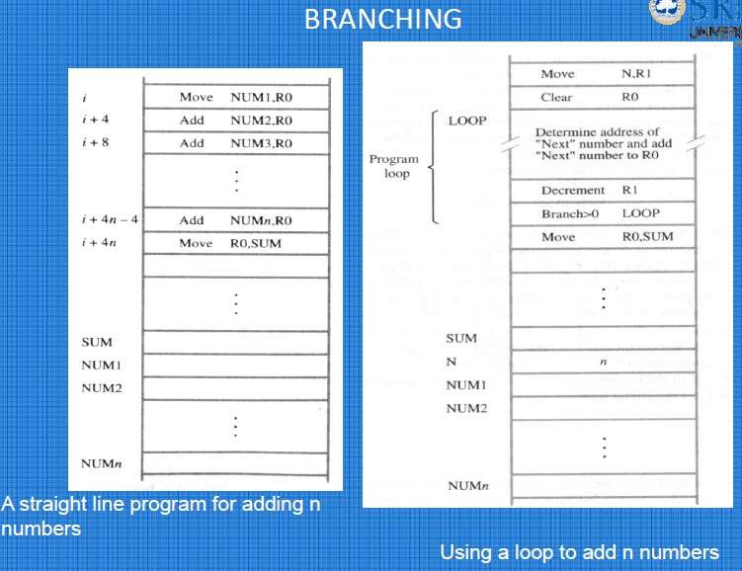

Slide 83
Move
N,R1
Clear R0
Determine address of
"Next" number and add
Branching
LOOP
Program loop
"Next" number to R0
Decrement R1
Branch>0 LOOP
Move R0,SUM
• • •
n
• • •
Branch target
Conditional branch
SUM N NUM1 NUM2
Figure 2.10. Using a loop to add n numbers.
NUMn

Slide 84
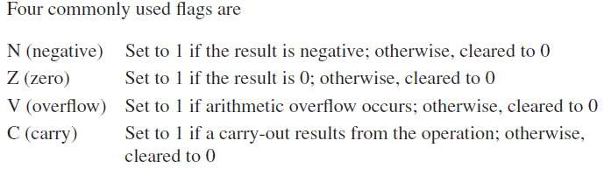
Condition Codes
Condition code flags
Condition code register / status register
Different instructions affect different flags

Slide 85
Conditional Branch Instructions
A: 1 1 1 1 0 0 0 0
+(−B): 1 1 1 0 1 1 0 0
Example:
  A: 1 1 1 1 0 0 0 0
  B: 0 0 0 1 0 1 0 0
1 1 0 1 1 1 0 0
C = 1
S = 1
V = 0
Z = 0

Slide 87
End of Unit-1

Slide 88
Unit-2.
Machine Instructions and Programs (contd..)

Slide 89
Addressing Modes

Slide 90
Generating Memory Addresses
How to specify the address of branch target?
Can we give the memory operand address directly in a single
Add instruction in the loop?
Use a register to hold the address of NUM1; then increment
by 4 on each pass through the loop.

Slide 91
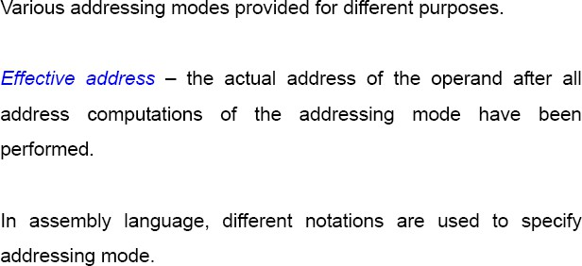
Addressing Modes
Addressing modes specify the way in which the address of
the operand is specified in the instruction.
Addressing mode gives the flexibility of writing programs.

Slide 92
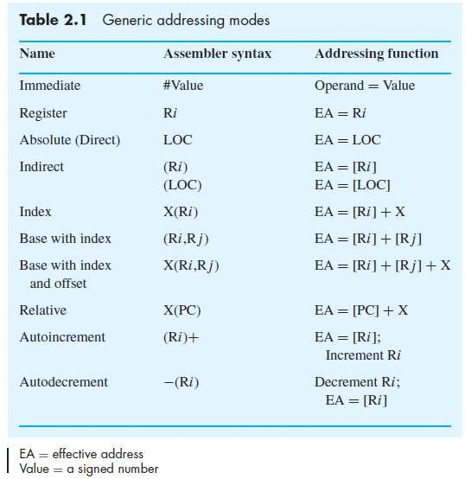
Addressing Modes
The different ways in which the location of an operand is specified in an instruction are referred to as addressing modes.

Slide 93
Register Mode
Register mode - The operand is the contents of a processor register; the name (address) of the register is given in the instruction.
Example: Move R3, R2
EA = R
No memory access required
Very fast execution: because processing data between registers does not involve memory
Faster instruction fetch
Limited number of registers
Very small address field needed

Slide 94
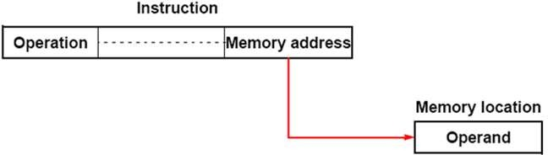
Absolute Mode ( Direct mode)
The operand is in a memory location; the address of this location
is given explicitly in the instruction. (In some assembly languages, this
mode is called Direct.)
In Direct Addressing mode the effective address of the operand is given directly in the instruction. So it require one extra memory reference to access the operand. The direct addressing mode is slow compared to immediate addressing mode.
Example:
Move LOC, R2

Slide 95
Register Mode and Direct(Absolute) Mode
Consider the following example
Move LOC, R2
Processor registers are used as temporary storage locations where the data in a register are accessed using the Register mode.
Memory locations (symbolically represented as LOC, A, B etc..) if they are used as operands in assembly instructions, are accessed by using the Direct mode.
Above example Move LOC, R2 uses these two modes.

Slide 96
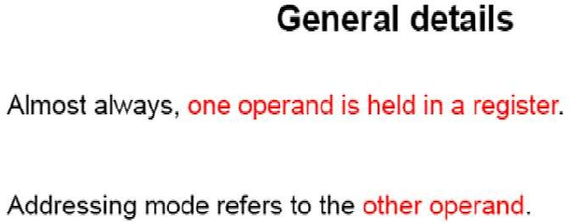

Slide 97
Immediate Mode
In Immediate Addressing mode the operand itself is present in the instruction. It is generally used for accessing constants.
Address and data constants can be represented using this mode.
The advantage of Immediate Addressing mode is that no extra memory reference needed to fetch the data since the value of the operand is given itself in the instruction. So Immediate Addressing mode is faster.
e.g. Move #200, R0 => (Move 200_{immediate}, R0) (Place the value 200 in Register R0)
Other Example: ADD #5, R1

Slide 98
Immediate Mode
Consider the example A=B+6, assembly program segment can be written as
Move B,R1
Add #6,R1
Move R1,A

Slide 99
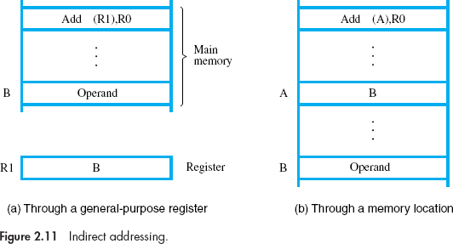
INDIRECTION AND POINTERS
Indirect mode – The effective address of the operand is the contents of a register or memory location whose address appears in the instruction.
In Indirect addressing mode the reference for effective address of the operand is given in the instruction i.e the operand part tells where the effective address of the operand is stored in memory.

Slide 100
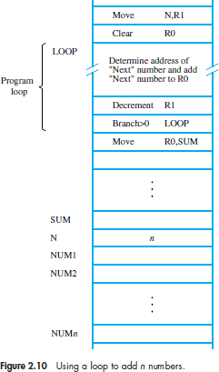
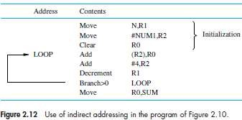
The register or memory location that contains the
address of an operand is called a pointer.
Consider the C-language statement A=∗B;
where B is a pointer variable. This statement may be compiled into
Move B,R1 Move (R1),A
Using indirect addressing through memory, the
same action can be achieved with
Move (B),A

Slide 101
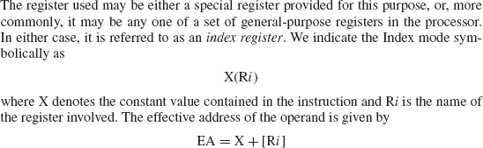
INDEXING AND ARRAYS
Index mode – the effective address of the operand is generated by adding a constant value to the contents of a register.
It is useful in dealing with lists and arrays.

Slide 102
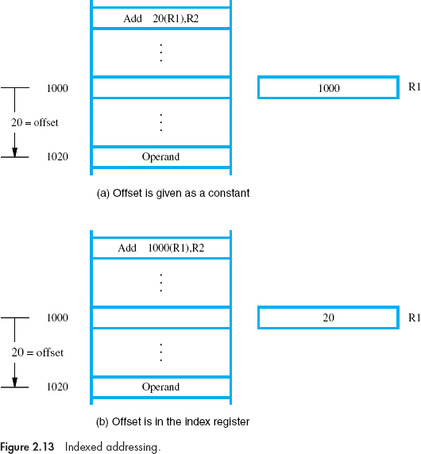

Slide 103
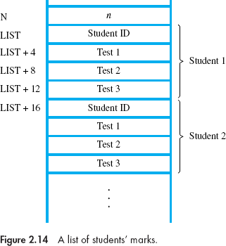
INDEXING AND ARRAYS

Slide 104
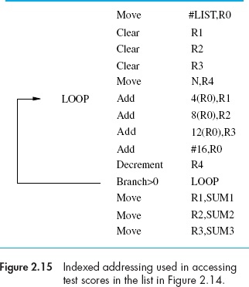
INDEXING AND ARRAYS

Slide 105
Indexing and Arrays
Index mode – the effective address of the operand is generated by
adding a constant value to the contents of a register.
Index register
X(R_{i}): EA = X + [R_{i}]
The constant X may be given either as an explicit number or as a
symbolic name representing a numerical value.
If X is shorter than a word and also a signed integer, sign-extension
is needed.

Slide 106
Indexing and Arrays
In general, the Index mode facilitates access to an operand whose location is defined relative to a reference point within the data structure in which the operand appears.
Several variations:
(R_{i}, R_{j}): EA = [R_{i}] + [R_{j}]
X(R_{i}, R_{j}): EA = X + [R_{i}] + [R_{j}]

Slide 107
Variations of index mode
Base with Index:
Assembler Syntax= (R_{i}, R_{j})
EA = [R_{i}] + [R_{j}] (R_{j} is called Base Register)
The effective address is the sum of the contents of registers Ri and Rj. This form of indexed addressing provides more flexibility in accessing operands, because both components of the effective address can be changed.
Base with Index and offset: Assembler Syntax= X(R_{i}, R_{j})
EA = X + [R_{i}] + [R_{j}]
the effective address is the sum of the constant X and the contents
of registers Ri and Rj.

Slide 108
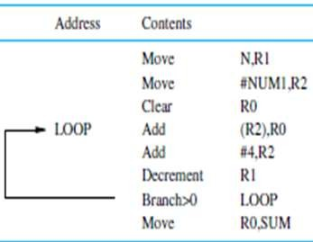
Relative Addressing
Relative mode – the effective address is determined by the Index mode using the program counter in place of the general-purpose register.
X(PC) – note that X is a signed
number
To calculate the branch target
address e.g Branch >0 LOOP
This location is computed by specifying it as an offset from the current value of PC.
Branch target may be either before or after the branch instruction, the offset is given as a singed num.

Slide 109
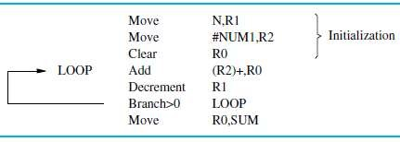
Additional Modes
Autoincrement mode – the effective address of the operand is the contents of a register specified in the instruction. After accessing the operand, the contents of this register are automatically incremented to point to the next item in a list.
Useful for accessing data items in successive locations in the memory.
Written as (R_{i})+. EA=[Ri] and then Ri=[Ri]+1;
Implicitly the increment amount is 1;
In byte addresable memory, the increment is 1 for byte-sized operands, 2 for
16-bit operands, and 4 for 32-bit operands.
Example:

Slide 110
Additional Modes
Autodecrement mode — The contents of a register specified in the instruction are first automatically decremented and are then used as the effective address of the operand.
Written as -(R_{i}). First Ri=[Ri]-1 then EA=[Ri]
Implicitly the decrement amount is 1;
The decrement is 1 for byte-sized operands, 2 for 16-bit operands,
and 4 for 32-bit operands.
In this mode, operands are accessed in descending address order.
Why the address is decremented before it is used in the Autodecrement
mode and incremented after it is used in the Autoincrement mode?.
The main reason for this is to show how these two modes can be used together to implement an important data structure called a stack.

Slide 111
Exercise
Write the five basic addressing modes with assembler syntax,
addressing function and give one example for each.
Registers R1 and R2 of a computer contain the decimal values 1200 and 4600. What is the effective address of the memory operand in each of the following instructions?
Load
Move
Store
Add
(e)
20(R1),R5 #3000,R5 R5,30(R1,R2)
−(R2),R5
Subtract (R1)+,R5

Slide 112
Assembly Language

Slide 113
Assembly Language
Use of symbolic names- mnemonics
Assembly language: A complete set of such symbolic names and rules for their use constitute a programming language, generally referred to as an assembly language.
Assembler: A program that translates assembly language program in to a
sequence of machine instructions
Source program & object program
The user program in its original alphanumeric text format is called a source program
Assembled machine language program is called an object program
Since there are several possible addressing modes for specifying operand
locations, the assembly language must indicate which mode is being used.
Example instructions
MOVE | R0, SUM
ADD | #5, R3 | ADDI | 5, R3
MOVE | #5,(R2) | MOVEI | 5,(R2)

Slide 114

Assembler Directives
Assembler directives (or commands): Assembler directives are the commands to the assembler that direct the assembly process. They also direct the assembler how program and data should be arranged in the memory. They do not generate any machine code.
SUM EQU 200: This EQU directive informs the assembler that the name
SUM should be replaced by the value 200
ORIGIN, tells the assembler program where in the memory to place the data block that follows.
DATAWORD directive is used to inform the assembler to place a data value at a specified location
The RESERVE directive declares that a memory block of 400 bytes is to be reserved for data, and that the name NUM1 is to be associated with address 208. This directive does not cause any data to be loaded in these locations.

Slide 115
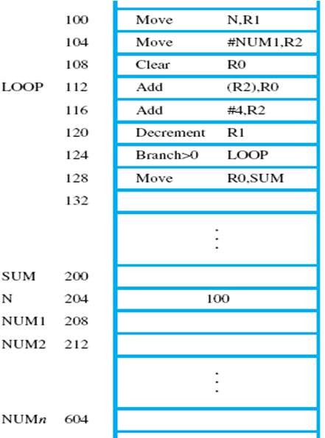
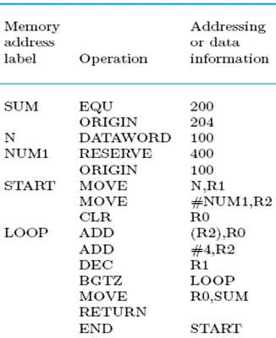
If the assembler is to produce an object program, it has to know
  How to interpret the names
  Where to place the instructions in the memory
  Where to place the data operands in the memory
In most assembly languages, the statements in a
source program are written in the form
Label Operation Operand(s) Comment

Slide 116
ASSEMBLY AND EXECUTION OF PROGRAMS
Any ALP must be assembled in to machine (object) program for execution
Assembler replaces all symbols denoting operations and addressing modes with the binary codes used in machine instructions, and replaces all names and labels with their actual values.
Symbol table: the assembler must keep track of addresses of successive instructions, and the labels (names) with their numerical values which are stored in a table called symbol table.
Two-pass assembler
Loader: A program which loads the object program into memory for execution
Debugger: A program which detects & reports syntax and other programming
errors during execution
NUMBER NOTATION
ADD #93,R1
binary number identified by a prefix symbol such as a percent sign:
ADD #%01011101,R1
hex representation is identified by a dollar sign prefix.
ADD #$5D,R1

Slide 117
Basic Input/Output
Operations

Slide 118
Basic Input/Output Operations
The data on which the instructions operate are not necessarily
already stored in memory.
Data need to be transferred between processor and outside world
(disk, keyboard, etc.)
I/O operations are essential, the way they are performed can have a
significant effect on the performance of the computer.

Slide 119
Program-Controlled I/O Example
Read in character input from a keyboard and produce character
output on a display screen.
Issue: Rate of data transfer (keyboard, display, processor)
Difference in speed between processor and I/O device creates the
need for mechanisms to synchronize the transfer of data.
A solution:
on output, the processor sends the first character and then waits for a signal from the display that the character has been received. It then sends the second character.
Input is sent from the keyboard in a similar way. The processor waits for a signal indicating that a character has been struck and the code is available in a buffer register in the keyboard. Processor reads that code

Slide 120
Program-Controlled I/O Example
Bus
Processor
SIN
Keyboard
SOUT
Display
DATAIN
DATAOUT
Registers
Flags
Device interface
Figure 2.19 Bus connection for processor, keyboard, and d.isplay

Slide 121
Program-Controlled I/O Example
In order to perform I/O transfers, we need machine instructions that can check the state of the status flags and transfer data between the processor and the I/O device.
READWAIT Branch to READWAIT if SIN = 0
Input from DATAIN to R1
WRITEWAIT Branch to WRITEWAIT if SOUT = 0
Output from R1 to DATAOUT
We assume that the initial state of SIN is 0 and the initial state of SOUT is 1. This initialization is normally performed by the device control circuits when the devices are placed under computer control before program execution begins.

Slide 122
Program-Controlled I/O Example
Memory-Mapped I/O – some memory address values are used to refer to peripheral device buffer registers such as DATAIN and , DATAOUT. No special instructions are needed. Also use device status registers.
MoveByte DATAIN, R1 MoveByte R1, DATAOUT
Let us assume that INSTATUS and OUTSTATUS are the status registers and bit b₃ in registers INSTATUS and OUTSTATUS corresponds to SIN and SOUT, respectively.
READWAIT Testbit #3, INSTATUS
Branch=0 READWAIT
MoveByte DATAIN, R1
WRITEWAIT Testbit #3, OUTSTATUS
Branch=0 WRITEWAIT
MoveByte R1, DATAOUT

Slide 123
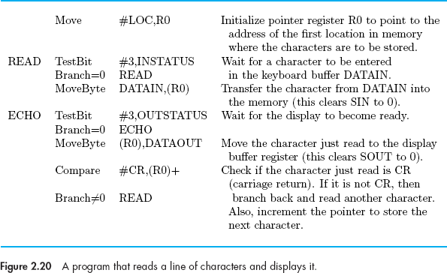
Example
Program to read a line of characters typed at a keyboard and send them out to a display device. The program finishes when the carriage return character, CR, is read, stored, and sent to the display.

Slide 124
Stacks and Queues

Slide 125
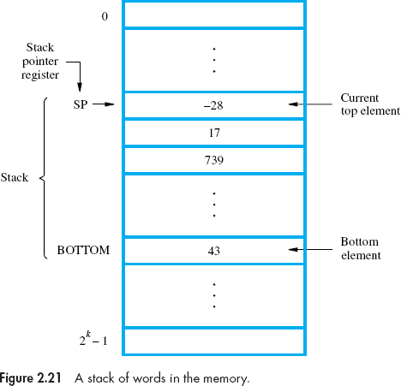
Stack Organization
A stack is a list of data elements, usually words or bytes, with the accessing restriction that elements can be added or removed at one end of the list only.
Use of stack- to organize the control and information linkage between the main program and the subroutine.
LIFO
PUSH & POP
Stack Pointer: A processor register is used to keep track of the address of the element of the stack that is at the top at any given time. This register is called the stack pointer (SP).

Slide 126
Stack Organization
The push operation can be implemented as
Subtract #4,SP
Move NEWITEM,(SP)
The pop operation can be implemented as
Move (SP),ITEM
Add #4,SP
If the processor has the Autoincrement and Autodecrement addressing modes, then the push operation can be performed by the single instruction
Move NEWITEM,−(SP)
and the pop operation can be performed by
Move (SP)+,ITEM

Slide 127
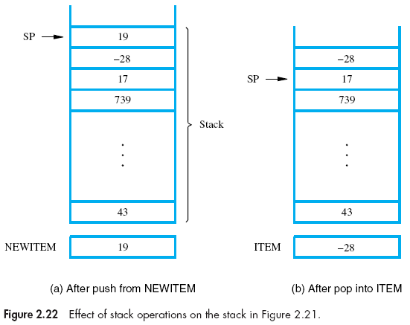
Stack Organization

Slide 128
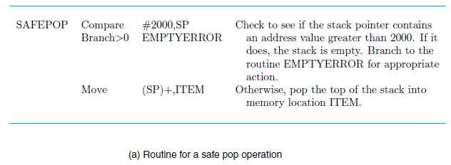
Checking for empty and full errors in pop and push operations

Slide 129
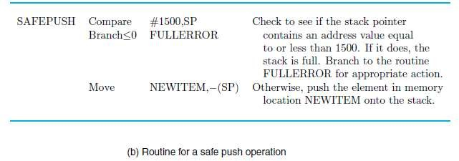
Checking for empty and full errors in pop and push operations

Slide 130
Queues
Queue: data structure similar to stack. The Data are stored in and retrieved from a queue on a first-in–first-out (FIFO) basis.
Addition and Deletion
Difference between stack and queue

Slide 131
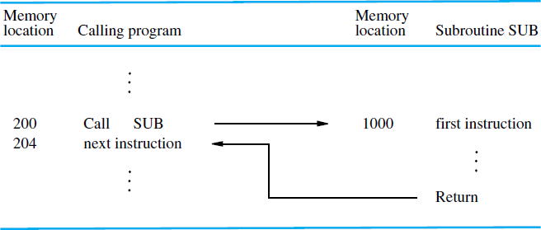
Subroutines
Subroutine: It is also called procedure, method, function, or routine.
It is a sequence of program instructions that perform a specific task. It is packaged as a unit and this unit can then be used in programs wherever that particular task should be performed.
Only one copy of the instructions that constitute the subroutine are placed in the memory. Any program that requires use of subroutine simply branches to its starting location.
Content of the PC is saved by the Call
instruction
The possibility to call and return from subroutines is referred to as subroutine linkage.
A Register used to store the return address
is called Iink register.

Slide 132
Subroutine linkage using a link register
Call instruction performs the following-
Store the contents of the PC in the link register
Branch to the target address specified by the instruction
Return instruction performs the following operation
Branch to the address contained in the link register

Slide 133
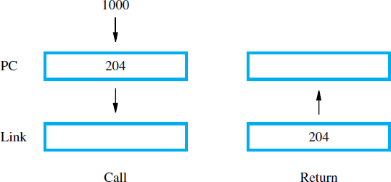
Subroutine linkage using a link register

Slide 134
Subroutine nesting and the processor call stack
Subroutine nesting: One subroutine calling another subroutine. In nested
subroutines, the last subroutine that completes task returns to its caller.
The original content of link register need to saved before a nesting call occurs, otherwise the return address of the first subroutine will be lost.
Return addresses are generated and used in LIFO order and hence stacks are
used to store them.
A particular register is designated as the stack pointer, SP, to be used in for this
operation.
The stack pointer SP points to a stack called the processor stack. The Call instruction pushes the contents of the PC onto the processor stack and loads the subroutine address into the PC. The Return instruction pops the return address from the processor stack into the PC.

Slide 135
Subroutines: Parameter Passing
Exchange of information
between the
subroutine is
calling program and the
called Parameter passing.
Passing parameters using registers is straightforward and efficient.
If number of parameter is huge – stack may be used.
Two types of parameter passing : pass by reference and pass by value.

Slide 136
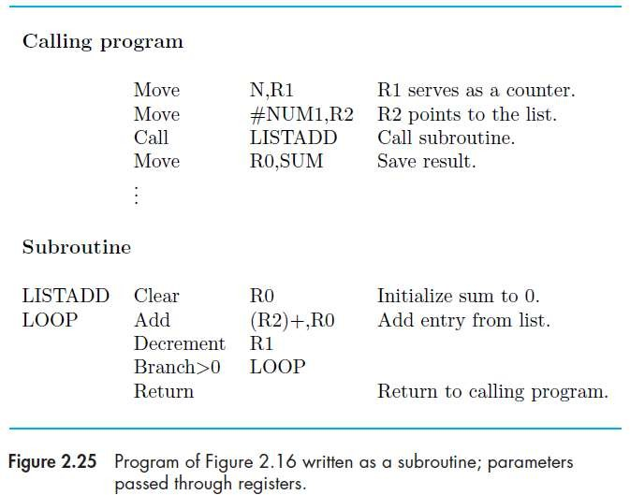
Subroutines: Parameter Passing through registers

Slide 137
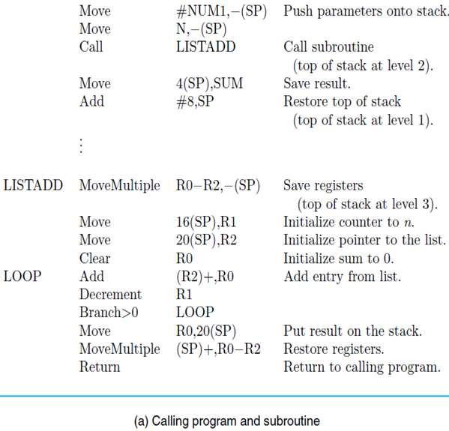
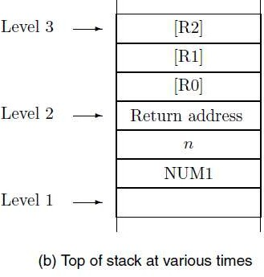
Subroutines: Parameter Passed on stack

Slide 138
THE STACK FRAME
The locations (in processor stack) that constitute a private work space for the subroutine, created when subroutine is entered and freed when subroutine returns is called a Stack frame.
In addition to SP, another pointer called FP (frame pointer) is
maintained.
frame pointer (FP), used for convenient access to the parameters passed to the subroutine and to the local memory variables used by the subroutine.

Slide 139
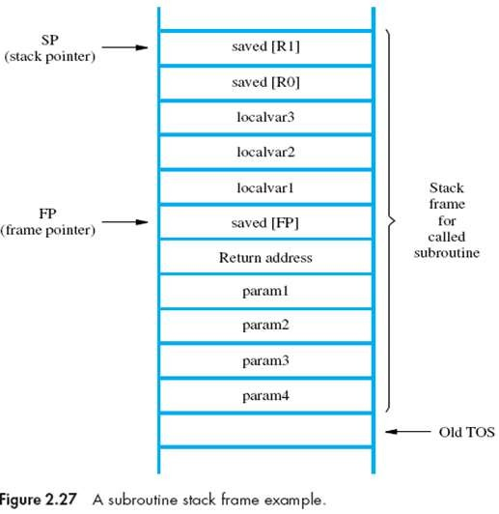

THE STACK FRAME

Slide 140
Stack Frames for Nested Subroutines
complete stack frames for nested subroutines build up on
the processor stack as they are called.
the saved contents of FP in the current frame at the top of the stack are the frame pointer contents for the stack frame of the subroutine that called the current subroutine.

Slide 141
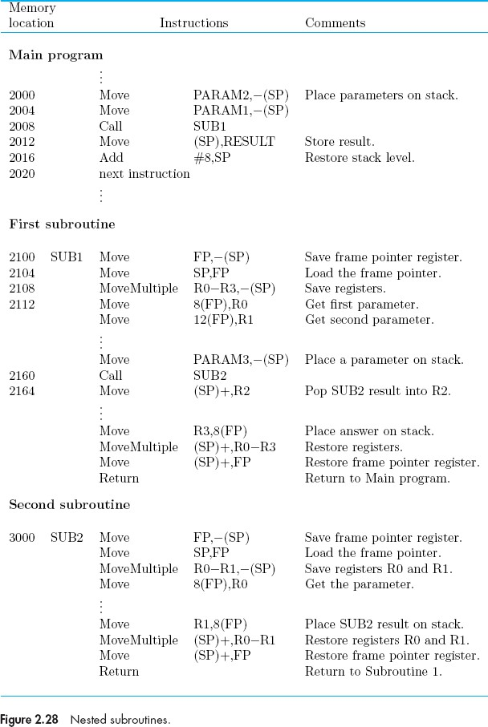
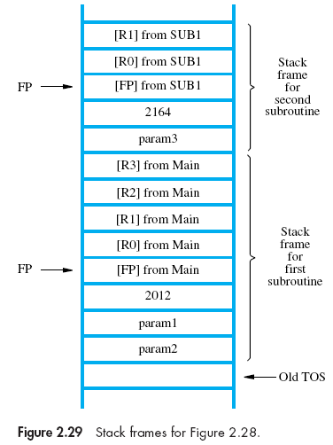

Slide 142
Additional Instructions

Slide 143
LOGIC INSTRUCTIONS
Logic operations such as AND, OR, and NOT, applied to individual
bits, are the basic building blocks of digital circuits
Not dst
Not Add
R0 #1,R0
Negate R0

Slide 144
LOGIC INSTRUCTIONS
Suppose that four ASCII characters are contained in the 32-bit register R0. In some task, we wish to determine if the leftmost character is Z. If it is, a conditional branch to YES is to be made.
ASCII code for Z is 01011010, in hexadecimal notation it is 5A
And Compare Branch=0
#$FF000000, R0 #$5A000000, R0 YES

Slide 145
SHIFT AND ROTATE INSTRUCTIONS
Logical Shifts
In a logical shift instruction, bits of an operand will be shifted right or
left some specified number of bit positions.
Two logical shift instructions are needed, one for shifting left
(LShiftL) and another for shifting right (LShiftR).
The general form of a logical left shift instruction is
LShiftL count, dst
The general form of a logical right shift instruction is LShiftR, count,d st

Slide 146
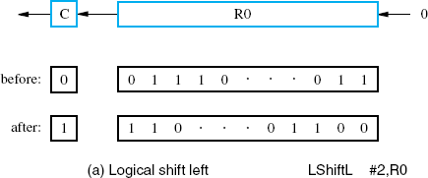
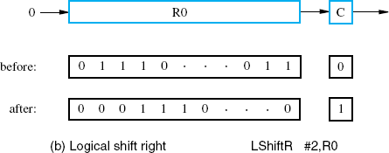
SHIFT AND ROTATE INSTRUCTIONS

Slide 147
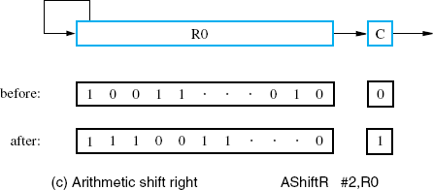
SHIFT AND ROTATE INSTRUCTIONS
The arithmetic left shift is exactly the same as the logical left Shift.

Slide 148
Rotate Operations
Rotate Operations move the bits that are shifted out of
one end of the operand back into the other end.
Two versions of both the left and right rotate instructions are usually provided. In one version, the bits of the operand are simply rotated. In the other version, the rotation includes the C flag.

Slide 149
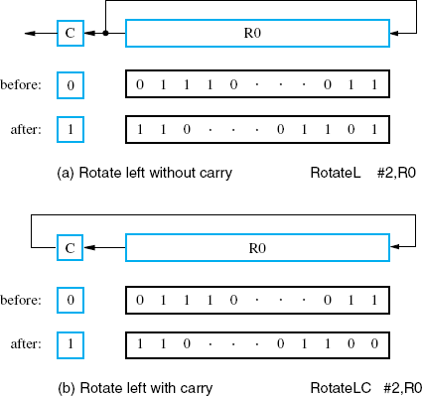
Rotate Operations

Slide 150
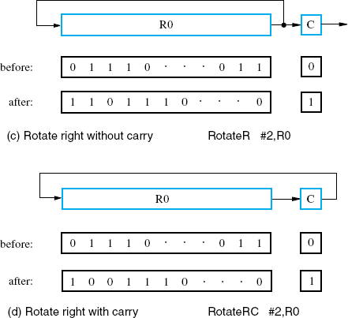
Rotate Operations

Slide 151
Encoding of Machine Instructions

Slide 152
Encoding of Machine Instructions
Assembly language program needs to be converted into machine
instructions. (ADD = 0100 in ARM instruction set)
To be executed in a processor, an instruction must be encoded in a compact binary pattern. Such encoded instructions are properly referred to as machine instructions.
In the previous section, an assumption was made that all
instructions are one word in length.
OP code: an encoded binary pattern indicating the type of operation
to be performed and the type of operands used
Suppose 32-bit word length, 8-bit OP code (how many instructions can we have?), 16 registers in total (how many bits?), 3-bit addressing mode indicator.
Add R1, R2
Move 24(R0), R5
LshiftR #2, R0
Move #$3A, R1
Branch>0 LOOP

Slide 153
Encoding of Machine Instructions
Add R1, R2
Move 24(R0), R5
LshiftR #2, R0
Move #$3A, R1
Branch>0 LOOP
8+7+7+ other info
8+7+7+ other info for index value
18 bits + other (immediate value)
8+ 24 bits for specifying branch address
8 7 7 10
OP code | Source | Dest | Other info
(a) One-word instruction

Slide 154
Encoding of Machine Instructions
What happens if we want to specify a memory operand using the
Absolute addressing mode?
Move R2, LOC
14-bit for LOC – insufficient
Solution – use two words
OP code | Source | Dest | Other info
Memory address/Immediate operand
(b) Two-word instruction

Slide 155
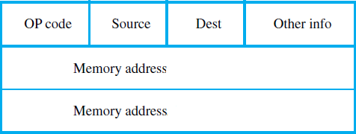
Encoding of Machine Instructions
Then what if an instruction in which two operands can be specified using the
Absolute addressing mode?
Move LOC1, LOC2
Solution – use two additional words
This approach results in instructions of variable length, dependent on the number of operands and the type of addressing modes used. Using multiple words, we can implement quite complex instructions. The term complex instruction set computer (CISC) has been used to refer to processors that use instruction sets of this type.

Slide 156
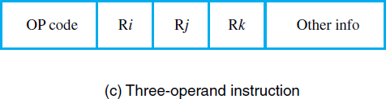
Encoding of Machine Instructions
If we insist that all instructions must fit into a single 32-bit word, it is not possible to provide a 32-bit address or a 32-bit immediate operand within the instruction.
It is still possible to define a highly functional instruction set, which makes
extensive use of the processor registers.
Add R1, R2 ---→ yes
Add LOC, R2 ---→ no, we can use Add (R3), R2 ---→ yes
The restriction that an instruction must occupy only one word can be seen in
reduced instruction set computers (RISC).
The RISC approach introduced other restrictions, such as that all manipulation of
data must be done on operands that are already in processor registers.
we may provide a more powerful instruction that uses three operands
Add R1,R2,R3, which performs the operation R3 ← [R1] + [R2]
A possible format for such an
instruction is

Slide 157
Characteristics of RISC Vs CISC processors
 | RISC (Reduced Instruction Set Computer) | CISC (Complex Instruction Set Computer)
1 | Simple instructions taking one cycle | Complex instructions taking multiple cycles
2 | Few instructions | Many instructions
3 | Fixed format instructions | Variable format instructions
4 | Few addressing mode, and most instructions have register to register addressing mode | Many addressing modes
5 | Multiple register set | Single register set
6 | Instructions are executed by hardwired control unit | Instructions are executed by microprogramed control unit
7 | Examples: Sun WS- Ultra SPARC II PowerPC (collaboration of IBM, Motorola, Apple) | Examples: Intel x86 architecture based processors. Motorola 68000 family PDP-11

Slide 158
End

